Slide 1
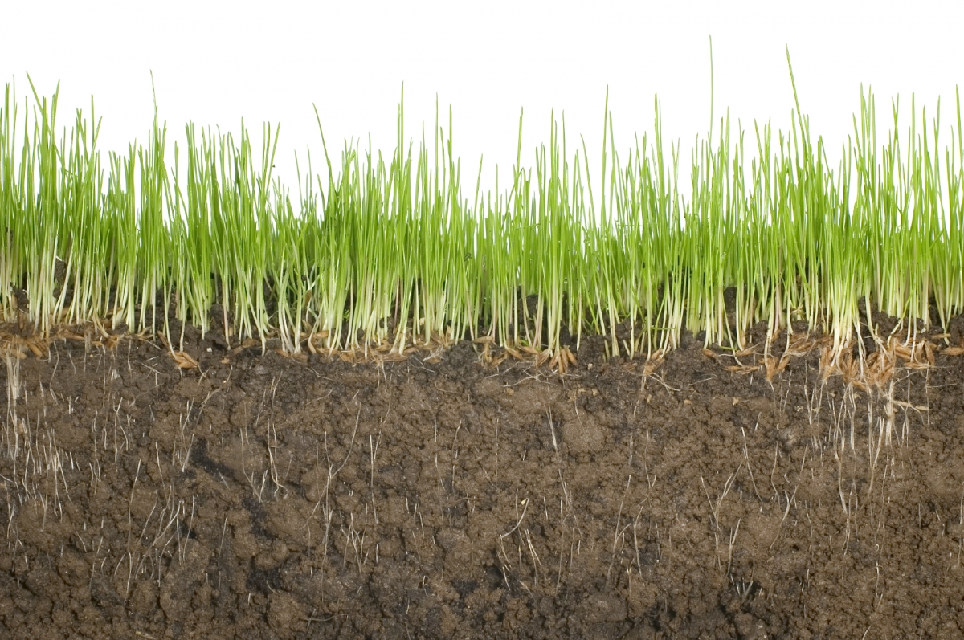

Slide 2
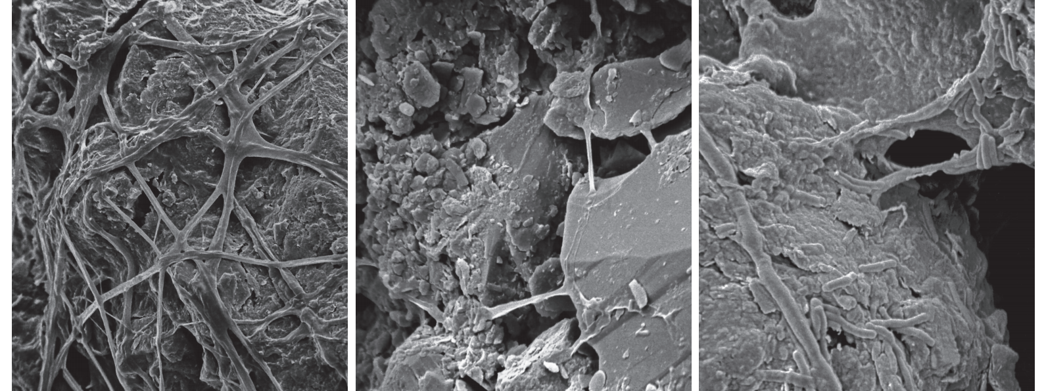

Slide 3
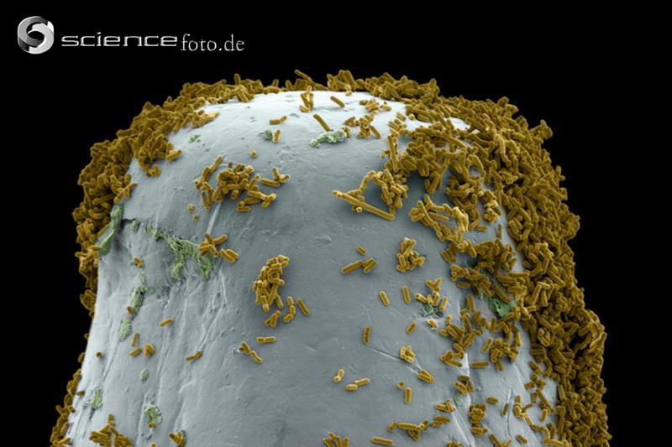

Slide 4
400 – 2,000 kg soil microbial biomass per hectare
(Fierer et al. Ecology Letters. 2009)
Notes:
equivalent to 10-20% of standing aboveground plant biomass

Slide 5
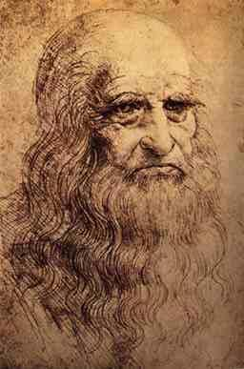
“We know more about the movement of celestial bodies than about the soil underfoot”
Leonardo da Vinci, ≈ 1510

Slide 6
How many microbial ‘species’ exist in soil?
Notes:
Assessments of soil diversity difficult for a number of reasons:
Dealing with all 3 domains of life –
2) Most of these taxa found in soil are microbial and these microbial taxa can not be identified using morphological characteristics or by culturing them in the laboratory. Fortunately – there have been important developments in molecular techniques that allow us to use DNA and RNA sequencing to characterize belowground diversity

Slide 7
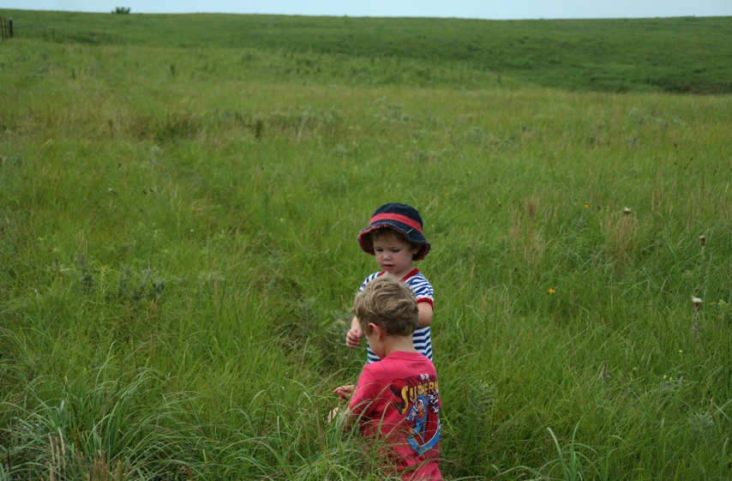
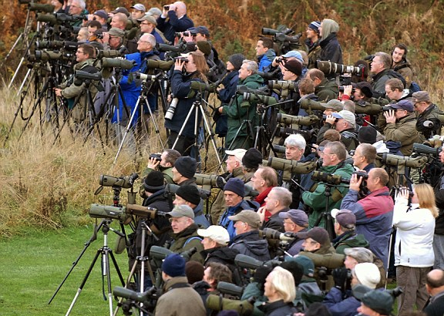
How many microbial ‘species’ exist in soil?
Notes:
Assessments of soil diversity difficult for a number of reasons:
Dealing with all 3 domains of life –
2) Most of these taxa found in soil are microbial and these microbial taxa can not be identified using morphological characteristics or by culturing them in the laboratory. Fortunately – there have been important developments in molecular techniques that allow us to use DNA and RNA sequencing to characterize belowground diversity

Slide 8
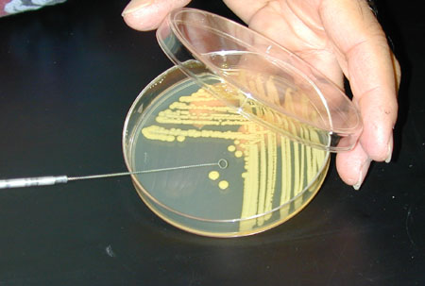
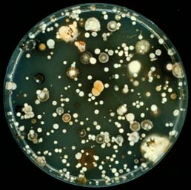
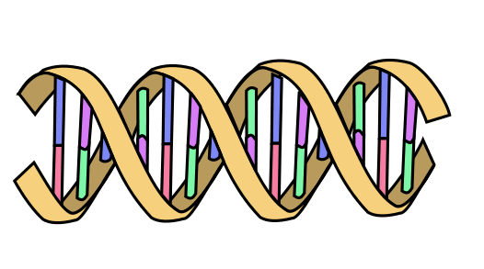
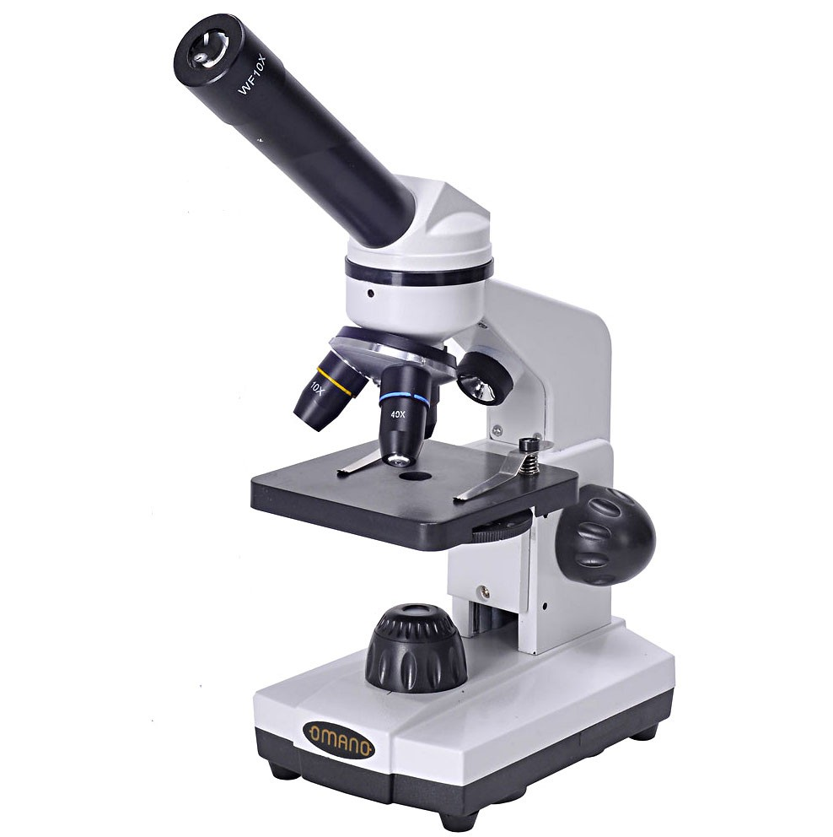

Slide 9

Notes:
approximately 3.4 km2, 0.8 km across, 4 km long

Slide 10
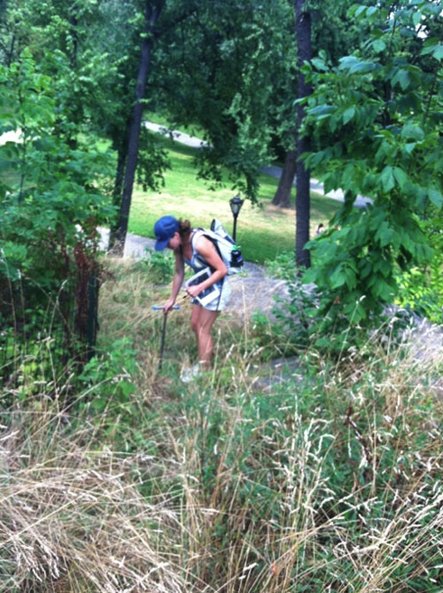
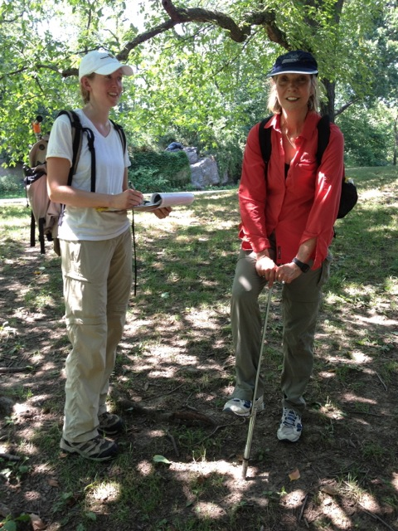
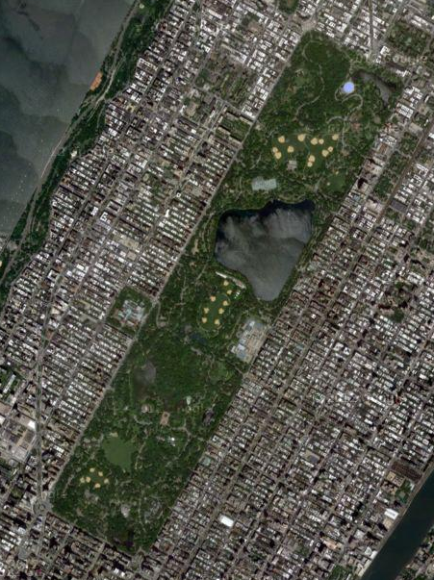
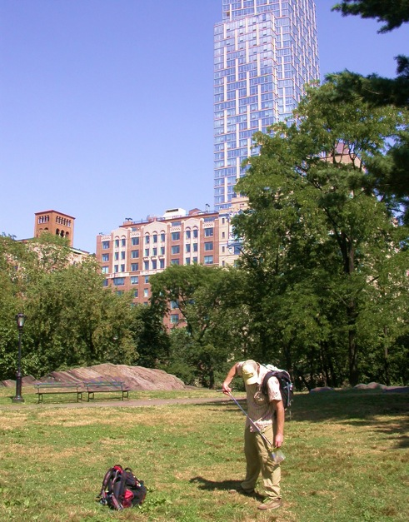
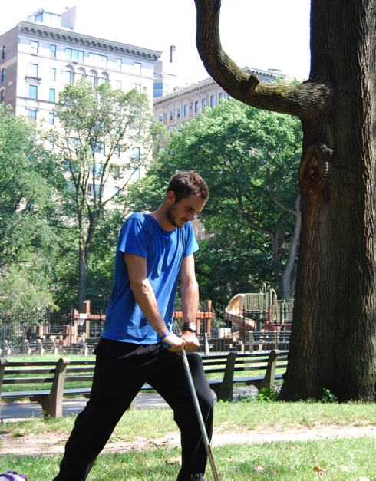

Slide 11
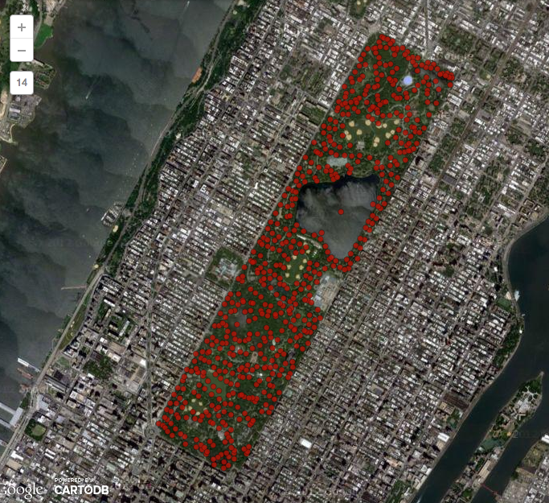
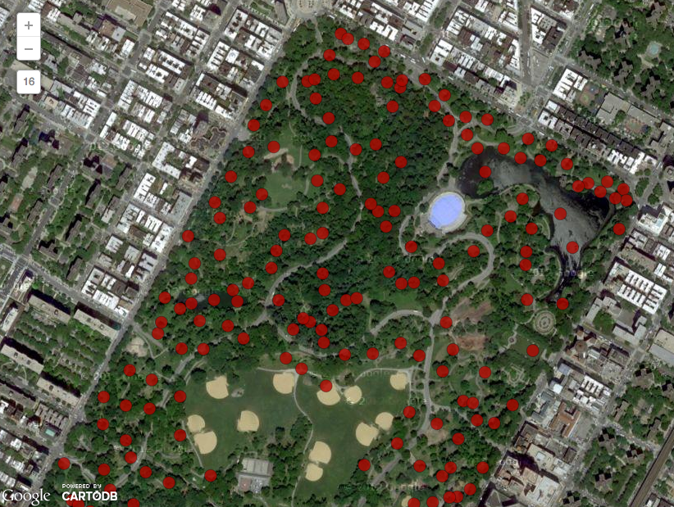
Sampling Locations
Ramirez et al. 2014. Proc. Royal Soc. B.
Notes:
600 sampling points across the park. (3miles x ½ mile)
actually only 570 samples

Slide 12
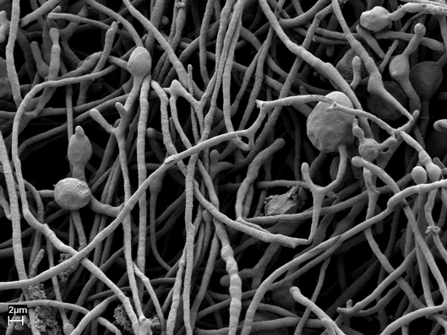
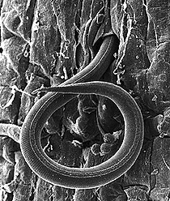
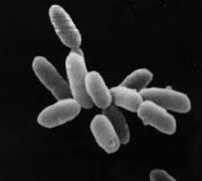
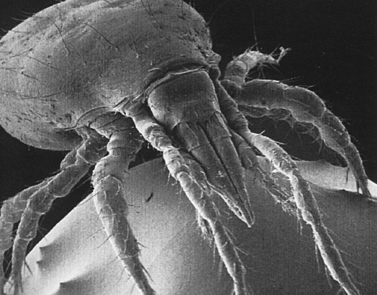
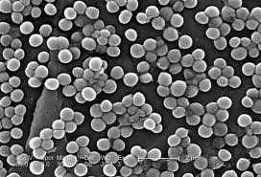
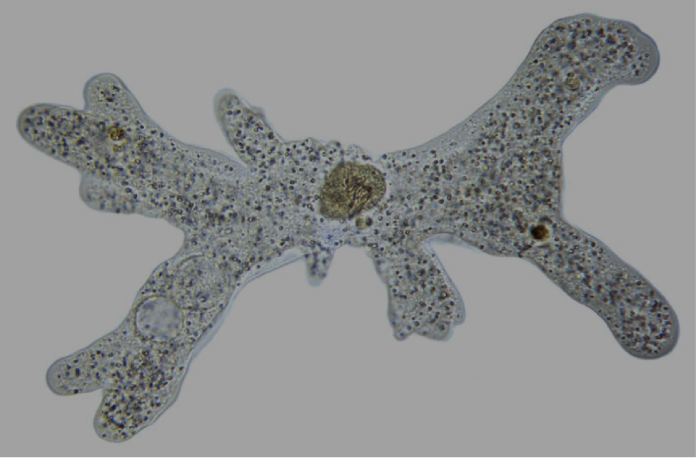
“Species”: ≥ 97% sequence similarity (16S or 18S rRNA gene)
Notes:
conservative – this would lump humans and apes all together. Admittedly arbitrary – but this does allow us to compare diversity on the same scale

Slide 13

Ramirez et al. 2014. Proc. Royal Soc. B.
Notes:
Totaling 650,000 species in the soil
Clarify– 16S rRNA genes- bacteria and archaea; 18S eukarya
Briefly mention alpha diversity

Slide 14
‘known’ species
unknown species
Ramirez et al. 2014. Proc. Royal Soc. B.
Notes:
10 to 15% of taxa matched those found in published databases.
Plants – 393
Animals- 256
(which could be an underestimate– insects)

Slide 15
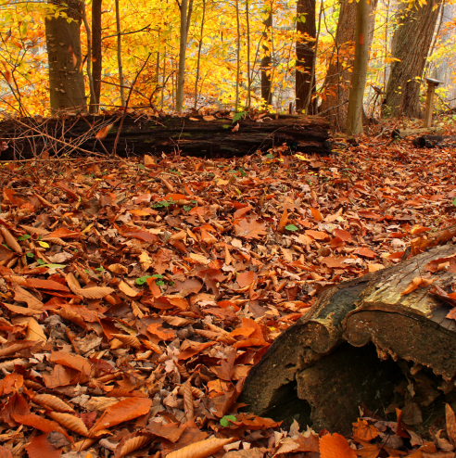
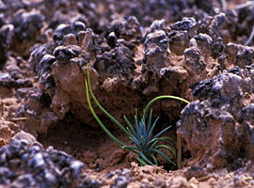
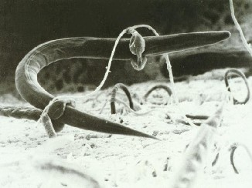
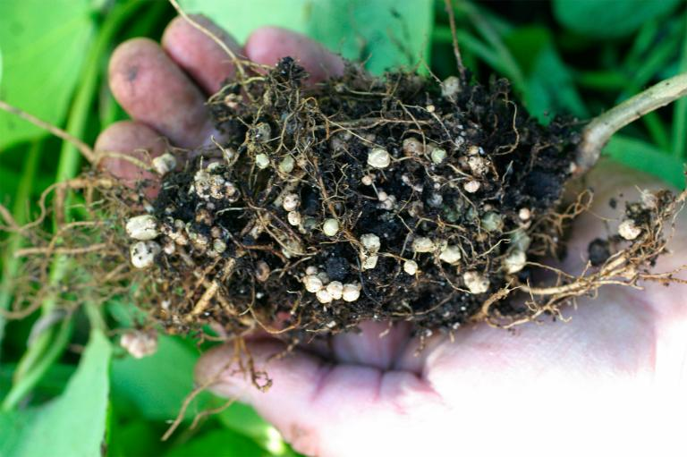
Notes:
plant growth – both positive effects and negative
critical role in the cycling of nutrients and carbon
soil erosion
soil microbes play a critical role in maintaining the fertility of soils or attempts to restore soil fertility

Slide 16
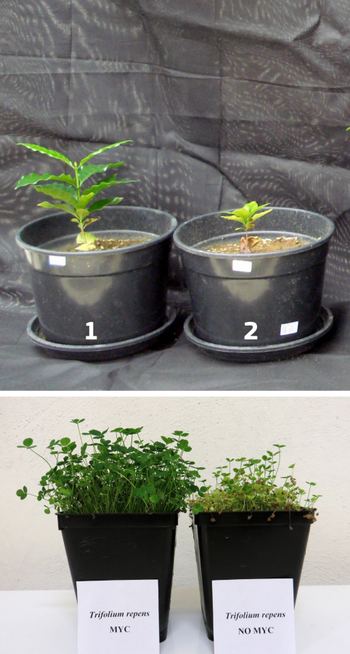
Notes:
coffee, trifolium (with and without mycorrhizal fungi)

Slide 17
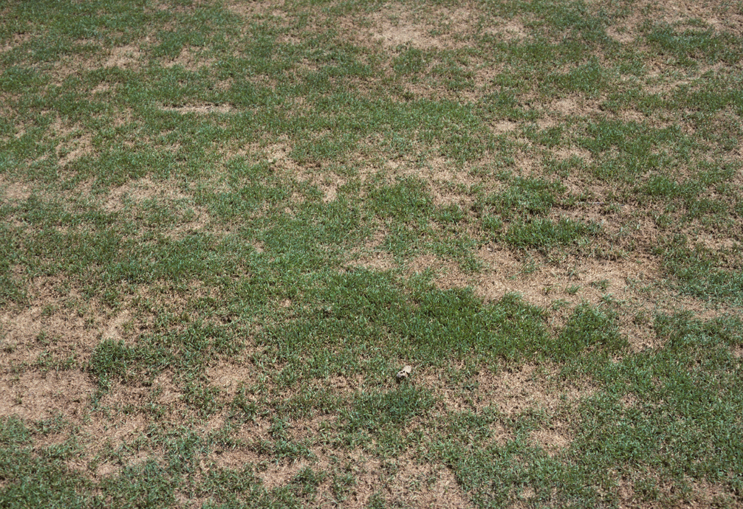

Notes:
inoculation of arbuscular fungi on growth of alfalfa

Slide 19
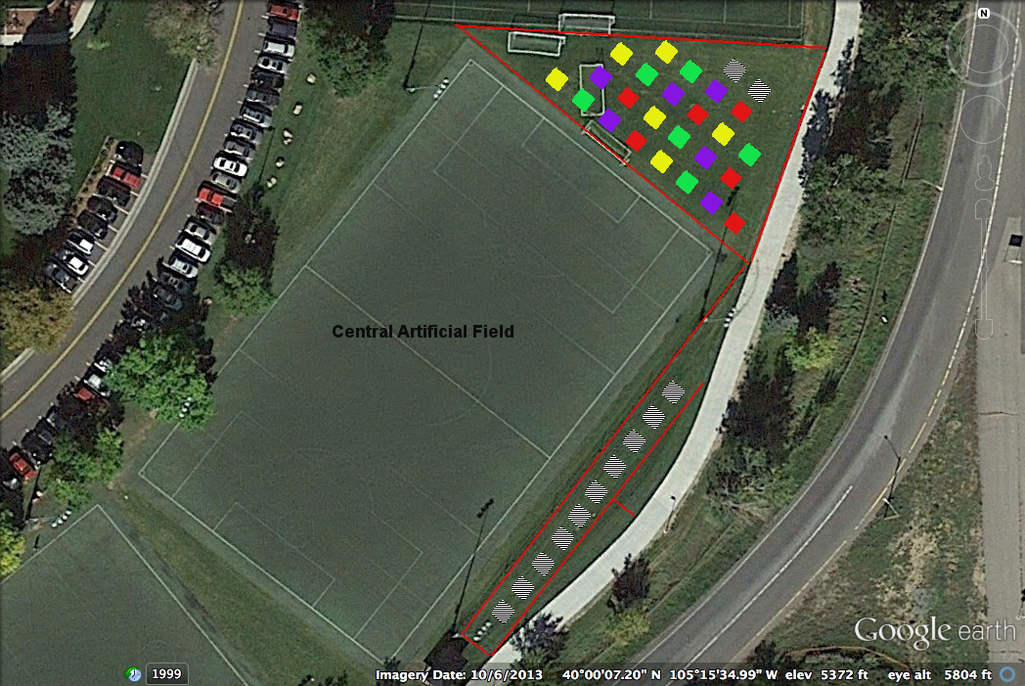

Slide 20
