Slide 1
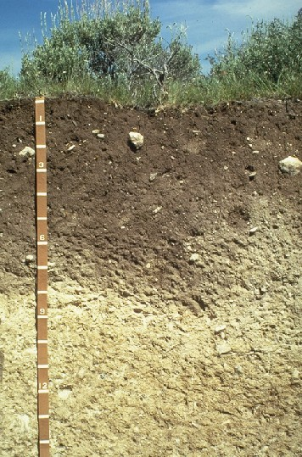
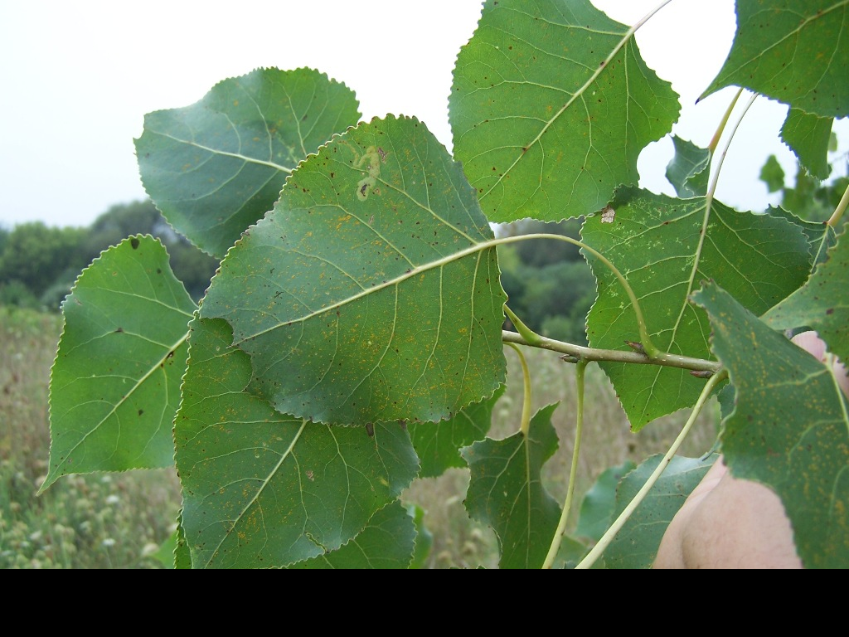

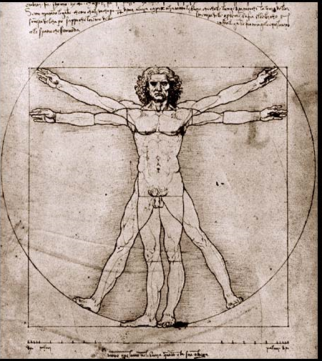
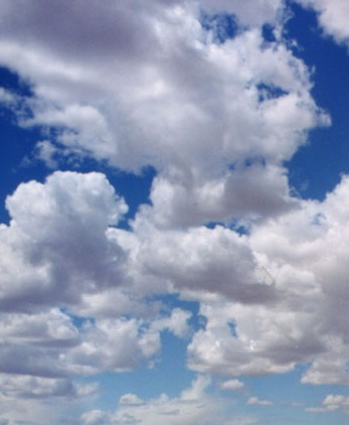
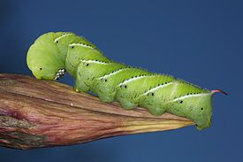
Exploring microbial diversity in the environment
Linking microbes to animal, plant, and ecosystem health

Slide 2
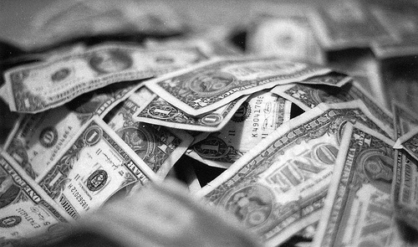
10⁹ cells gram⁻¹
10⁵ cells cm⁻²
10⁶ cells m⁻³
10⁷ cells cm⁻²
Notes:
great if you are a microbial ecologist, not so great if you are a germ-o-phobe
a billion in soil
a million in air
10 million on bills
100,000 on plant leaves
of course – you don’t even need to travel to exotic locales like soils to find large numbers of microbes

Slide 3
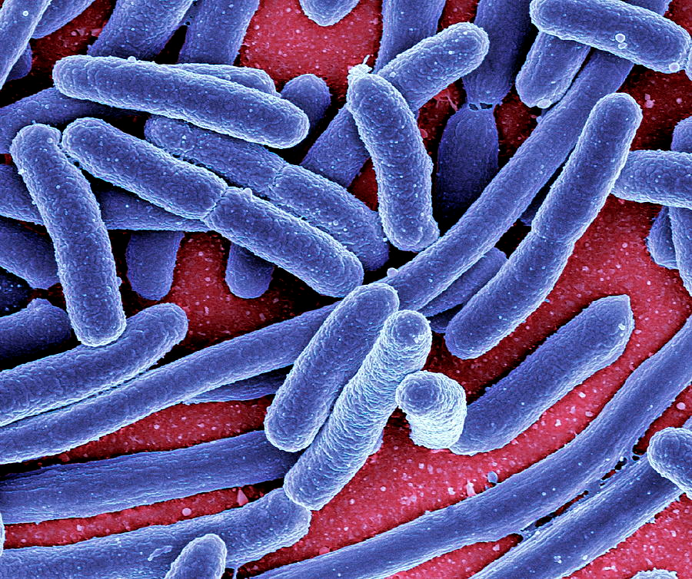
≈ 50% of the biomass on Earth is microbial
(Whitman et al. PNAS 1998)

Slide 4
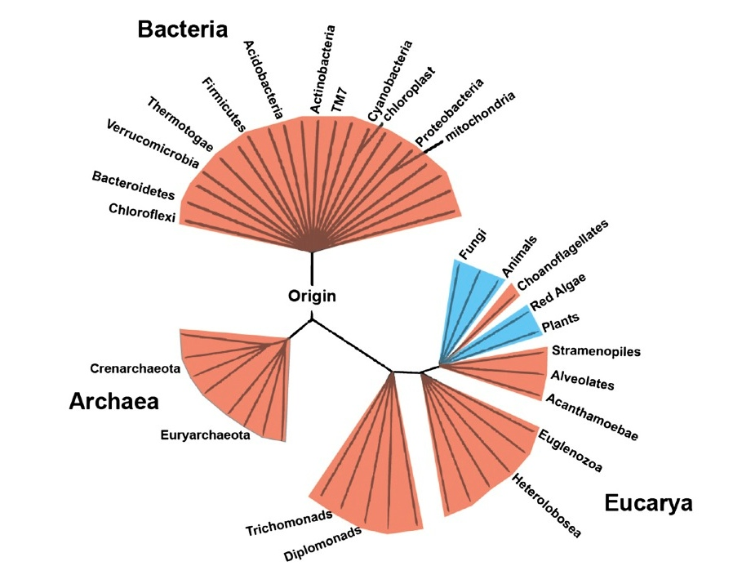
Most of the biological diversity on earth is microbial
You are here
Notes:
As a microbial ecologist – this is how I view the world.

Slide 5
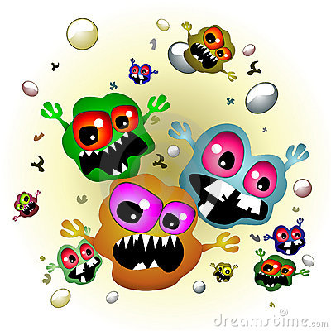
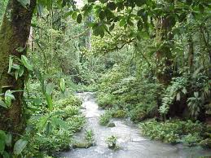
A paradigm shift:
The only good microbe is a dead microbe.
A few microbes are pathogens, many are harmless or beneficial.
Notes:
the cooties paradigm

Slide 6
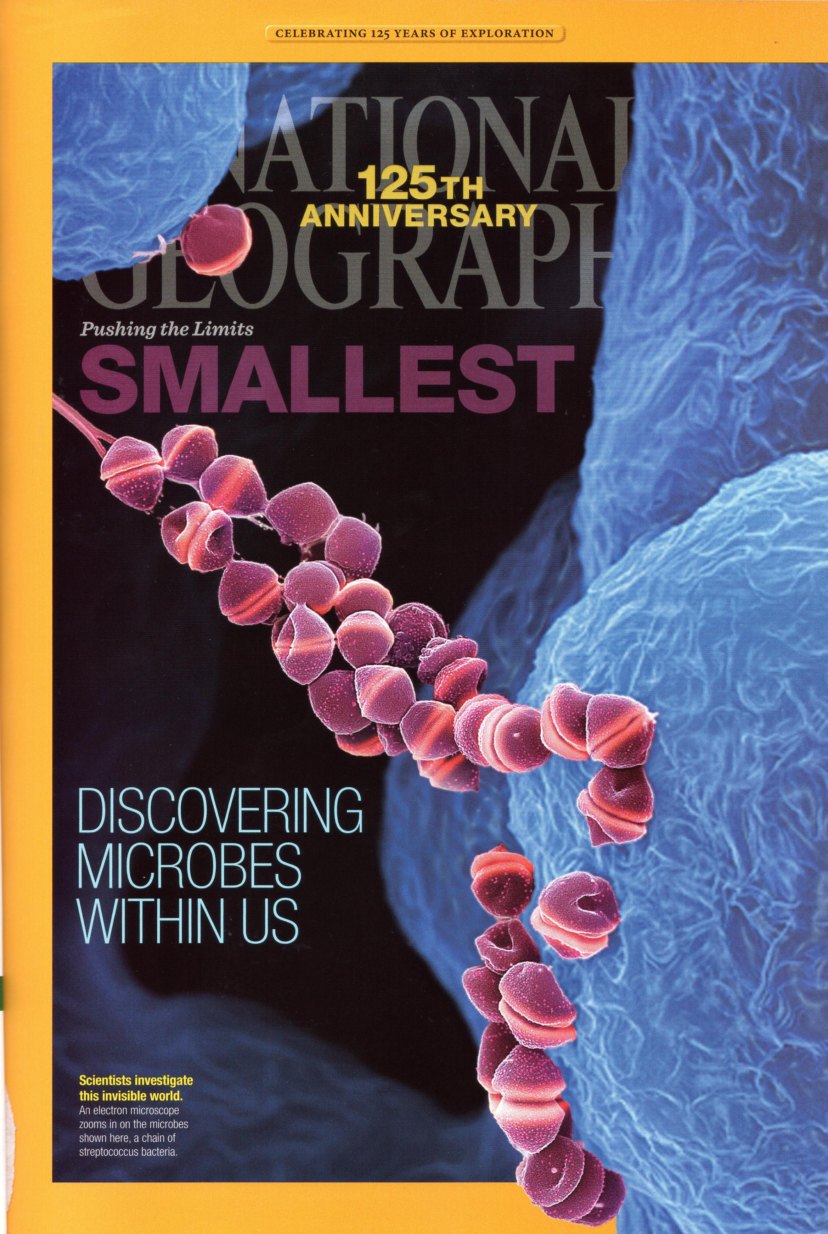
“They’re invisible. They’re everywhere. And they rule.”
Notes:
image of streptococcus
January 2013 issue
I want to start of by preaching to the converted. As has already been nicely demonstrated in the previous talks – we are living in a golden age of microbiology – exciting time to be a microbiologist or even just someone with a passing interest in microbes. 2 factors that have led to this ‘golden age’ – methodological advances. Growing recognition both by scientists and by the general public that there is an enormous wealth of microbial diversity and that not all of these
Book is good competition for books on princesses, dinosaurs, unicorns

Slide 7
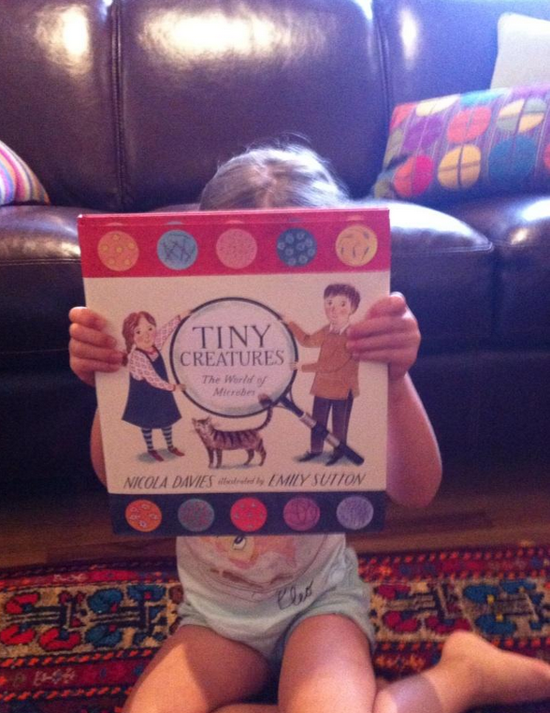
“They’re invisible. They’re everywhere. And they rule.”
Notes:
image of streptococcus
January 2013 issue
I want to start of by preaching to the converted. As has already been nicely demonstrated in the previous talks – we are living in a golden age of microbiology – exciting time to be a microbiologist or even just someone with a passing interest in microbes. 2 factors that have led to this ‘golden age’ – methodological advances. Growing recognition both by scientists and by the general public that there is an enormous wealth of microbial diversity and that not all of these
Book is good competition for books on princesses, dinosaurs, unicorns

Slide 8
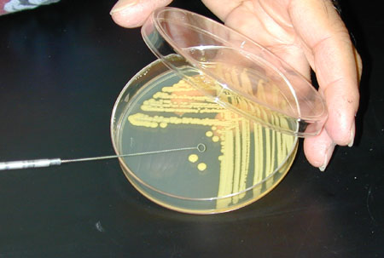
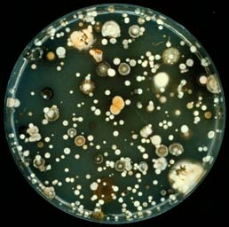
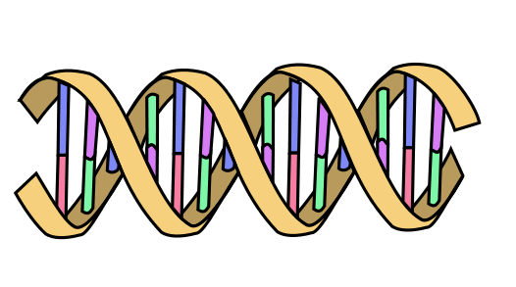
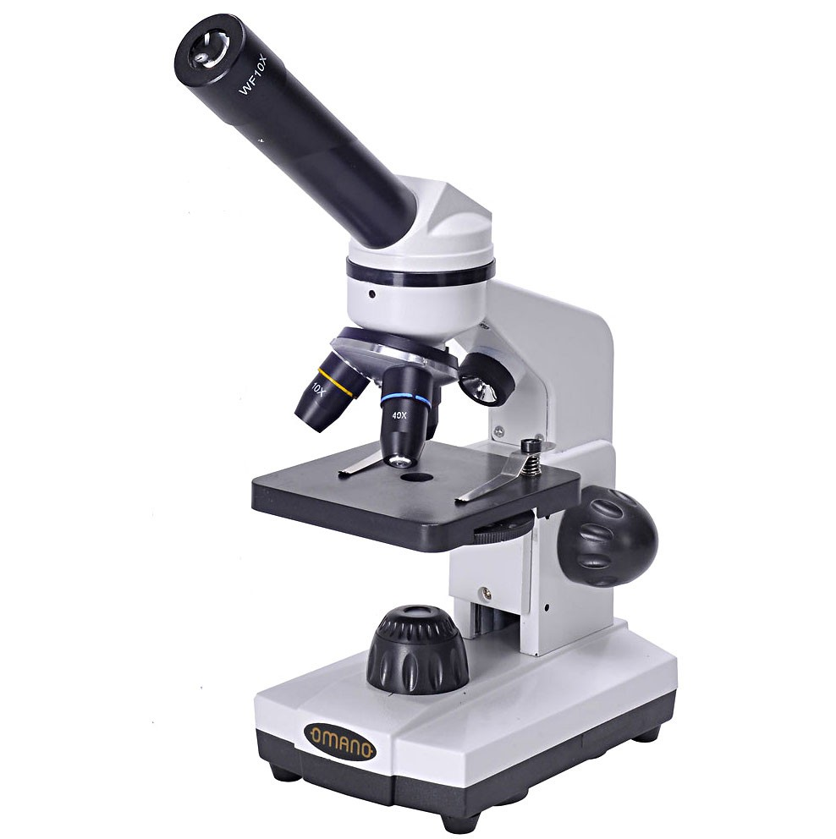

Slide 9
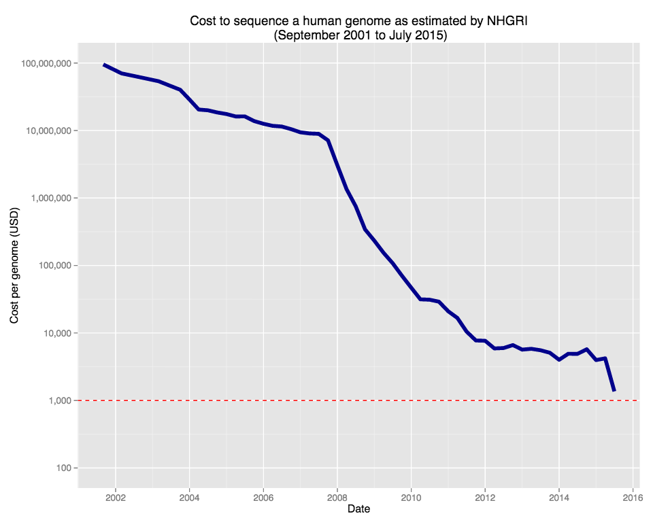
Rapid decline in DNA sequencing costs

Slide 11

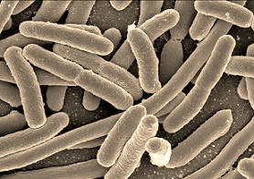
10 trillion human cells
100 trillion microbial cells in the human body
Occupy the
Human Body
we are the 90%

Slide 12
20,000 human genes
20 million microbial genes
Our microbiome provides us with important traits that we did not need to evolve on our own

Slide 13
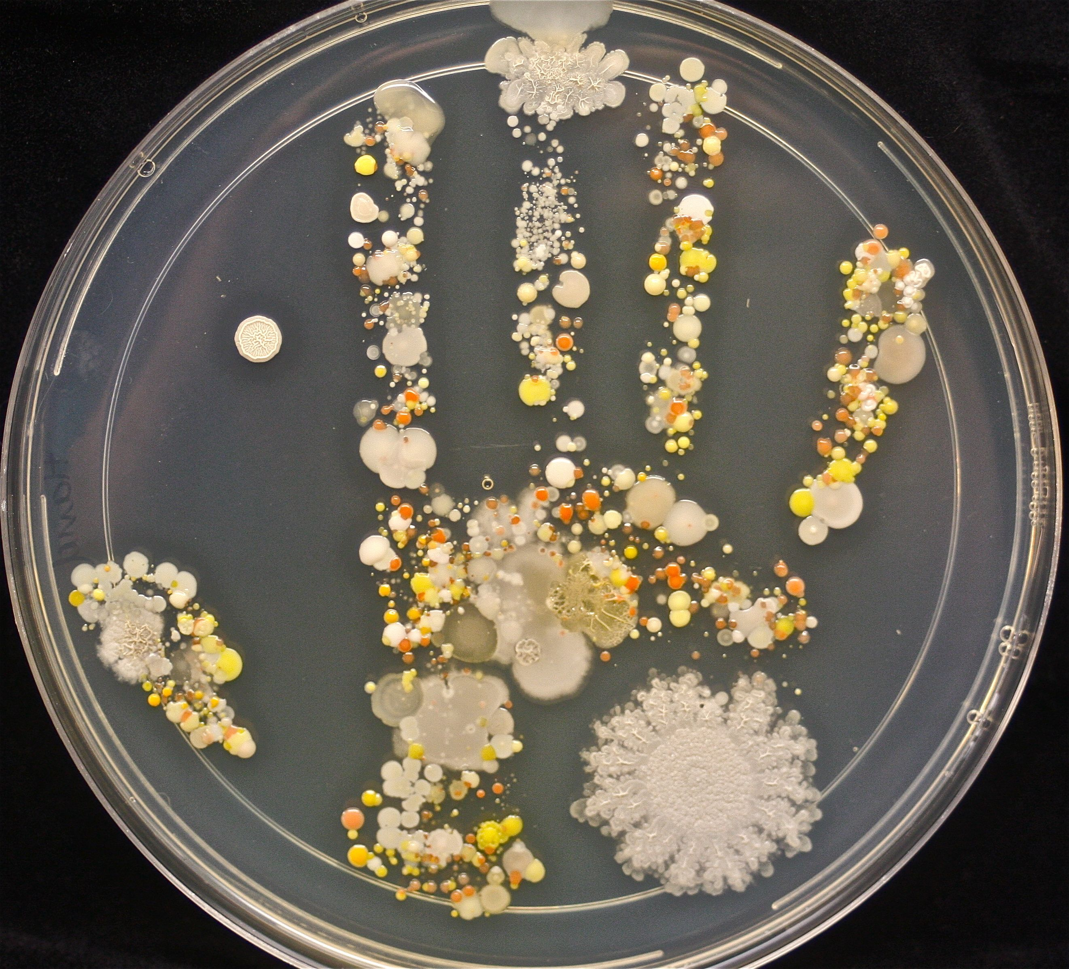

Slide 14
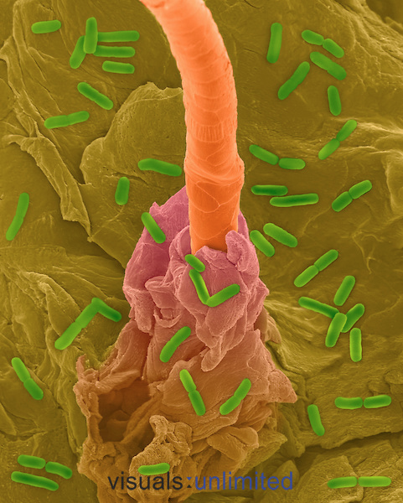

Slide 15
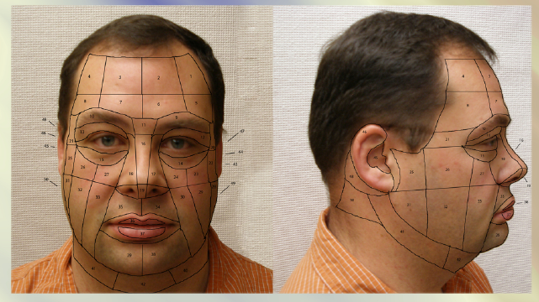

Slide 16
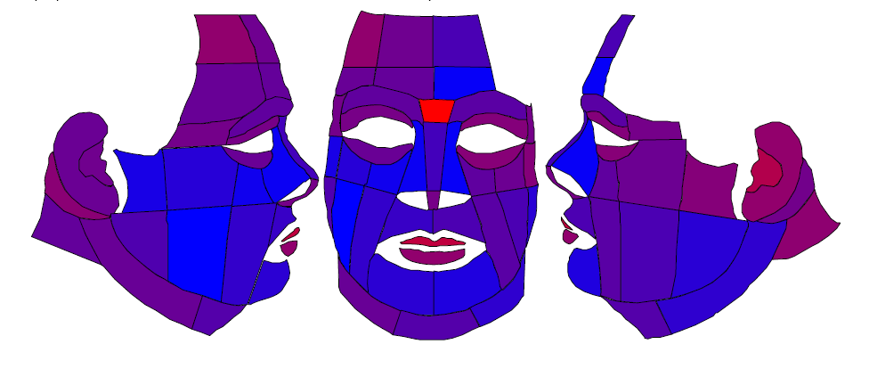
Bacterial diversity (# ‘species’ out of 2000 sequences per sample)
= 300 ‘species’
= 50 ‘species’

Slide 17
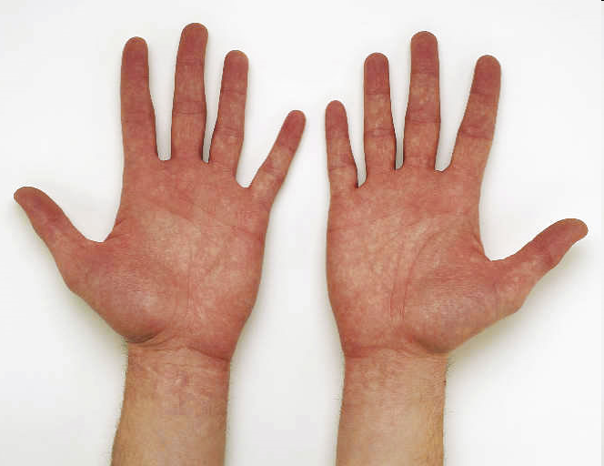
Fierer et al. 2008. PNAS
Notes:
Mention # of phylotypes shared.

Slide 18
Only 13% of palm bacterial species are shared between any two individuals
Fierer et al. 2008. PNAS
Notes:
Mention # of phylotypes shared.

Slide 19

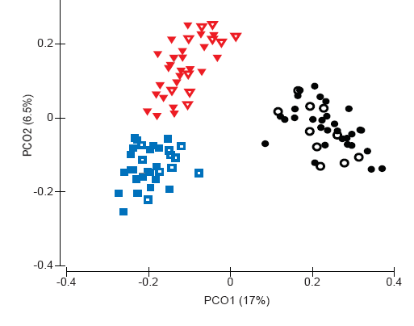
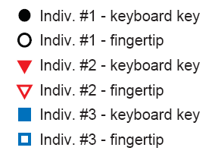
Use of hand bacteria for forensic identification
Fierer et al. 2010. PNAS

Slide 20

Notes:
Individuals harbor very distinct communities
Your hand communities do not change appreciably over time
Bacterial communities remain on touched objects for weeks
We can use bacteria to match touched objects to owner with >90% accuracy

Slide 21
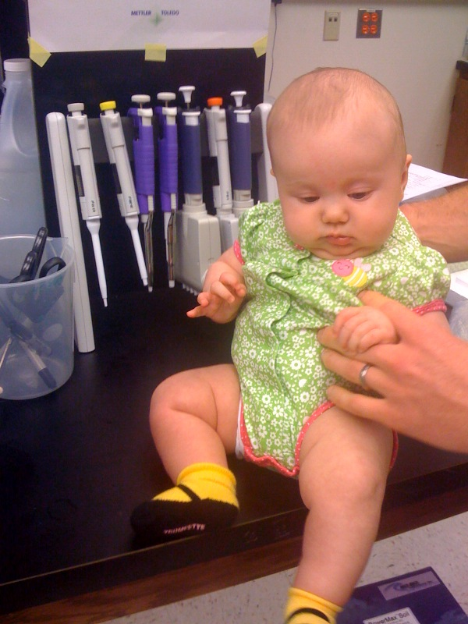
Why do each of us harbor such unique microbial communities?
genetics?
parental influences?
diet or lifestyle?
surroundings?

Slide 22
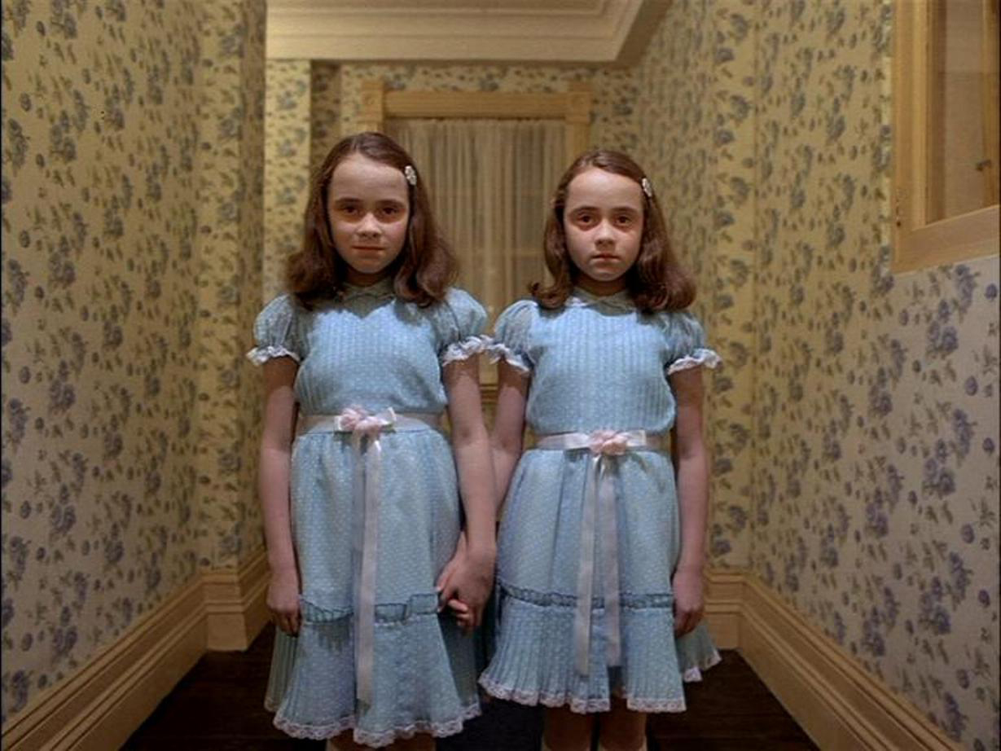
Identical twins harbor bacterial communities that are no more similar than non-identical twins

Slide 23
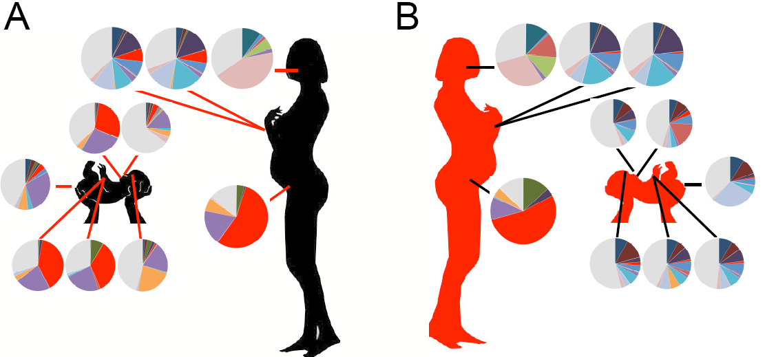
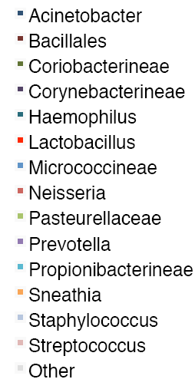
Vaginal delivery
C-section delivery
Dominguez-Bello et al. 2010. PNAS.

Slide 24
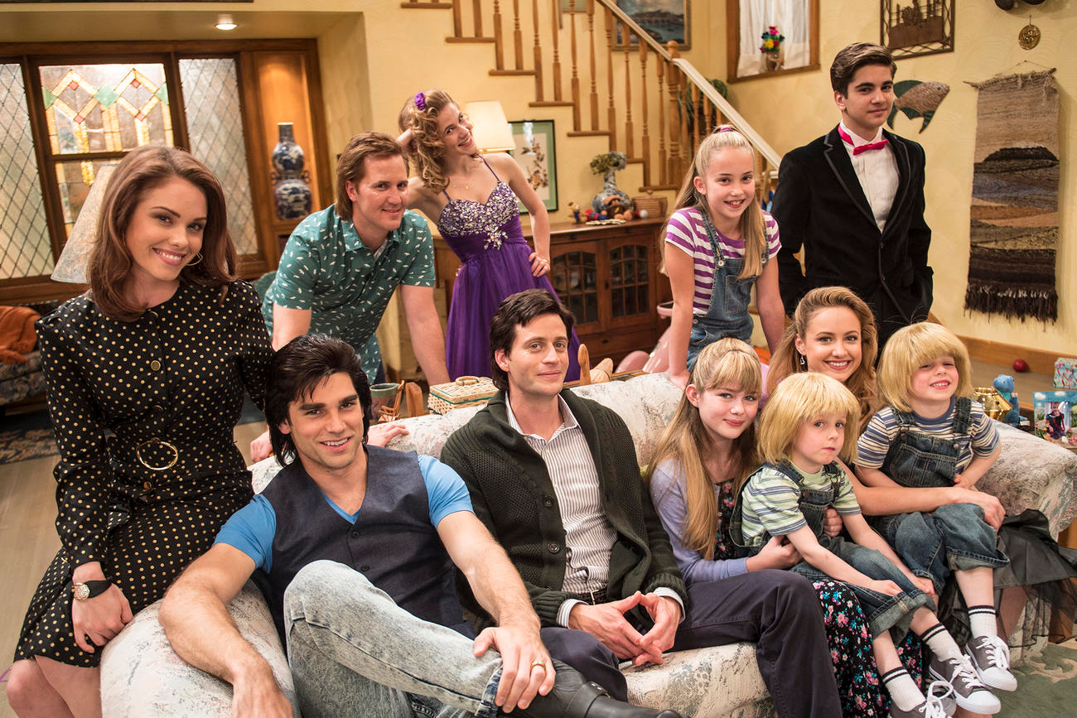
Individuals sharing the same household share more similar bacterial communities (even if unrelated)

Slide 25
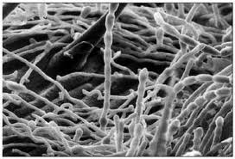
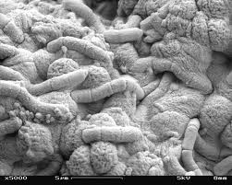
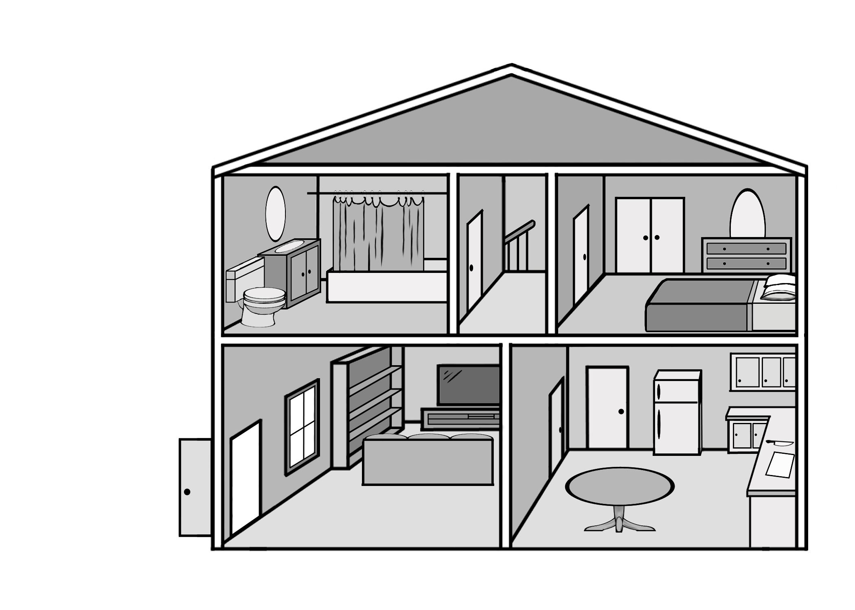
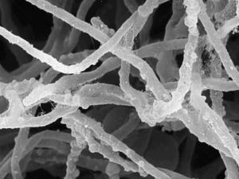
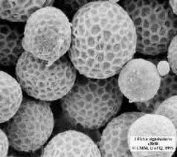
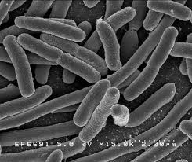
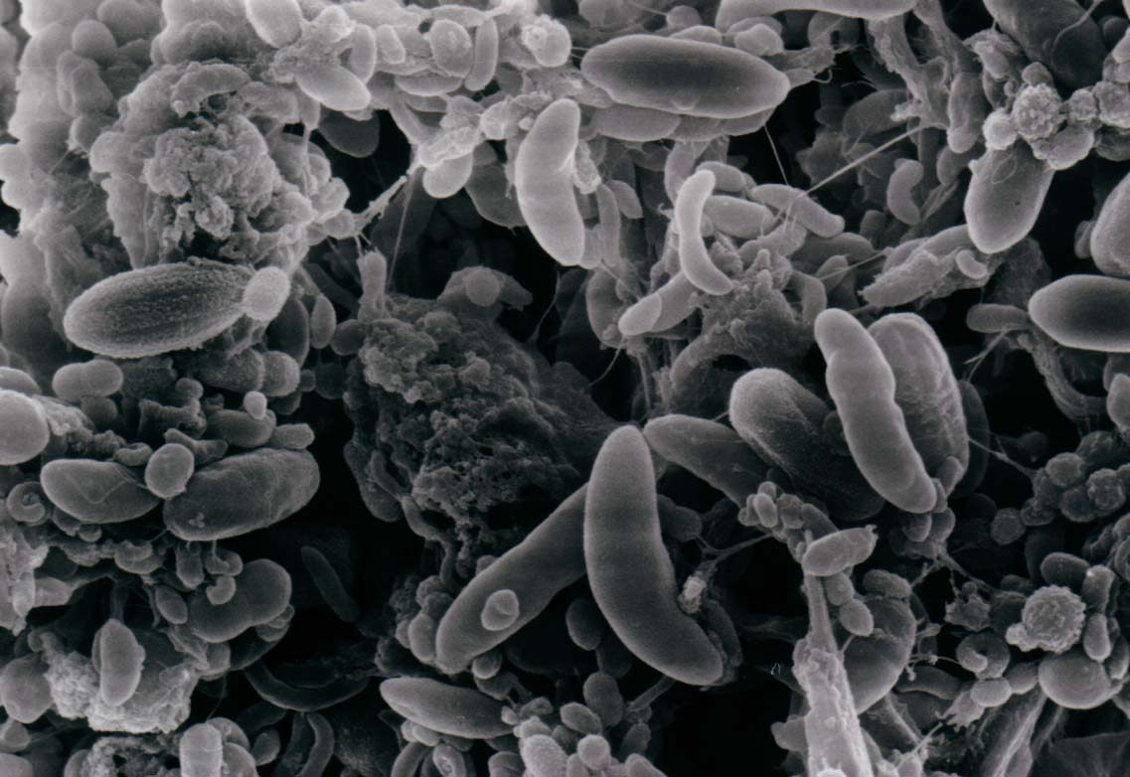
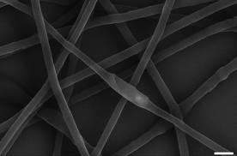
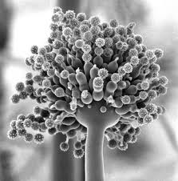
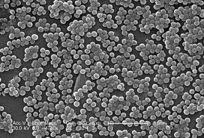
Notes:
we spend >90% of our time indoors, yet we know surprisingly little about the microbes found inside our homes.

Slide 26
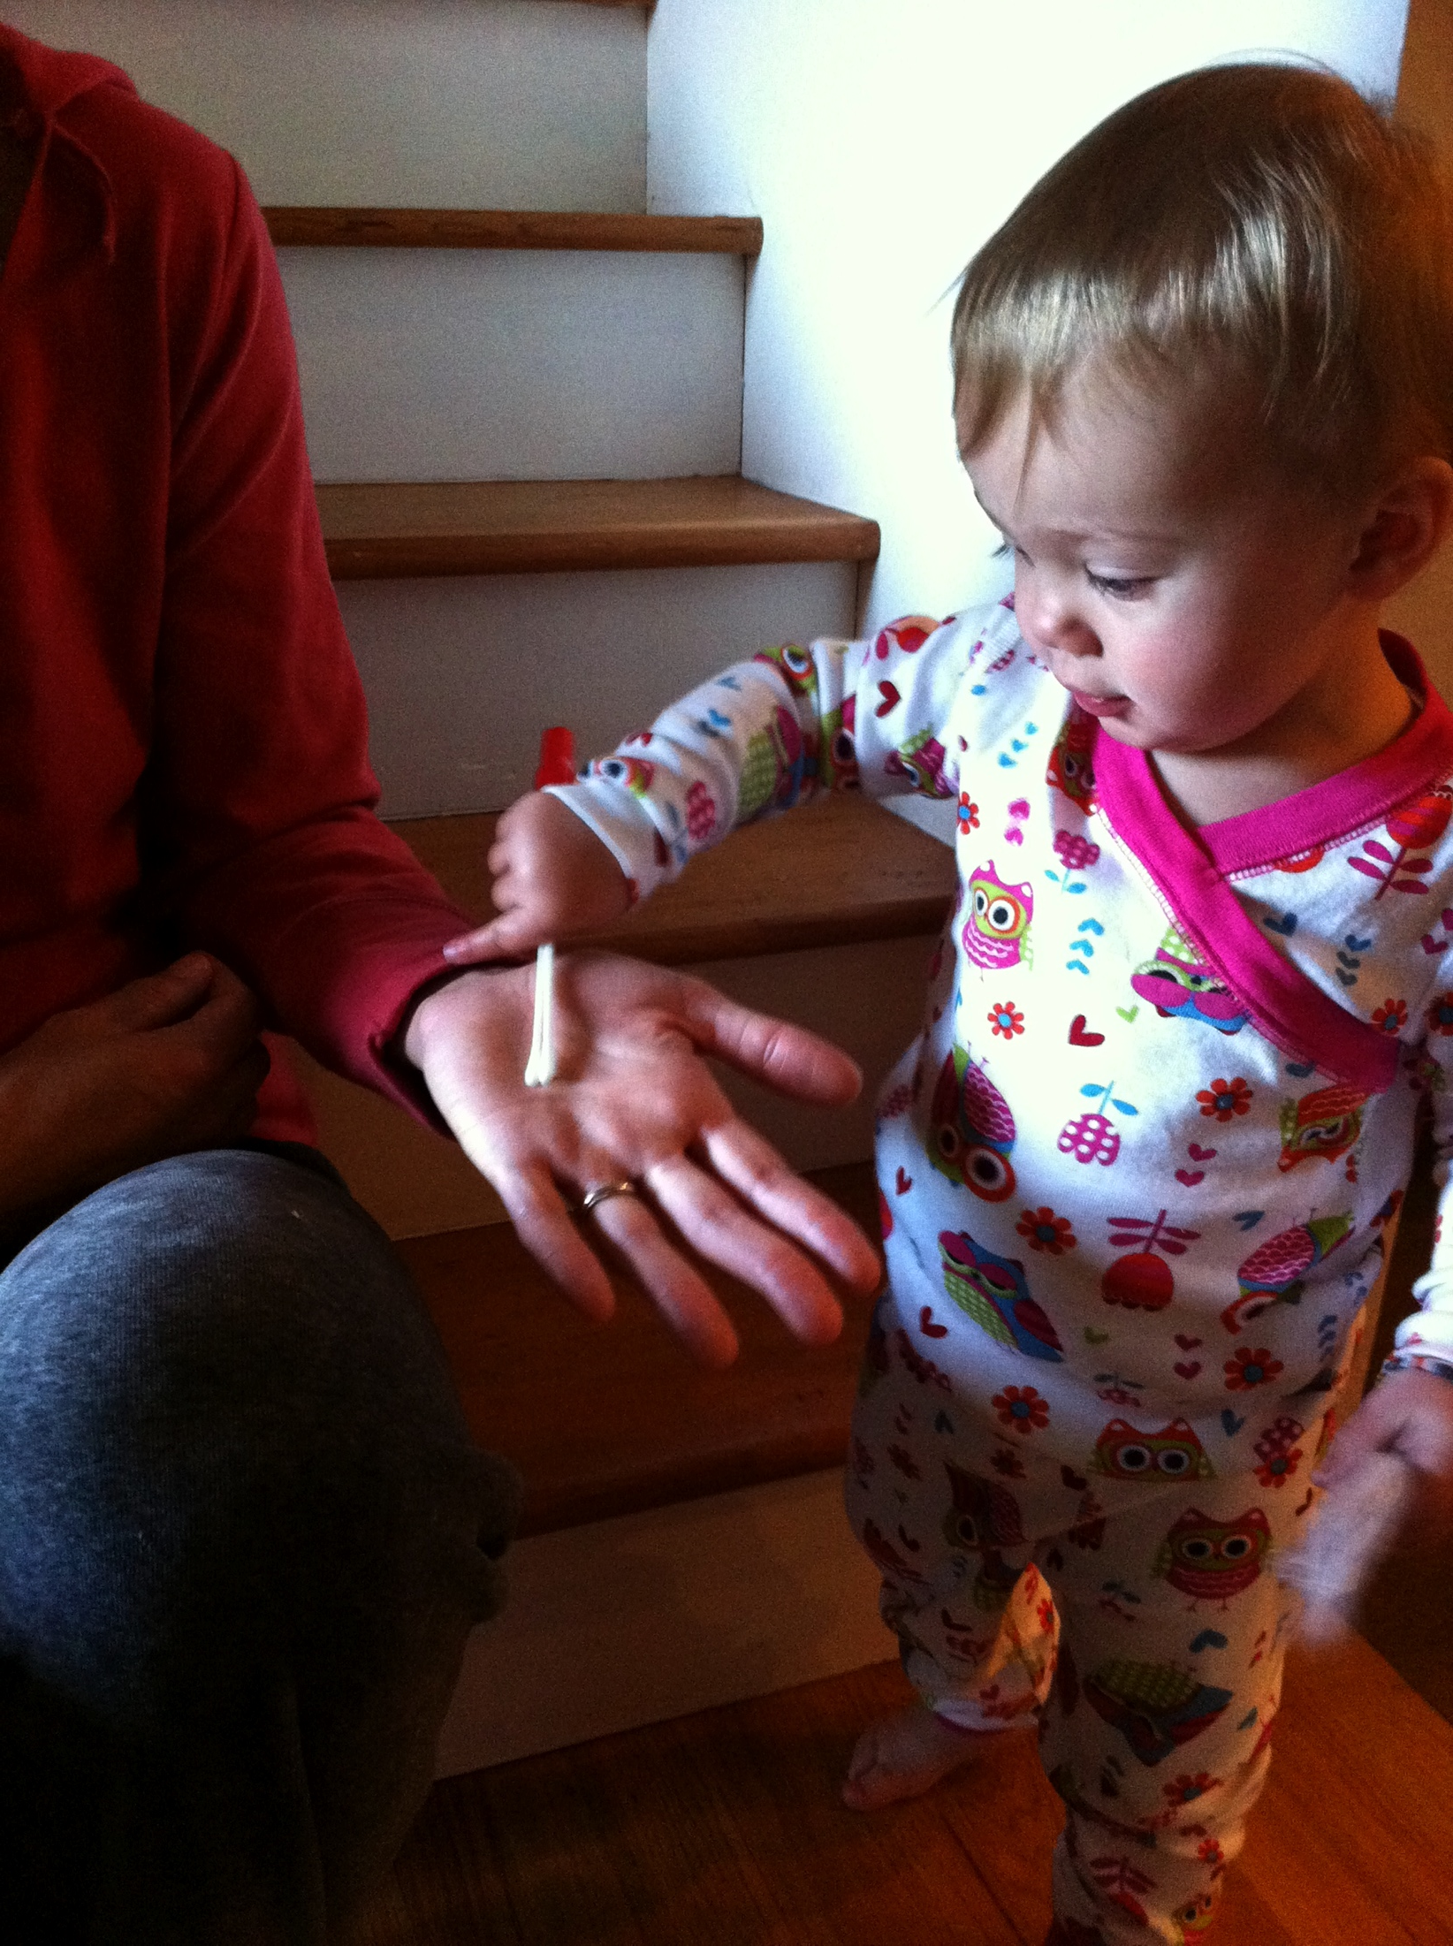
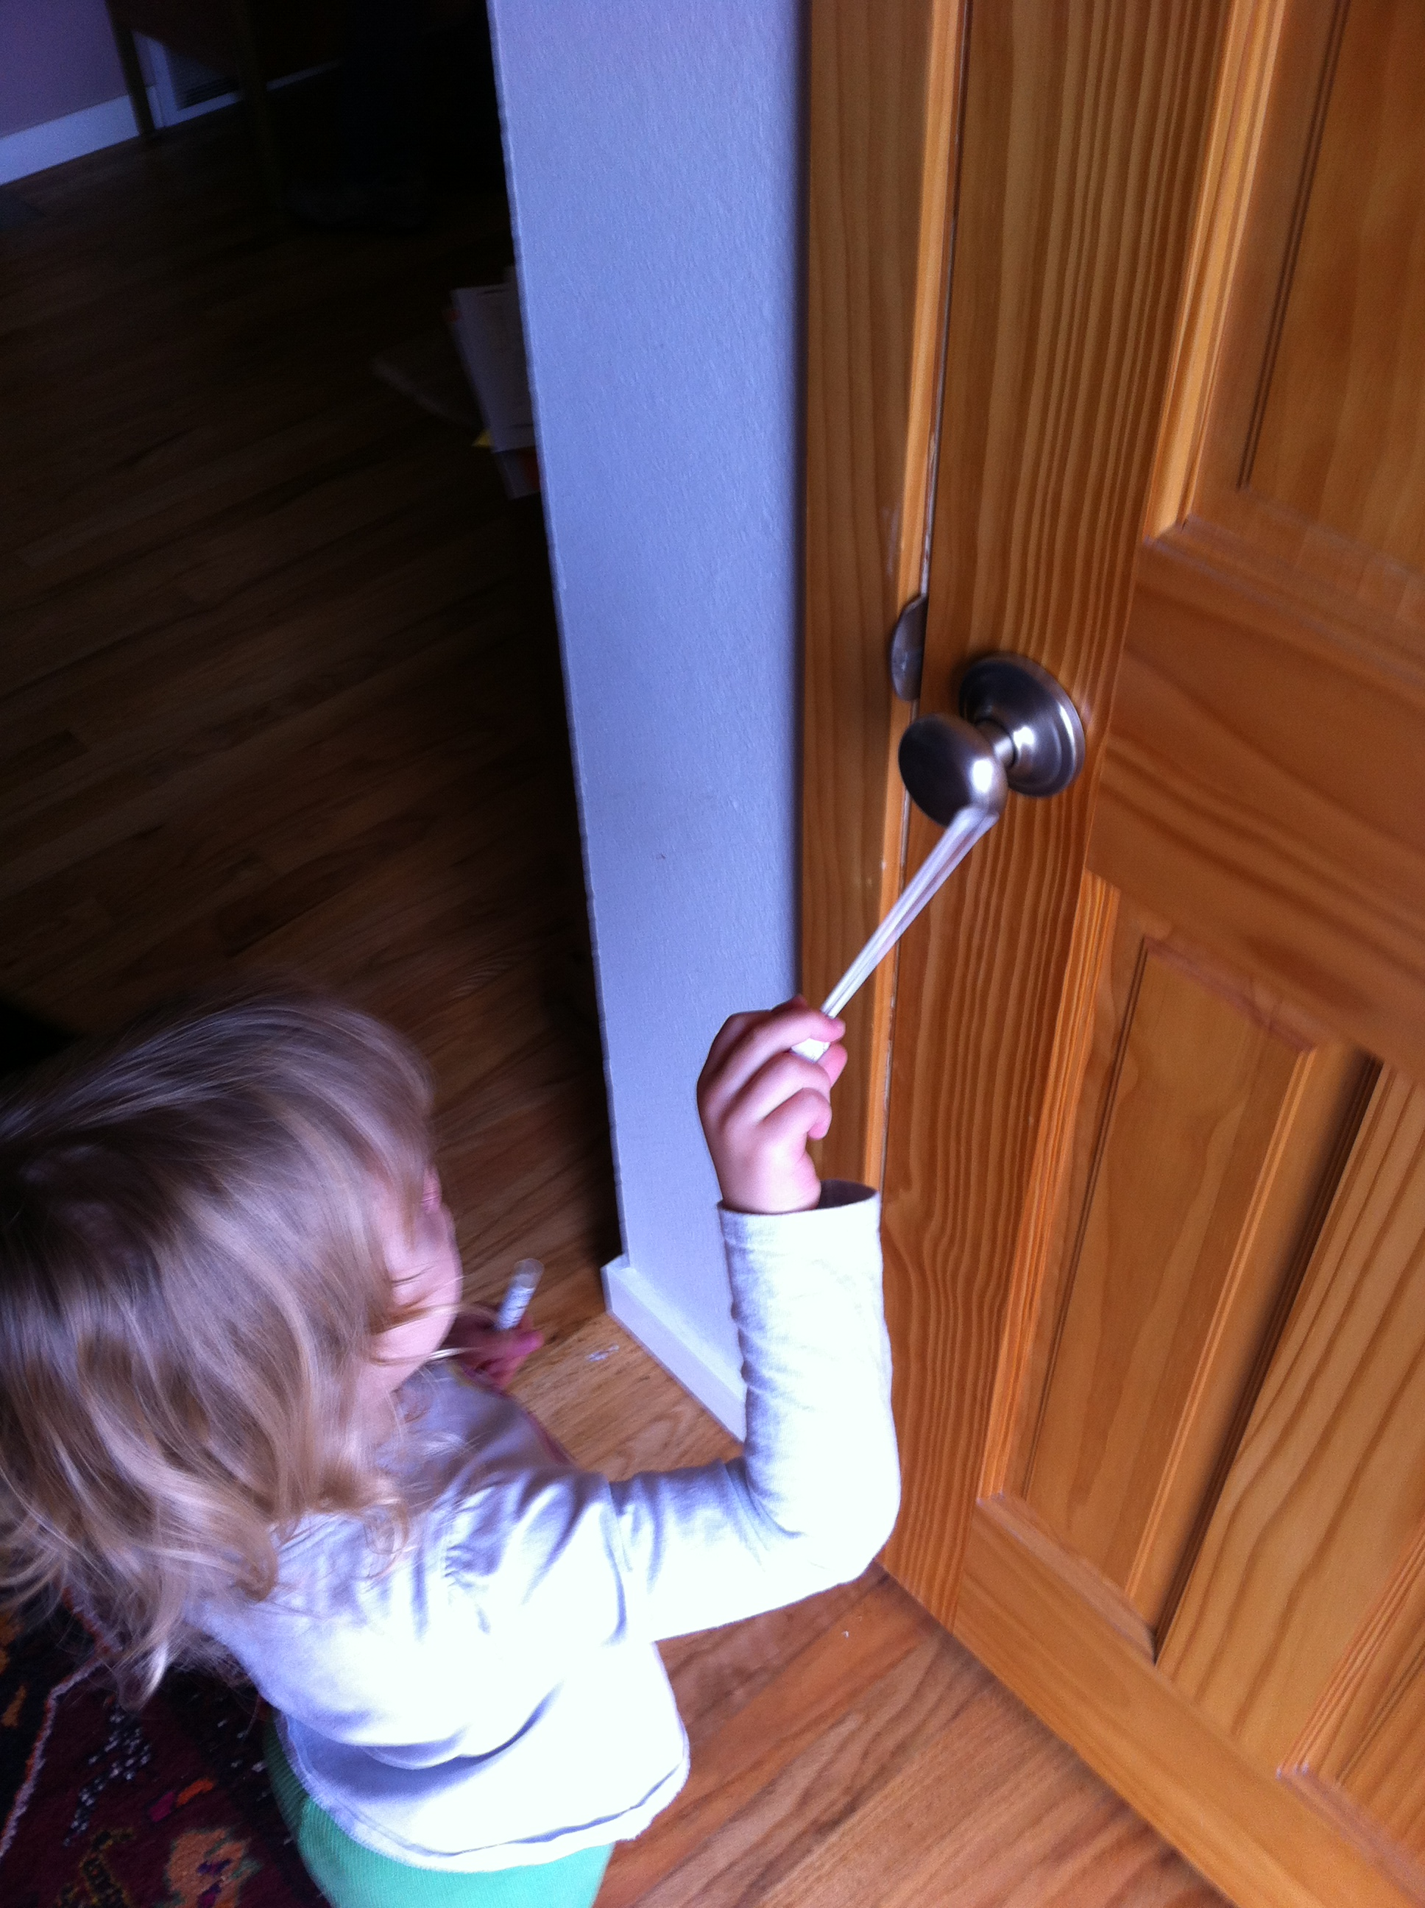

Slide 27
What constitutes a ‘good’ skin microbial community?

