Slide 1
Climate Resiliency Design Challenge Unit
Lesson 1

Slide 2
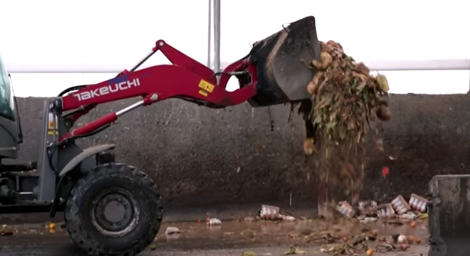
Video
Watch this video and record what you notice and wonder on your Student Activity Sheet.
Notes:
1. (10 min) Begin the lesson by showing this video. Have students write down their observations and questions on a Notice and Wonderings Chart on their Student Activity Sheet. Have students discuss with a partner and then share out some of their ideas in a class discussion.
Suggested Prompts:
What did you notice from that video?
What are you wondering?
What does this video have to do with what we've just learned about climate change and human causes?
Do you think there's something we could do^{A}?
Listen for student responses that mimic the next step in the lesson, such as:
This video discussed how using food waste could be a solution to reducing the Greenhouse Gas: methane.
We think we could look at the food waste at our school or across DPS and see what is being done or what we could do.

Slide 3
How does this Work?
Methane
Landfill
Notes:
1. (10 min) Begin the lesson by showing this video. Have students write down their observations and questions on a Notice and Wonderings Chart on their Student Activity Sheet. Have students discuss with a partner and then share out some of their ideas in a class discussion.
Suggested Prompts:
What did you notice from that video?
What are you wondering?
What does this video have to do with what we've just learned about climate change and human causes?
Do you think there's something we could do^{A}?
Listen for student responses that mimic the next step in the lesson, such as:
This video discussed how using food waste could be a solution to reducing the Greenhouse Gas: methane.
We think we could look at the food waste at our school or across DPS and see what is being done or what we could do.

Slide 4
How does this Work?
Methane
Landfill
Notes:
1. (10 min) Begin the lesson by showing this video. Have students write down their observations and questions on a Notice and Wonderings Chart on their Student Activity Sheet. Have students discuss with a partner and then share out some of their ideas in a class discussion.
Suggested Prompts:
What did you notice from that video?
What are you wondering?
What does this video have to do with what we've just learned about climate change and human causes?
Do you think there's something we could do^{A}?
Listen for student responses that mimic the next step in the lesson, such as:
This video discussed how using food waste could be a solution to reducing the Greenhouse Gas: methane.
We think we could look at the food waste at our school or across DPS and see what is being done or what we could do.

Slide 5
How does this Work?
Methane
Trap Methane
Use as Energy
Landfill
Notes:
1. (10 min) Begin the lesson by showing this video. Have students write down their observations and questions on a Notice and Wonderings Chart on their Student Activity Sheet. Have students discuss with a partner and then share out some of their ideas in a class discussion.
Suggested Prompts:
What did you notice from that video?
What are you wondering?
What does this video have to do with what we've just learned about climate change and human causes?
Do you think there's something we could do^{A}?
Listen for student responses that mimic the next step in the lesson, such as:
This video discussed how using food waste could be a solution to reducing the Greenhouse Gas: methane.
We think we could look at the food waste at our school or across DPS and see what is being done or what we could do.

Slide 6
Observations and Inquires
What did you notice from the video?
What are you wondering?
What does this video have to do with what we've just learned about climate change and human causes?
Do you think there's something we could do?
Notes:
Note that as high school students, can’t do much to change vehicular stuff, electricity changes are hard, etc.

Slide 7
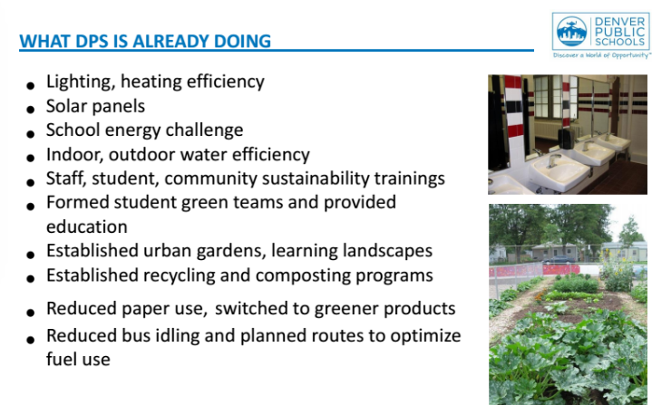
Notes:
2. (10 min) Next, show students the DPS key strategies slide. Shift to a Sharing Initial Ideas Discussion.
Suggested Prompts:
What do these things have to do with carbon dioxide emissions?
Are we doing any of these things at our school?
What could we do in our school to help?
Listen for student responses that mimic the next step in the story line, such as
We think the things that involve vehicles have an impact on carbon dioxide emissions.
We have seen recycling bins and other waste bins around school.
Our heating system is unreliable.
What does composting have to do with CO₂? We can easily turn off lights.
We probably can't build solar panels.

Slide 8
DPS Solid Waste Plan
Read the passage on your Student Activity Sheet and answer the Making Sense Question.

Slide 9
Initial Ideas
Are we doing any of this stuff at our school (things described in the solid waste plan)?
What are other ways we could reduce food waste at our school?
If you want to solve a problem, what are some important things to know so that you can create an effective solution?
What do we need to know in order to begin addressing food waste at school?
Notes:
3. (15 min) Introduce DPS solid waste plan and generate questions. We decided to focus on solid food waste aspect based on the video we started with. What can we do about solid food waste at our school? The solid waste plan talks a little bit about food scraps but we think there is more that can be done.
Suggested Prompts:
Are we doing any of this stuff at our school (things described in the solid waste plan)?
What are other ways we could reduce food waste at our school?
If you want to solve a problem, what are some important things to know so that you can create an effective solution?
What do we need to know in order to begin addressing food waste at school?
What might we want to know in order to decide what solutions might be best?
What do we know? What else might we need or want to know? Why?
What questions do we have?
Where might we obtain this information?
Listen for student responses such as, to build driving questions:
We are not composting. We are not recycling in the cafe or elsewhere. We need to take actions to reduce food waste at our school.
In order to do that we need to do some background research to learn more about why food is wasted at our school and what might be done. We might also talk with people to figure out what is being done about food waste, what has been done, and gauge if people are interested in dealing with food waste in our school and why.
We are wondering:
How does the food system create waste?
Why is food wasted?
Can we waste less in the first place?
Why do we need to reduce the amount of food waste that goes to landfills?
What does this have to do with emissions?
Do we have a recycling bin in the cafe?
How much do we waste?
Where is the waste generated?
Can we measure our food waste?
Is there a better use for food waste?
Who makes decisions that leads to food waste?
Guide students to the design challenge of mitigating the impact of food waste on climate change while also considering how potential actions they could select might in turn affect aspects of the system and their own communities. Given this recognition, students might also consider how the effort of reducing food waste might also address social concerns at their school. Encourage questions that reference information, concerns, and insights that relate to what we have already learned. Encourage empowerment to change the system. Capture ideas on a Notice and Wondering Chart.

Slide 10
Generating Questions
What questions do we need to answer to make this a good design challenge?
Where could we get the information to answer our questions?
What are some constraints to this design challenge? (What are we able to do and not able to do?)

Slide 11
Prioritizing and Grouping Questions
Can we group any of these questions together?
How can we prioritize any of these groups?
Notes:
4. (10 min) Once students have had the opportunity to share their ideas on the Notice and Wondering Chart, categorize and prioritize the questions in order of importance.
Suggested Prompts:
Can we group any of the questions together?
Looking at our Driving Question Board, what do we need to answer first in order to make a feasible change? What do we need to know first? Why?
What are the limits to this challenge?
Are there limits to what we can do?
Which solutions might be most appropriate given realities (social, cultural, political, institutional, actual and potential resource access, environment etc….) of our context?
Given the actions we might take, what logistical considerations should we pay attention to (social, cultural, available resources, potentially available resources, institutional, perceptions, priorities etc…)?
Where do we go next?
Listen for student responses that mimic the next row in the storyline, such as:
We are not composting. We are not recycling in the cafe or elsewhere. We need to take actions to reduce food waste at our school.
We are wondering how the food system in our school works and think that would be a good place to start.

Slide 12
Where should we go next?
What questions should we start with?
Notes:
Listen for student responses that mimic the next row in the storyline, such as:
We are not composting. We are not recycling in the cafe or elsewhere. We need to take actions to reduce food waste at our school.
We are wondering how the food system in our school works and think that would be a good place to start.

