Slide 1
Climate Resiliency Design Challenge
Lesson 3

Slide 2
Do now
What did we do last class?
What did we figure out last class?
What did we decide to investigate next?
Notes:
(5 mins) Begin with a Consensus Building Discussion to re-orient the students to the storyline.
Suggested Prompts:
What did we do last class?
What did we figure out last class?
What did we decide to do today?
Listen for students responses that align with today’s lesson plan:
Last class we read an article about the different components in the food system
We figured out that food is wasted at many parts in the system
We realized that we can’t change most parts of the system but we do have some control over what happens at our school
We decided we wanted to design an investigation to see what the food waste situation is at our school in order to come up with solutions to minimize the food waste.
We also want to share our results with people who can have a bigger impact (school administration, people from the district)

Slide 3
Analyzing Data
Read through the Graphs and Background Information Handout and complete the Notice and Wonderings table in your Student Activity Sheet.
Notes:
2. (15 mins) Direct students to look at the graphs and background information handout. Have them complete the notice and wonderings table in their Student Activity Sheets to themselves, and then discuss with a partner.
Suggested prompts:
Take a look at this graph, what do you notice?
What terms are unfamiliar to you?
What questions do you have from this graph?
What does this graph tell us?
What are the trends/patterns?
Listen for student responses such as:
Cereals have both the highest food waste and the highest carbon footprint.
Meat has a high carbon footprint but low food waste. Why is the carbon footprint of meat so high?
Milk has equal food waste and carbon footprint.
Meat and vegetables have the same carbon footprint, but vegetables have a much higher food waste.
What are oil crops and pulses?
What are starchy roots, why is their food waste so high compared to their carbon footprints?
Do all types of food give off the same amount of methane when they are decomposing?
According to figure B, the most food is wasted at the agricultural level.
The biggest carbon footprint occurs at the consumption level.
What is important for our design challenge from these graphs?
We can’t control the food waste at any of the levels except consumption, however the food wasted and carbon footprints are relatively high at this level so our work could have an impact.
There is a variety of food types being wasted and these different types have different carbon footprints. We may need to understand which of these types are wasted the most at our school.

Slide 4
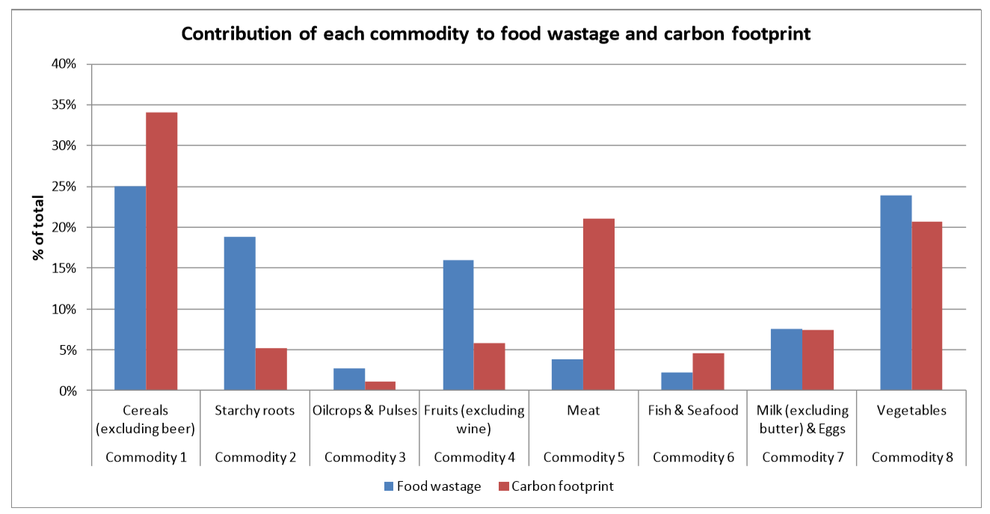
FAO, Food wastage footprint: Impacts on natural resources

Slide 5
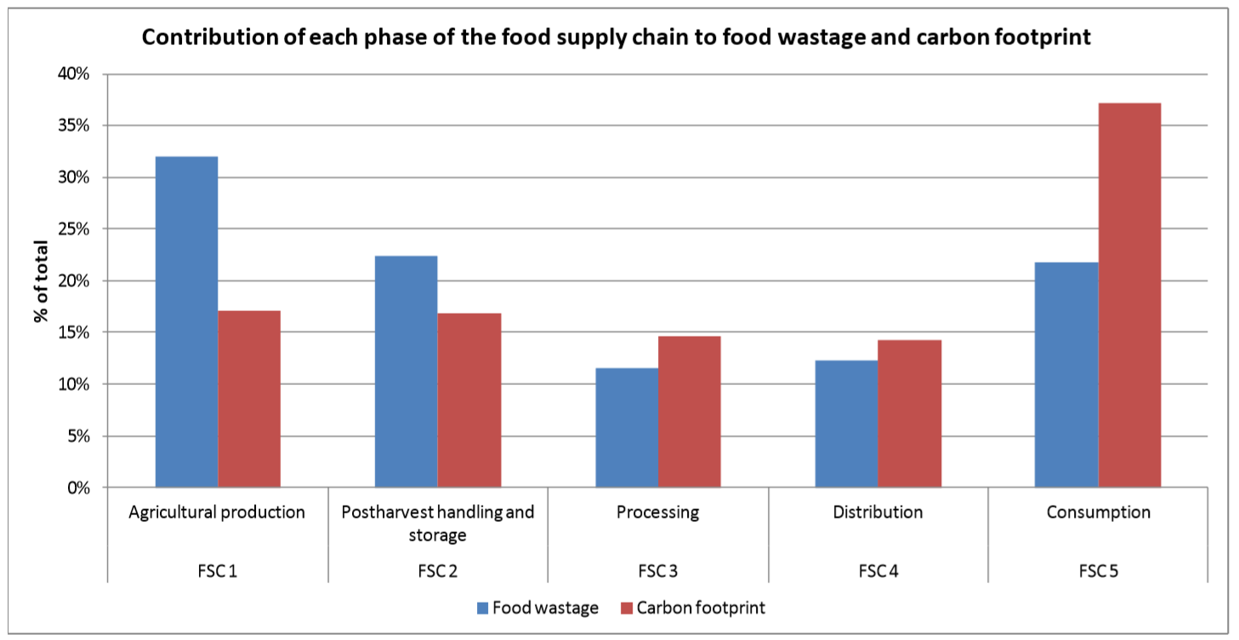
FAO, Food wastage footprint: Impacts on natural resources

Slide 6
Designing an Investigation
What information from those graphs is applicable to our school?
What data could we collect?
How are we going to collect this data?
Notes:
3. (15 mins) Now that students have an understanding of their place and potential impact on the issue of greenhouse gas emissions and food waste, guide students in an initial ideas discussion^{A} to help determine how they want to go about assessing the situation at their school.
Suggested Prompts:
What data do we need to collect at our school?
How are we going to collect this data?
Accept all students responses that are realistic and will contribute to the understanding of the food waste system, such as:
What types of food are we eating at lunch? As individuals? As a school?
What types of food are we wasting? How much of these foods are we wasting? As individuals? as a school?
Why are we wasting food? (survey created for consumer habits)

Slide 7
Designing an Investigation
How do we want to divide up the work for this investigation?
Get into groups and begin writing up your plans! Use the questions in your Student Activity Sheet to help you.
Notes:
4. (1 hour) Divide students into groups^{B} to tackle different aspects of the design challenge. Once students are in their groups, have them work together to come up with a detailed plan for how they plan to collect and analyze the data for the question they are working towards. Give students the “Tips for Designing your Investigation” handout to help facilitate the planning of their investigation.

Slide 8
Carrying out our Investigation
Go collect your data!
Notes:
5. (2-3 days) Once students have an approved plan, allow the appropriate amount of class time to collect and analyze data as well as create visual representations of their results (posters, slides, etc.).

Slide 9
Where should we go next?
We have collected all this data, what should we do with it?

