Slide 1
Climate Resiliency Unit
Lesson 2

Slide 2
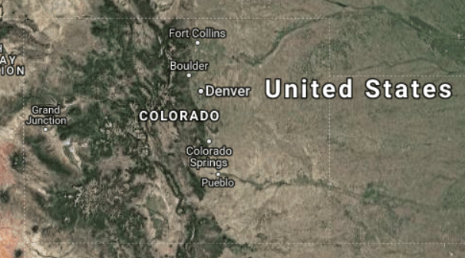
Do now
What do you know about characteristics of Colorado that might help us figure out why temperatures are increasing?
Notes:
1. (5 min) Begin with a Do Now discussion to get the class reoriented to the storyline, what the class decided to investigate first.
Suggested Prompts:
What do you know about Colorado that might help us figure out why temperatures are increasing?
Ask students to share their ideas and create a class list of things we know about Colorado and questions we might have about the state.
Listen for and capture student responses, such as:
Colorado has mountains.
Colorado has many days of sun, more than most other places.
Most people in Colorado live in the Denver metro area/the Front Range.
Denver wasn’t on the list of cities they talked about. I’m still wondering what’s different because Denver is the biggest city.
Where are those cities?
More people are moving to CO, the population is increasing.
My city is changing, neighborhoods are getting developed, there are more buildings. Things seem to be changing quickly in my community.
What the report say about Denver
Colorado has weird weather. It seems like we’ve been having more drastic weather events like when it flooded a few years ago.

Slide 3
Climate Report
Let’s review the Climate Central report about the temperature patterns in the US.
What does the Climate Central report have to say about temperature trends in cities and states?
Notes:
2. (15 min) Remind students we decided at the end of last class to look at the report mentioned in the video. In groups of 2-3, ask students to go to the report online or give students a copy of the PDF (Denver focused).
Suggested Prompts:
What’s going on in Denver, specifically?
What patterns do you notice in cities getting hotter the fastest?
When did they start collecting this data?
How much is the temperature changing?
What patterns do you see? What looks weird, what doesn’t make sense in the report?
Lead an Initial Ideas discussion about patterns and things students noticed in the report.
Suggested Prompts:
What did you notice?
What did you figure out related to the question prompts?
What’s going on in Denver, specifically?
What patterns do you notice in cities getting hotter the fastest?
When did they start collecting this data?
How much is the temperature changing?
What patterns do you see? What looks weird? What doesn’t make sense in the report?
What extreme things did you notice?
What did you notice about Colorado in relation to the rest of the data?
Listen for student responses and capture the ideas for everyone to see:
The change is not the same everywhere since 1970.
Some places are cooler or not experiencing much change.
There is danger and extreme heat.
It looks regional; those places are always hot.
The data goes back to 1970.
Heat is the number one weather related killer.
The temperature is changing about 15 degrees.
Temperatures are changing even in places that we don’t see as normally hot.
Ask students what questions the report brings up so far that we need to add to the Driving Questions Board.
Suggested Prompts:
What questions should we add to our Driving Questions Board?
Which questions should we prioritize now?
Listen for student responses such as:
Why is heat dangerous? I have air conditioning, why is this a threat? Why does heat kill more people?
Who are vulnerable populations? Why does this matter for health?
How do they make those predictions?
What does humidity feel like? What does a change feel like?
How many people live in the places that are getting hotter, the fastest?
What’s the scale? Are rural places included?
Are they just averaging the cities?
What do people have to do with this? Are people moving?
Is this change just in the city, is it the in state, or is it everywhere?

Slide 4
Climate Report
What questions should we add to our Driving Questions Board?
What questions should we answer first?
Notes:
Ask students what questions the report brings up so far that we need to add to the Driving Questions Board.
Suggested Prompts:
What questions should we add to our Driving Questions Board?
Which questions should we prioritize now?
Listen for student responses such as:
Why is heat dangerous? I have air conditioning, why is this a threat? Why does heat kill more people?
Who are vulnerable populations? Why does this matter for health?
How do they make those predictions?
What does humidity feel like? What does a change feel like?
How many people live in the places that are getting hotter, the fastest?
What’s the scale? Are rural places included?
Are they just averaging the cities?
What do people have to do with this? Are people moving?
Is this change just in the city, is it the in state, or is it everywhere?

Slide 5
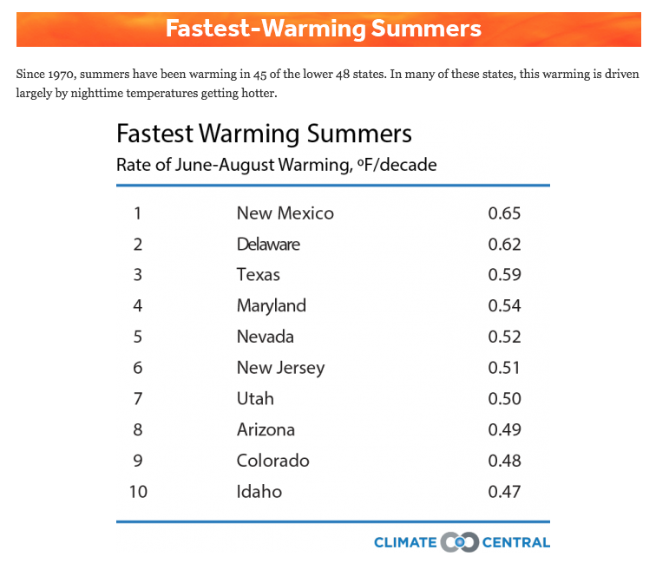
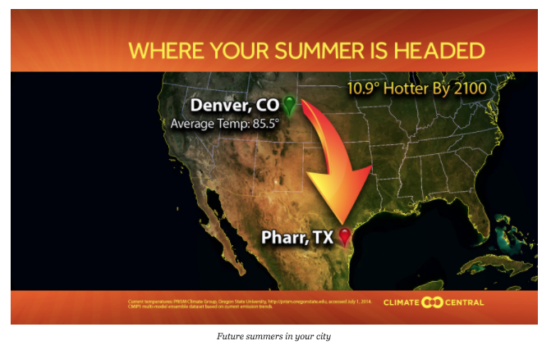
Part A
Work in your groups to answer questions 1-3
Notes:
3. (15 min) We decide we need to compare cities and states. In the same groups, give students the Student Activity Sheet and have them do Part A (see the Student Activity Sheet Answer Key for answers).
Suggested Prompts:
Before your group starts the Student Activity Sheet, look at the data table. What are they providing information about? What is being compared? What unit is being measured and over what time period? How long has this data been collected? What is the summer temperature pattern?
After students have had a chance to answer the first 3 questions^{A}, facilitate a discussion to answer question 4 on the Student Activity Sheet.
Suggested Prompts:
As your group completes questions 1-3, what patterns do you see in the data?
For question 4, let’s discuss the temperature changes in Denver vs. Colorado as a whole class. What trends do you see in the data?

Slide 6
Part A
Now, work in your group to answer questions 5 and 6
Notes:
Next, have students work in their groups to complete questions 5 and 6^{B}. Finish up with a classroom discussion of each group’s responses for these questions.
Suggested Prompts:
As your group now completes questions 5 and 6, what claims and evidence can you determine from the data? What ideas do you have about what is causing the data results? What ideas do you have on how we can investigate the causes of the data results?
As a class, let’s share responses for questions 5 and 6.
Now, let’s brainstorm ideas on how we can investigate what is causing the differences in average summer temperatures between Denver and Colorado.

Slide 7
Part A
What have we figured out?
What are we wondering?
Notes:
4. (5 min) Guide students in a Building Consensus Discussion.
Suggested Prompts
What have we figured out today? What questions do we still have?
Listen for student responses:
The temperature is changing faster in cities than it is in states.
It seems like cities are warming faster because there are more people and more buildings.
We are wondering: is this happening all over the world?

Slide 8
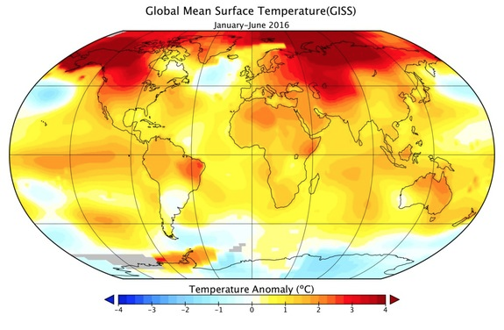
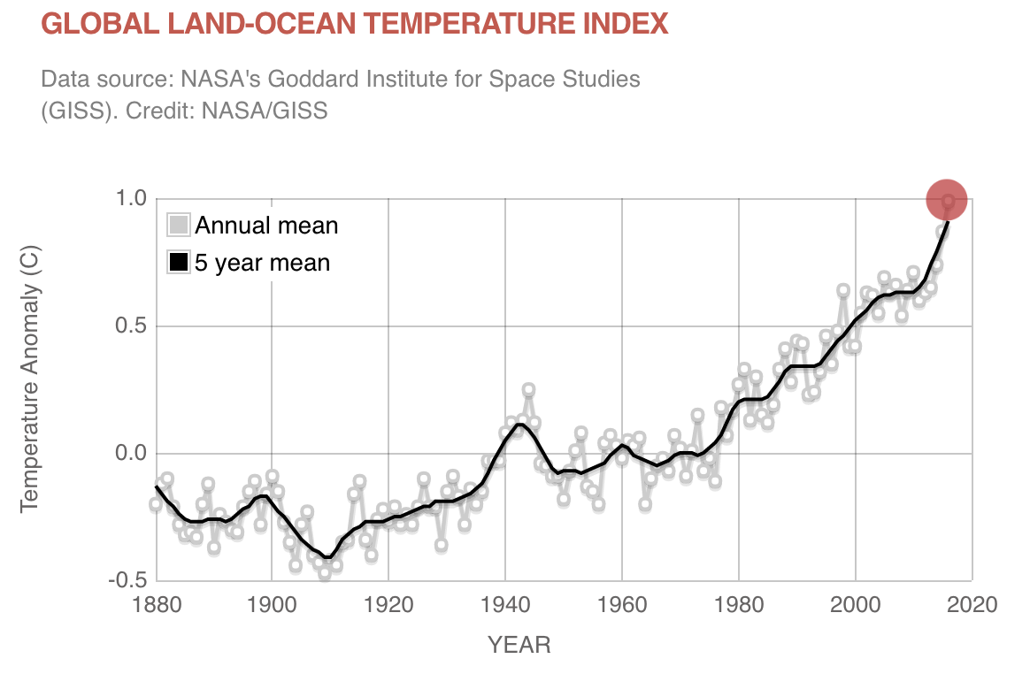
Part B
Notes:
5. (10 min) Have students start Part B^{C}: What’s going on in the world? Students should interpret the graphs and answer the question about each graph. Then finish class with a Building Consensus discussion.
Suggested Prompts:
What does temperature anomaly mean? What do we think it is telling us?
Which regions are seeing the most change and which ones are seeing the least? What are the differences between land and ocean? Do you see any latitude dependence?
What questions do you have about the city, state, and global data?
Listen for student responses, such as:
Temperature anomaly is a way to talk about how temperature is changing by showing the difference in the current temperature from the average temperature over a long period of time.
Overall, the temperature in the world is getting hotter and it has been getting hotter since about the 1880s. However, the changes in temperature aren’t the same across the world - for example, in the Arctic, the temperature is hotter than expected.
We are wondering: why is this happening? Why is it getting hotter faster in some places than others and what does this have to do with the overall warming trend we saw in the graph?
There are places in the world that are getting hotter even though there aren’t buildings or a lot of people there; why is that happening?

Slide 9
What did we figure out today?
Notes:
6. (5 min) End the class with the following discussion to set up for next class:
Suggested Prompts:
What did we figure out today?
What should we investigate next class?
Listen for student responses that mimic the next row of the storyline:
We figured out that temperatures are increasing worldwide but that cities seem to be increasing faster than states on average or rural areas.
We wonder why cities and other regions of the world getting hotter? There are places in the world that are getting hotter even though there aren’t buildings or a lot of people there; why is that happening?

Slide 10
What should we investigate next class?

