Slide 1
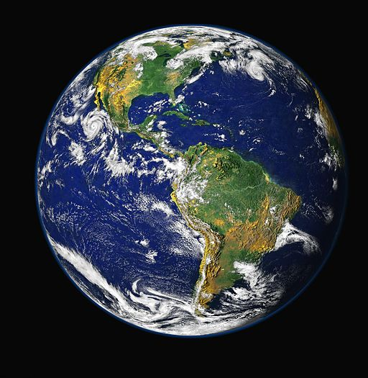
Lesson 5
What was Earth’s temperature
like in the past?

Slide 2
Do Now
Yesterday, we investigated if other parts of the world are warming too.
What did we find out?
Notes:
1. (5 min) Begin with a Do Now to activate their previous knowledge from the last lesson. Use a Consensus Building Discussion ¹ to help reorient students in the story line. Use the following prompts to help students articulate what they figured out in the last lesson. Students will be answering on their paper first (3 minutes) and then share out (2 minutes).
Yesterday we decided that we needed to look at more data over time to determine if this was really a trend.
Suggested Prompts:
What did we figure out last time?
What did we investigate?
Listen for student responses ² that refer to what we figured out last time, such as:
We investigated the albedo and temperature of Earth to see if they are changing.
We figured out that other parts of the world are getting warmer, too.

Slide 3
So what should we focus on today?
We decided that we needed to look at more data over time to determine if the warming temperatures are a trend.
In your own words, what is a trend?
Where have you seen trends before in your life?
At this point in our investigation, do you think that the rising temperatures are a trend?
Notes:
2. (5 min) Next, shift to a Sharing Initial Ideas Discussion ³. Use the following prompts to guide students to articulate what they think they should focus on in today’s lesson .
Suggested Prompts:
In your own words, what is a trend?
Where have you seen trends before in your life?
At this point in our investigation, do you think that the rising temperatures are a trend?
What do you think we could/should do to help us decide whether or not this is a trend?
How will we know if this is a trend?
Listen for student responses such as:
To find out if it is a trend, we need to learn about what a trend is. We need to look at data over time to see if it is a trend or something unusual. Then we need to find out where the data is coming from and decide if we trust it.

Slide 4
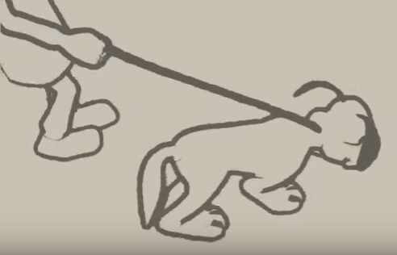
What is a trend?
We are going to watch a video to help us visualize what a trend is and how to determine its pattern.
Notes:
3. (10 min) Now that students have decided the path of the lesson, draw the students attention to the part of their Student Activity Sheet where they will summarize or draw what a trend is from watching a video. Show the “Trends and Variations” video and discuss what a trend is.
https://www.youtube.com/watch?v=e0vj-0imOLw
Suggested Prompts:
What do you notice about the person and the dog?
What is a trend?
Listen for student responses such as:
Even though the dog is walking all over the place, they are still walking up (increasing trend)
A trend is an overall pattern over time. There might be little changes along the way, but we are looking at the bigger picture to see real trends.
Discuss the four major types of trends, and have the students draw the four types on their Student Activity Sheet (next slide)
Suggested Prompts:
What are the four different types of trends?
What are the differences between the various trends?
Listen for student responses such as:
An increasing trend means that both of the axes are increasing.
A decreasing trend means that one goes down while the other goes up.
A constant trend means that while one goes up, the other stays the same.
No trend means that you can’t draw a line because the data is all over the place.
Have students apply what they have learned about trends to the graph of the world’s human population over time. (next slide)
Suggested Prompts:
What do you notice about the world’s human population over time?
Does this make sense based on what you’ve learned about in history classes?
What do you think will happen to the population as time goes on?
Listen for student responses such as:
A long time ago the population was mostly constant.
The world’s human population has been increasing for awhile, but recently it’s been increasing much faster.
Make sure students have a summary or drawings in their observations section of the Student Activity Sheet so that they can refer back to it later.

Slide 5
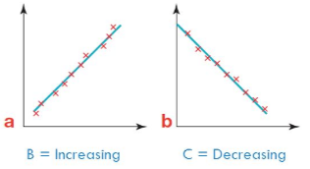
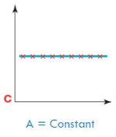
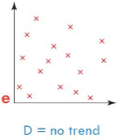
Summarize the four main types of trends
Notes:
3. (10 min) Now that students have decided the path of the lesson, draw the students attention to the part of their Student Activity Sheet where they will summarize or draw what a trend is from watching a video. Show the “Trends and Variations” video and discuss what a trend is.
https://www.youtube.com/watch?v=e0vj-0imOLw
Suggested Prompts:
What do you notice about the person and the dog?
What is a trend?
Listen for student responses such as:
Even though the dog is walking all over the place, they are still walking up (increasing trend)
A trend is an overall pattern over time. There might be little changes along the way, but we are looking at the bigger picture to see real trends.
Discuss the four major types of trends, and have the students draw the four types on their Student Activity Sheet (next slide)
Suggested Prompts:
What are the four different types of trends?
What are the differences between the various trends?
Listen for student responses such as:
An increasing trend means that both of the axes are increasing.
A decreasing trend means that one goes down while the other goes up.
A constant trend means that while one goes up, the other stays the same.
No trend means that you can’t draw a line because the data is all over the place.
Have students apply what they have learned about trends to the graph of the world’s human population over time. (next slide)
Suggested Prompts:
What do you notice about the world’s human population over time?
Does this make sense based on what you’ve learned about in history classes?
What do you think will happen to the population as time goes on?
Listen for student responses such as:
A long time ago the population was mostly constant.
The world’s human population has been increasing for awhile, but recently it’s been increasing much faster.
Make sure students have a summary or drawings in their observations section of the Student Activity Sheet so that they can refer back to it later.

Slide 6
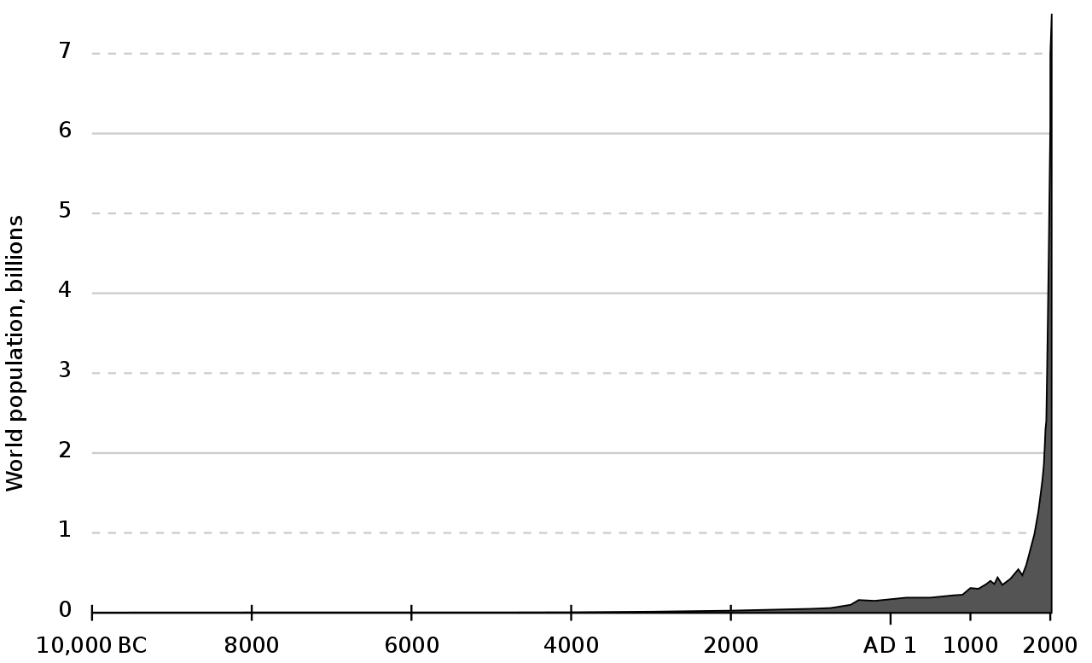
Describe the trend of human population
Notes:
3. (10 min) Now that students have decided the path of the lesson, draw the students attention to the part of their Student Activity Sheet where they will summarize or draw what a trend is from watching a video. Show the “Trends and Variations” video and discuss what a trend is.
https://www.youtube.com/watch?v=e0vj-0imOLw
Suggested Prompts:
What do you notice about the person and the dog?
What is a trend?
Listen for student responses such as:
Even though the dog is walking all over the place, they are still walking up (increasing trend)
A trend is an overall pattern over time. There might be little changes along the way, but we are looking at the bigger picture to see real trends.
Discuss the four major types of trends, and have the students draw the four types on their Student Activity Sheet (next slide)
Suggested Prompts:
What are the four different types of trends?
What are the differences between the various trends?
Listen for student responses such as:
An increasing trend means that both of the axes are increasing.
A decreasing trend means that one goes down while the other goes up.
A constant trend means that while one goes up, the other stays the same.
No trend means that you can’t draw a line because the data is all over the place.
Have students apply what they have learned about trends to the graph of the world’s human population over time. (next slide)
Suggested Prompts:
What do you notice about the world’s human population over time?
Does this make sense based on what you’ve learned about in history classes?
What do you think will happen to the population as time goes on?
Listen for student responses such as:
A long time ago the population was mostly constant.
The world’s human population has been increasing for awhile, but recently it’s been increasing much faster.
Make sure students have a summary or drawings in their observations section of the Student Activity Sheet so that they can refer back to it later.

Slide 7
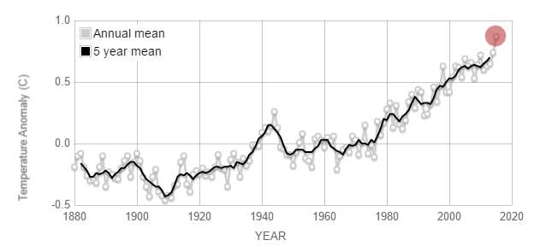
Trends in temperature
One key thing we need to do when we look at a graph is to look at the pattern of its overall direction. We can draw a line of best fit on the graph that helps us see the trend in the data being displayed.
Source:
http://climate.nasa.gov/vital-signs/global-temperature/
Notes:
4. (10 min) Have the students look at the graph and visualization of global temperatures.
Show the “Global Temperatures 1880s-Present” graph and visualization:
http://climate.nasa.gov/vital-signs/global-temperature/
Ask students to describe the trends they observe. Draw a line on the graph if the technology allows so that students can see the increasing trend and discuss the color change of the visualization (color change represents warming temperatures worldwide). Refer students back to their Do Now answers and have a discussion⁴.
Suggested Prompts:
Look back at your answers to the Do Now. Are these increased temperatures really a trend?
What kind of trend do we see in this data?
Now that we know there is a trend, is about 150 years of information enough?

Slide 8
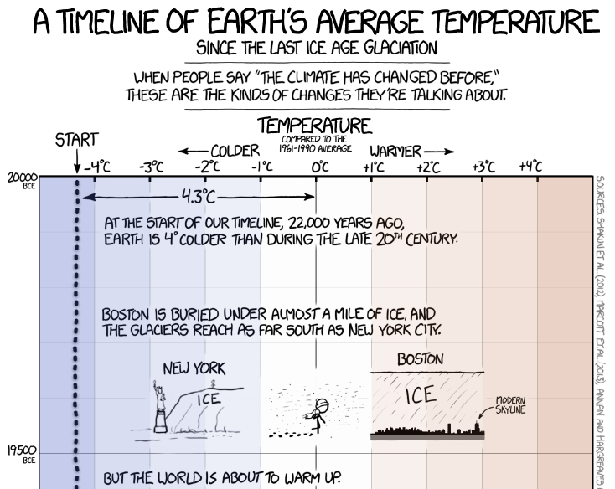
Do we have enough data?
In the past, we know that Colorado was once covered by a warm sea but it also was buried under ice during the last Ice Age.
To know more about Earth’s past temperatures, looking at 150 years of data is not enough information to see the trend of the world’s temperature.
We need to look at more data about past temperatures on Earth!
Read “A Timeline of Earth’s Average Temperature” graph Strip
Notes:
5. (20 min) Once you have completed the discussion, students should have said that 150 years is not enough time to know the Earth’s average temperature compared to the age of the Earth (4.5 billion years).
Show “A Timeline of Earth’s Average Temperature” infographic to explore further back in time:
https://xkcd.com/1732/
and downloadable file (click on image to zoom in)
https://imgs.xkcd.com/comics/earth_temperature_timeline.png
Slowly scroll through the comic and highlight the temperature and important events in the world. Ask students what the temperature trend is like (VERY slow, steady increase in temperature or moving to the right of the graph, the warmer it gets). At the end of the graph point out the 1800s (where the graph from the previous slide started). Ask students to describe what the temperature is like from this point on to the present point (super sharp increase in temperature).
After going over the graph, show the short video “Earth’s Temperature as a Rollercoaster”:
https://www.climate.gov/news-features/videos/earths-temperature-history-roller-coaster
Suggested Prompts:
Has the Earth’s temperature changed over a longer period of time (starting during the last ice age 22,000 years ago to present)?
What things do you notice about the trend of Earth’s temperature over a longer period of time (22,000 years vs. 200 years)?
Are there any key events or changes that stand out in this graph? (start of Ind. Rev., fossil fuel use, etc.)
Was there ever an increase that quickly in the first part of the timeline?
How do we know the temperatures from before we had thermometers to measure it?
Listen for student responses such as:
No. There was a slow increase throughout the whole comic, but then right at the end there was a sharp increase.

Slide 9
Where is the data coming from?
We are wondering how scientists know what the temperature was before scientists could record temperatures.
Read the paragraph on your student sheet and answer the question that follows.
Notes:
6. (10 min) Once you have completed the discussion around there being a gradual increase, but not really knowing where that data comes from, have students read the paragraph on Ice Cores in their Student Activity Sheet and summarize or draw what they read.
Suggested Prompts:
What do you notice in this diagram?
What do you wonder about?
What’s in here that can help us see if there’s a link between activities humans do and temperature?
Listen for student responses such as:
Scientists drill into ice and can find out the amount of CO₂ that was in the atmosphere at a certain time. The further down they drill the older the ice, so they can determine what the atmosphere was like thousands of years ago. There is a relationship between CO₂ and temperature, so they can calculate the temperature from the amount of CO₂ in the ice. Looking back at the comic, there was the industrial revolution, airplanes, and more fossil fuel usage that was happening around 1700-1800.
How the heck do scientists know?
Have students analyze some ice core data -- see what it looks like, or watch a video about it: cleanet.org: https://www.youtube.com/watch?v=oHzADl-XID8. It clearly explains the relationship between CO₂ and temperature, which is fine at this point.

Slide 10
Why the big jump?
We noticed this point on the graph that seemed to happen right before the intense temperature increase, so what is it?
Independently read the summary on your student activity sheet silently, and answer the questions that follow the reading.
Notes:
7. (10 min) Students pointed out the Industrial Revolution, but what is that? Have students read the half page in their Student Activity Sheet and record what they notice and wonder about ⁵ in the box underneath the reading. Push students thinking that the sharp increase really did not happen until humans started mass production of things in cities.
Suggested Prompts:
What did you notice about the Industrial Revolution?
What are you still wondering about?
Listen for student responses such as:
There were a lot more people coming to the cities in the Industrial Revolution and they were building a lot more factories that were releasing the CO₂. They were also increasing their transportation by cars and inventing trains to transport the things that they made.
Conclusion: “What have we figured out so far?” (next slide)
Suggested Prompts:
What did we find out after we watched the trend video?
What kind of trend did we decide is happening to our temperatures?
What other questions do we have about the increase in temperatures on Earth?
Listen for student responses such as:
We figured out that trends are patterns that happen over time. We found out that the Earth has been very slowly warming, but there was a super crazy sharp increase in temperatures around the time of the Industrial Revolution, which has us thinking that humans and the factories have something to do with the increase in temperature.
We also found out that scientists get this data from ice cores because the further you drill down, the older the ice (called superposition) and we can find out the amount of CO₂ from these cores. We still aren’t sure how the amount of CO₂ fits into the increasing temperatures that we have seen recently, so we will need to investigate what types of things release CO₂.
Record and post what we figured and what we are wondering on the Driving Questions Board.

Slide 11
What did we figure out?
What did we find out after we watched the trend video?
How do scientists find out what Earth’s temperature was in the distant past?
How did the Industrial Revolution change life for people?
What kind of trend did we decide is happening to our temperatures compared to the Earth’s past temperatures?
Notes:
7. (10 min) Students pointed out the Industrial Revolution, but what is that? Have students read the half page in their Student Activity Sheet and record what they notice and wonder about ⁵ in the box underneath the reading. Push students thinking that the sharp increase really did not happen until humans started mass production of things in cities.
Suggested Prompts:
What did you notice about the Industrial Revolution?
What are you still wondering about?
Listen for student responses such as:
There were a lot more people coming to the cities in the Industrial Revolution and they were building a lot more factories that were releasing the CO₂. They were also increasing their transportation by cars and inventing trains to transport the things that they made.
Conclusion: “What have we figured out so far?” (next slide)
Suggested Prompts:
What did we find out after we watched the trend video?
What kind of trend did we decide is happening to our temperatures?
What other questions do we have about the increase in temperatures on Earth?
Listen for student responses such as:
We figured out that trends are patterns that happen over time. We found out that the Earth has been very slowly warming, but there was a super crazy sharp increase in temperatures around the time of the Industrial Revolution, which has us thinking that humans and the factories have something to do with the increase in temperature.
We also found out that scientists get this data from ice cores because the further you drill down, the older the ice (called superposition) and we can find out the amount of CO₂ from these cores. We still aren’t sure how the amount of CO₂ fits into the increasing temperatures that we have seen recently, so we will need to investigate what types of things release CO₂.
Record and post what we figured and what we are wondering on the Driving Questions Board.

Slide 12
What do we need to do next?
How do you think human activities which started in the Industrial Revolution and the world’s increasing temperature are related?
Notes:
8. (5 min) Before dismissing students, ask student to brainstorm what our next steps should be in our investigations.⁸
Suggested Prompts:
What should make sure to do in our next science class?
What do we need to investigate next time we meet for science?
Listen for student responses such as:
We need to find out if human activities since the Industrial Revolution release CO₂ and cause Earth’s temperature to rise.

