Slide 1
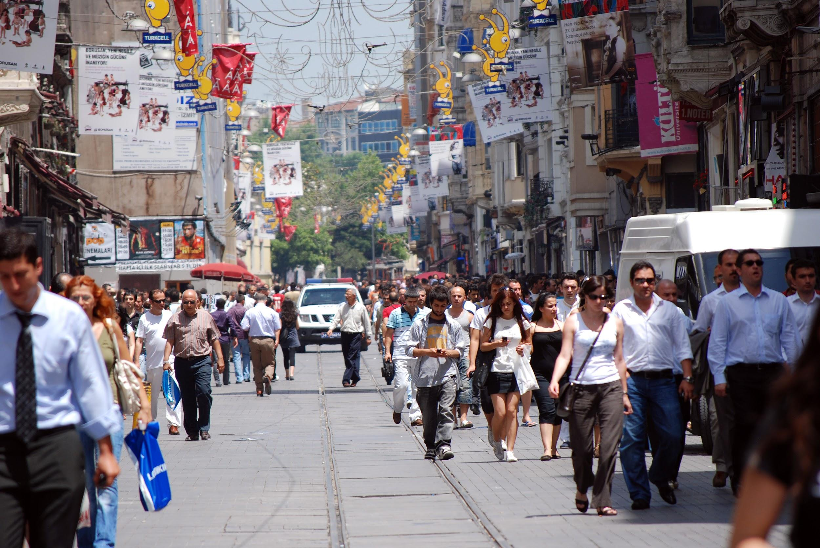
How does human activity affect the trend of warming temperatures on Earth?

Slide 2
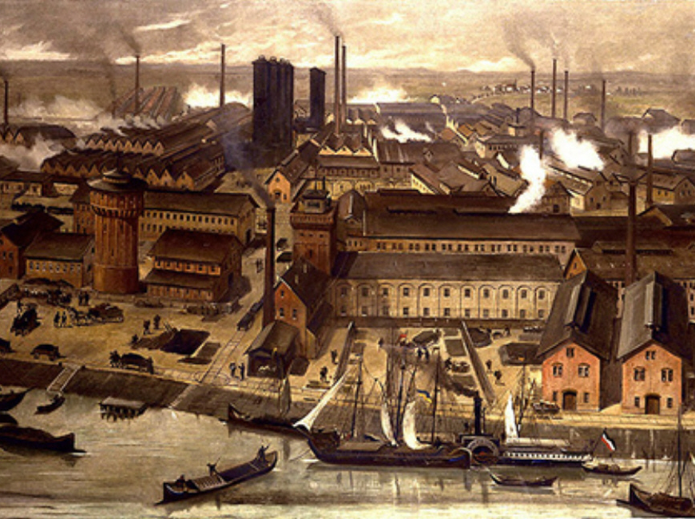
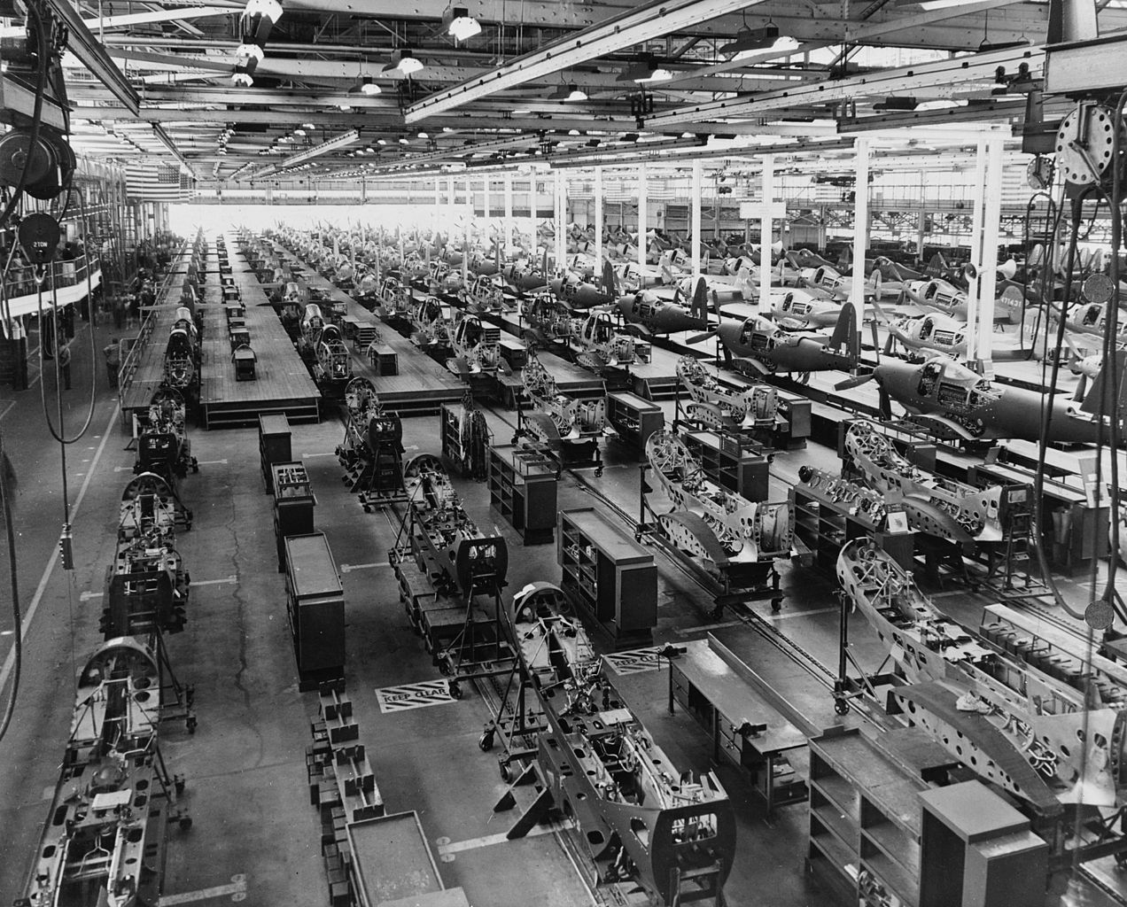
Do Now
What did we figure out last time about the trend of Earth’s temperature in the past?
What are we now wondering about?
Notes:
(5 min) Hand out Student Activity Sheets to each student and begin with a Do Now to activate students’ previous knowledge about human activities related to the Industrial Revolution. Have a Consensus Building Discussion ¹ to help reorient students in the storyline. Use the following prompts to help students articulate what they figured out in the last lesson. Students write down their responses on the Do Now section of their Student Activity Sheet.
Suggested Prompts:
What did we figure out last time?
What are we now wondering about?
Listen for student responses ² such as:
We learned that the Industrial Revolution started in the late 1700s (in the UK) to early 1800’s (in the US).
The world’s population has also increased a lot since the Industrial Revolution.
We also learned that ice cores tell us about the Earth’s past temperature and that the temperature has increased a lot since the start of the Industrial Revolution.
We’re wondering if human activities affect the Earth’s temperature since the graphs we looked at show that since the start of the Industrial Revolution, the temperature has increased a great deal and at a faster rate than in Earth’s past.

Slide 3
From the Industrial Revolution to now
How did the Industrial Revolution change human activities?
What “powered” the Industrial Revolution?
What is the connection between fossil fuels and CO₂?
How do you think we can explore the connection between fossil fuels, CO₂, and the Earth’s temperature?
Notes:
2. (5 min) Next, shift to a Sharing Initial Ideas Discussion ³, to guide students to articulate what they think they should focus on in today’s lesson. Focus on how they think post-industrial human activity is related to the increase in temperatures on Earth. Propose the question "How would data show us that fossil fuel use by humans is causing the trend of warming global temperatures?" to direct students’ learning toward this lesson’s driving question.
Suggested Prompts:
How did the Industrial Revolution change human activities?
More resources, like fossil fuels, are being used since then. What are fossil fuels, where do they come from, what are they used for?
What is the connection between fossil fuels and CO₂?
How do you think we can explore the connection between fossil fuels, CO₂, and the Earth’s temperature?
Listen for student responses such as
Since the Industrial Revolution, people started using fossil fuels more.
Fossil fuels are mined and drilled from underground. They’re formed the remains of ancient plants and animals.
We’ve heard that fossil fuels release greenhouse gases (GHGs), like CO₂ and that they’re related to the greenhouse effect (GHE).
We should look at model of how CO₂ affects temperature.

Slide 4
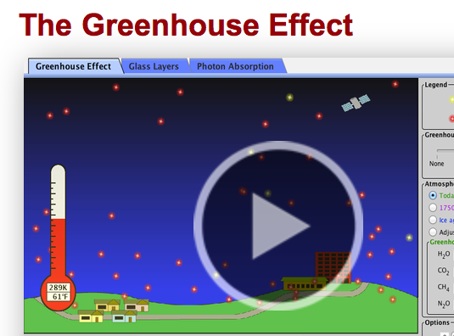
Modeling our world
What are simulations and models?
Why do we use them?
How do think a simulation or model can help us understand more about CO₂ and temperature?
Notes:
3. (20 min) As a whole class, explain that scientists use models to build understanding of phenomena (e.g. weather, climate). Project the PhET Greenhouse Effect simulation and explain that it is a model to explore what factors affect the Earth’s temperature. Give a brief introduction as to how the simulation works and explain the right sidebar features (legend, GHG concentration, time frame, temperature, etc.).
Direct students to observe what the status of CO₂ and temperature is at each time frame. Have them decide to go back or forward in time (Last Ice Age, 1750 start of the Industrial Revolution, Today or vice versa) and observe what happens to the variables, especially CO2 concentrations and temperature.
Suggest ways to alter the simulation to increase the temperature the most and the least—ask students to describe how CO₂ and temperature respond. Have students suggest changes to each variable in the simulation and describe the outcome that they observe and what they understand is happening as a result.
There are other GHGs listed, explore with them but keep the focus on CO₂ since that is the GHG of most concern for human activities in relation to global temperatures.
PhET The Greenhouse Effect simulation:
https://phet.colorado.edu/en/simulation/greenhouse
Next, have a whole class discussion to assess student understanding of the Greenhouse Effect by asking students to share out how the amount of CO₂ affects temperature (more CO₂, higher temperatures and less CO₂ lower temperatures). Ask students to complete the Exploring Greenhouse Gases simulation section of their Student Activity Sheet.
Now watch “The Greenhouse Effect” video to connect CO₂ and its role in the warming Earth:
https://cleanet.org/resources/42808.html
Check for understanding by asking students to give claims, evidence, and reasoning about the relationship between GHGs, the GHE, and Earth’s temperature. Students write down their responses on the Understanding GHGs and the GHE section on their Student Activity Sheet.
Suggested Prompts:
What did you notice when we explored the Greenhouse Effect simulation? What are the conditions of the GHGs when the temperature is the warmest, when it is the coolest?
What is the role of CO₂ in the atmosphere? Why is this important?
How do you think that having more people using more resources affects the amount of CO₂ in the atmosphere?
Listen for student responses such as:
CO₂ traps heat to warm the Earth. When the amount of this greenhouse gas (GHG) is changed the temperature changes.
There is naturally CO₂ in the atmosphere, which traps heat and allows life and liquid water to exist on our planet by keeping the planet at a habitable temperature.
It makes sense that if more fossil fuels are used for energy then more CO₂ is put in the atmosphere and temperatures will rise.

Slide 5
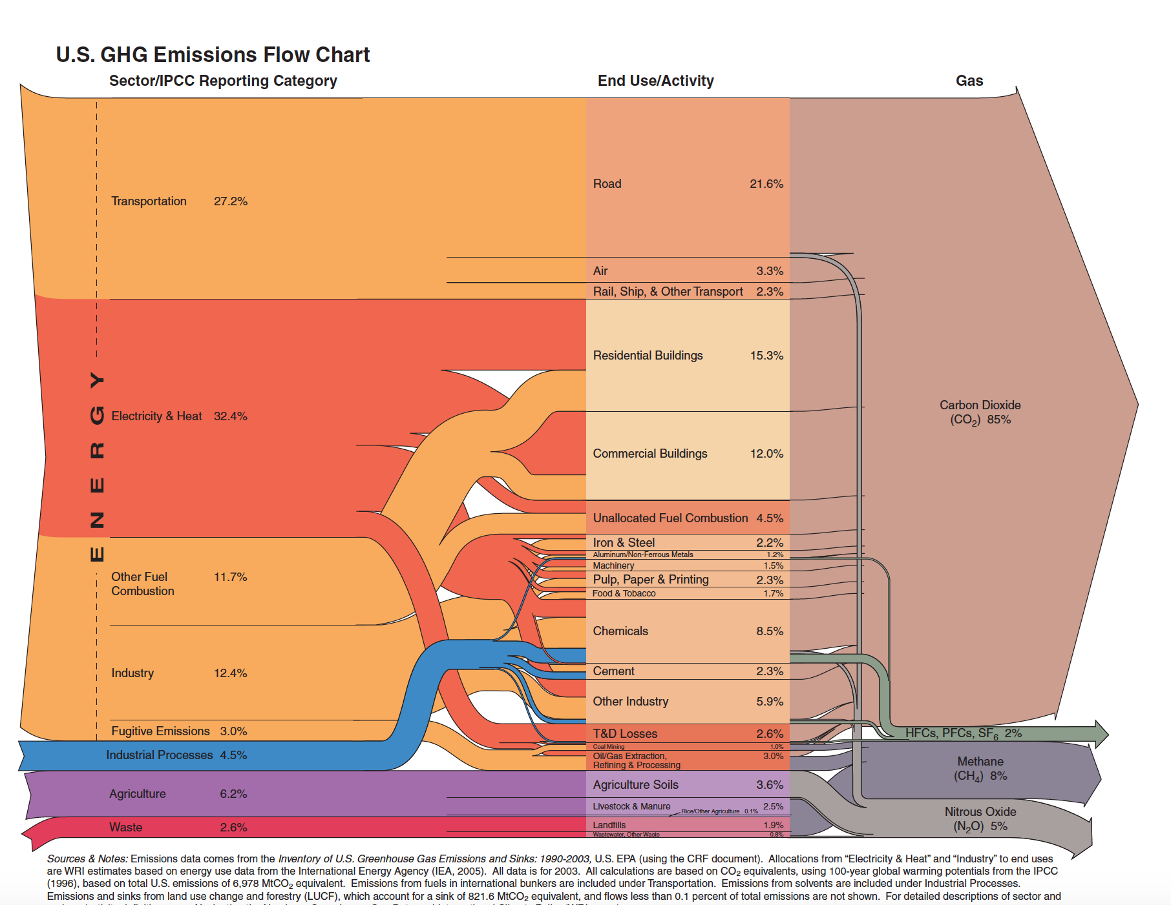
Humans, energy use, and greenhouse gases
We learned about greenhouse gases (GHGs) using the simulation, and we learned about how GHGs warm Earth through the Greenhouse Effect (GHE).
What human activities do you think produce the most GHGs?
Which GHG do you think humans emit (release) the most?
What happens to CO₂ after it is emitted into the atmosphere?
Notes:
4. (10 min.) Ask students to brainstorm human activities that use fossil fuels for energy and which activities they think produces the most CO₂.⁴ Hand out the Data Sheet to student teams to compare their responses to the “US Greenhouse Gas Emissions” chart (Figure 6.1): http://cleanet.org/resources/47840.html
Have students complete the Human Activities that Emit CO₂ and Other GHGs section in their Student Activity sheet and then share out what they learned from the GHG Emission chart.
Suggested Prompts:
What connections can you make about human activities and GHGs from the infographic?
What GHGs are emitted?
Which GHG is emitted the most?
Listen for student responses such as:
We emit GHGs mainly from transportation, electricity, generating heat, and industry..
GHGs include carbon dioxide, methane, and nitrous oxide, plus some others gases.
CO2 is emitted the most (85%) by human activities.
Now that students have a basic understanding about the GHE, GHGs and their sources ask students what they think happens to the CO2 after it is emitted (released) into the atmosphere. Accept all student ideas.
Next, show the “Following Carbon Through the Atmosphere” visualization:
https://www.nasa.gov/feature/goddard/2016/eye-popping-view-of-CO2-critical-step-for-carbon-cycle-science
Repeat the visualization and ask students to state what they observe happening to CO₂ once it is emitted into the air (CO₂ disperses through the atmosphere, most CO₂ is emitted in the Northern Hemisphere and stays there as that is where most people and industry are found).
Suggested Prompts:
What happens to CO₂ after it is emitted into atmosphere?
Where does it look like most of the CO₂ is coming from?
Listen for responses, such as:
CO₂ seems to be coming mostly from areas that have lots of people, which makes sense based on our previous lessons.
Carbon flows in a cycle, similar to how the water cycle works.

Slide 6
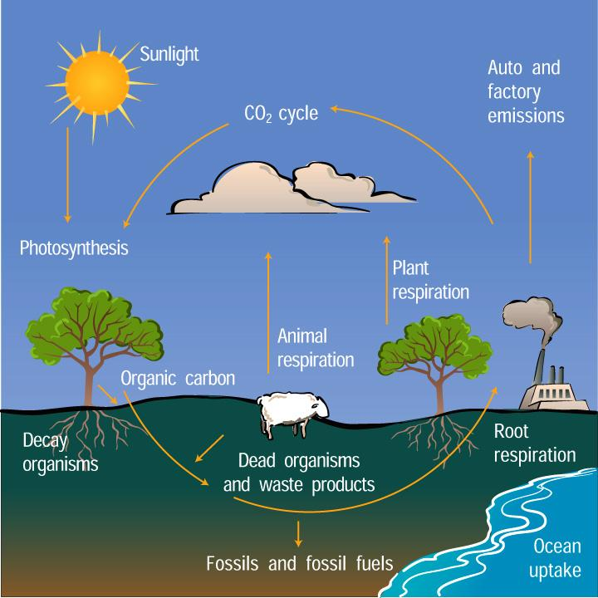
Carbon-go-round
What is the connection between carbon and carbon dioxide?
Where does carbon come from?
Where does carbon go?
Notes:
5. (45 min) Now bring in the concept of the Carbon Cycle by asking students where they think all of the extra CO₂ that is being emitted into the atmosphere originally came from, where the carbon in carbon dioxide comes from, and where it is going to end up (conservation of matter).⁵ Accept all student ideas.
Using the Data Sheets, review the basic Carbon Cycle diagrams (Figure 6.2 and Figure 6.3) and have students share out their observations. Have them write down their observations of what they can decipher from the images for where carbon is stored (sinks) and carbon dioxide is released (sources). Students write down their responses on the Connecting CO₂ and the Carbon Cycle section of their Student Activity Sheet.
Suggested Prompts:
Where is carbon stored (sink)?
Where is carbon released (source)?
Listen for responses, such as:
Carbon flows in a cycle, similar to how the water cycle works.
Carbon is stored in the atmosphere, ocean, and on land in plants, animals and the ground, etc.
Carbon is released from volcanoes, forest fires, factories, soils, plants and animals, etc.
CO2 flows around the world, most of it is released and stays in the Northern Hemisphere (that is where most people live and industry is located).
Introduce the online interactive “Carbon Dioxide and the Carbon Cycle”⁶
https://rmpbs.pbslearningmedia.org/resource/pcep14.sci.ess.co2cycle/carbon-dioxide-carbon-cycle/#
Give a brief demonstration on how to use the interactive. Students will work in partners to complete the investigation and answer the interactive on the application section of their Student Activity Sheet.
Have the interactive website url pre-bookmarked on student computers or tablets. If these resources are unavailable, then project it from the teacher’s computer/smartboard. If technology is not available, make color copies of each interactive slide packet for each team of two students:
After students have completed the interactive activity, ask them to explain what they now know about carbon, where and how much is stored (sinks), where and how much is released (sources), and describe how carbon moves from one part of the environment to another (atmosphere, geosphere, biosphere, hydrosphere), and consider what role natural events and human activities play in the cycling of carbon throughout Earth. Students write down their responses on the Connecting CO₂ and the Carbon Cycle section of their Student Activity Sheet.
Suggested Prompts:
Where and how much carbon and CO₂ is naturally stored and released on Earth?
Where does the carbon in CO₂ from fossil fuels originally come from?
How can we know that we are releasing CO₂ into the atmosphere from human activities that uses fossil fuels?
How do human activities affect the balance and flow of the Carbon Cycle?
Listen for responses, such as:⁷
We see that carbon is stored in different “reservoirs” on Earth (water, air, land, living things) and it is cycled throughout the Earth in different amounts and timeframes.
All living things have carbon in them. When these die they turn into fossil fuels after millions of years.
When humans use fossil fuels, which are stored underground in a sink, and burn them for energy the carbon is released by this process and acts as a source carbon dioxide in the atmosphere.
Human activities change the natural concentration of CO₂ in the atmosphere and the balance of the Carbon Cycle. Human activities act as a source that releases CO2 into the atmosphere , which is happening at a faster rate than natural processes can take it out of the atmosphere and store it.

Slide 7
Tracing the tracks of CO₂ in the Carbon Cycle
What stores carbon (sinks)?
What releases carbon (sources)?
Where does CO₂ “fit” into the Carbon Cycle?
Notes:
5. (45 min) Now bring in the concept of the Carbon Cycle by asking students where they think all of the extra CO₂ that is being emitted into the atmosphere originally came from, where the carbon in carbon dioxide comes from, and where it is going to end up (conservation of matter).⁵ Accept all student ideas.
Using the Data Sheets, review the basic Carbon Cycle diagrams (Figure 6.2 and Figure 6.3) and have students share out their observations. Have them write down their observations of what they can decipher from the images for where carbon is stored (sinks) and carbon dioxide is released (sources). Students write down their responses on the Connecting CO₂ and the Carbon Cycle section of their Student Activity Sheet.
Suggested Prompts:
Where is carbon stored (sink)?
Where is carbon released (source)?
Listen for responses, such as:
Carbon flows in a cycle, similar to how the water cycle works.
Carbon is stored in the atmosphere, ocean, and on land in plants, animals and the ground, etc.
Carbon is released from volcanoes, forest fires, factories, soils, plants and animals, etc.
CO2 flows around the world, most of it is released and stays in the Northern Hemisphere (that is where most people live and industry is located).
Introduce the online interactive “Carbon Dioxide and the Carbon Cycle”⁶
https://rmpbs.pbslearningmedia.org/resource/pcep14.sci.ess.co2cycle/carbon-dioxide-carbon-cycle/#
Give a brief demonstration on how to use the interactive. Students will work in partners to complete the investigation and answer the interactive on the application section of their Student Activity Sheet.
Have the interactive website url pre-bookmarked on student computers or tablets. If these resources are unavailable, then project it from the teacher’s computer/smartboard. If technology is not available, make color copies of each interactive slide packet for each team of two students:
After students have completed the interactive activity, ask them to explain what they now know about carbon, where and how much is stored (sinks), where and how much is released (sources), and describe how carbon moves from one part of the environment to another (atmosphere, geosphere, biosphere, hydrosphere), and consider what role natural events and human activities play in the cycling of carbon throughout Earth. Students write down their responses on the Connecting CO₂ and the Carbon Cycle section of their Student Activity Sheet.
Suggested Prompts:
Where and how much carbon and CO₂ is naturally stored and released on Earth?
Where does the carbon in CO₂ from fossil fuels originally come from?
How can we know that we are releasing CO₂ into the atmosphere from human activities that uses fossil fuels?
How do human activities affect the balance and flow of the Carbon Cycle?
Listen for responses, such as:⁷
We see that carbon is stored in different “reservoirs” on Earth (water, air, land, living things) and it is cycled throughout the Earth in different amounts and timeframes.
All living things have carbon in them. When these die they turn into fossil fuels after millions of years.
When humans use fossil fuels, which are stored underground in a sink, and burn them for energy the carbon is released by this process and acts as a source carbon dioxide in the atmosphere.
Human activities change the natural concentration of CO₂ in the atmosphere and the balance of the Carbon Cycle. Human activities act as a source that releases CO2 into the atmosphere , which is happening at a faster rate than natural processes can take it out of the atmosphere and store it.

Slide 8
Human activities and the Carbon Cycle
What is the connection between human activities, CO₂, and the Carbon Cycle?
What impact do greenhouse gases emitted from human activities have on the global temperature?
Notes:
6. (15 min) Ask students to think about how this change in the Carbon Cycle balance from adding more GHGs to the atmosphere is changing how the Greenhouse Effect (GHE) works.
Suggested Prompts:
How do you think human activities that burn fossil fuels, which release carbon in the form of CO₂, affects the levels of GHGs in the atmosphere and how the Greenhouse Effect works?
Listen for student responses such as:
Human activities that burn fossil fuels add more CO₂ to the atmosphere and that causes the GHE to trap even more heat and warm the Earth more.
As a class, watch and then discuss the basics of GHGs, the GHE, and what adding more CO₂ to the atmosphere from burning fossil fuels does to the natural balance of Earth’s temperature.
“Climate Change Basics” video: http://cleanet.org/resources/45172.html
Have a whole class share discussion to assess student understanding of GHGs, the natural GHE and how human activities that release more GHGs are causing an enhanced or amplified GHE, which results in global warming. Bring in the opportunity to discuss ideas and solutions on how humans can also think of ideas and solutions to address the observed human-caused climate change. Students complete the CO₂ to Climate Change Connections section on their Student Activity Sheet.
Suggested Prompts:
What is the main source of of additional CO₂ that is being added to the atmosphere?
How does this change the Greenhouse Effect?
What does this change do to the temperature of Earth?
What can we do to change the amount of CO₂ that we release into the atmosphere and the effects of it?
Listen for student responses such as:
Greenhouse gases are naturally occurring and good but humans are increasing the amount of them, especially CO₂, in the atmosphere by burning fossil fuels.
The Greenhouse Effect is getting stronger since more CO₂ is being added by humans to the atmosphere.
The Earth’s temperature is rising because more GHGs, like CO2, are in the atmosphere because of humans burning fossil fuels.
We can reduce our use of fossil fuels and conserve energy to slow down global warming.

Slide 9
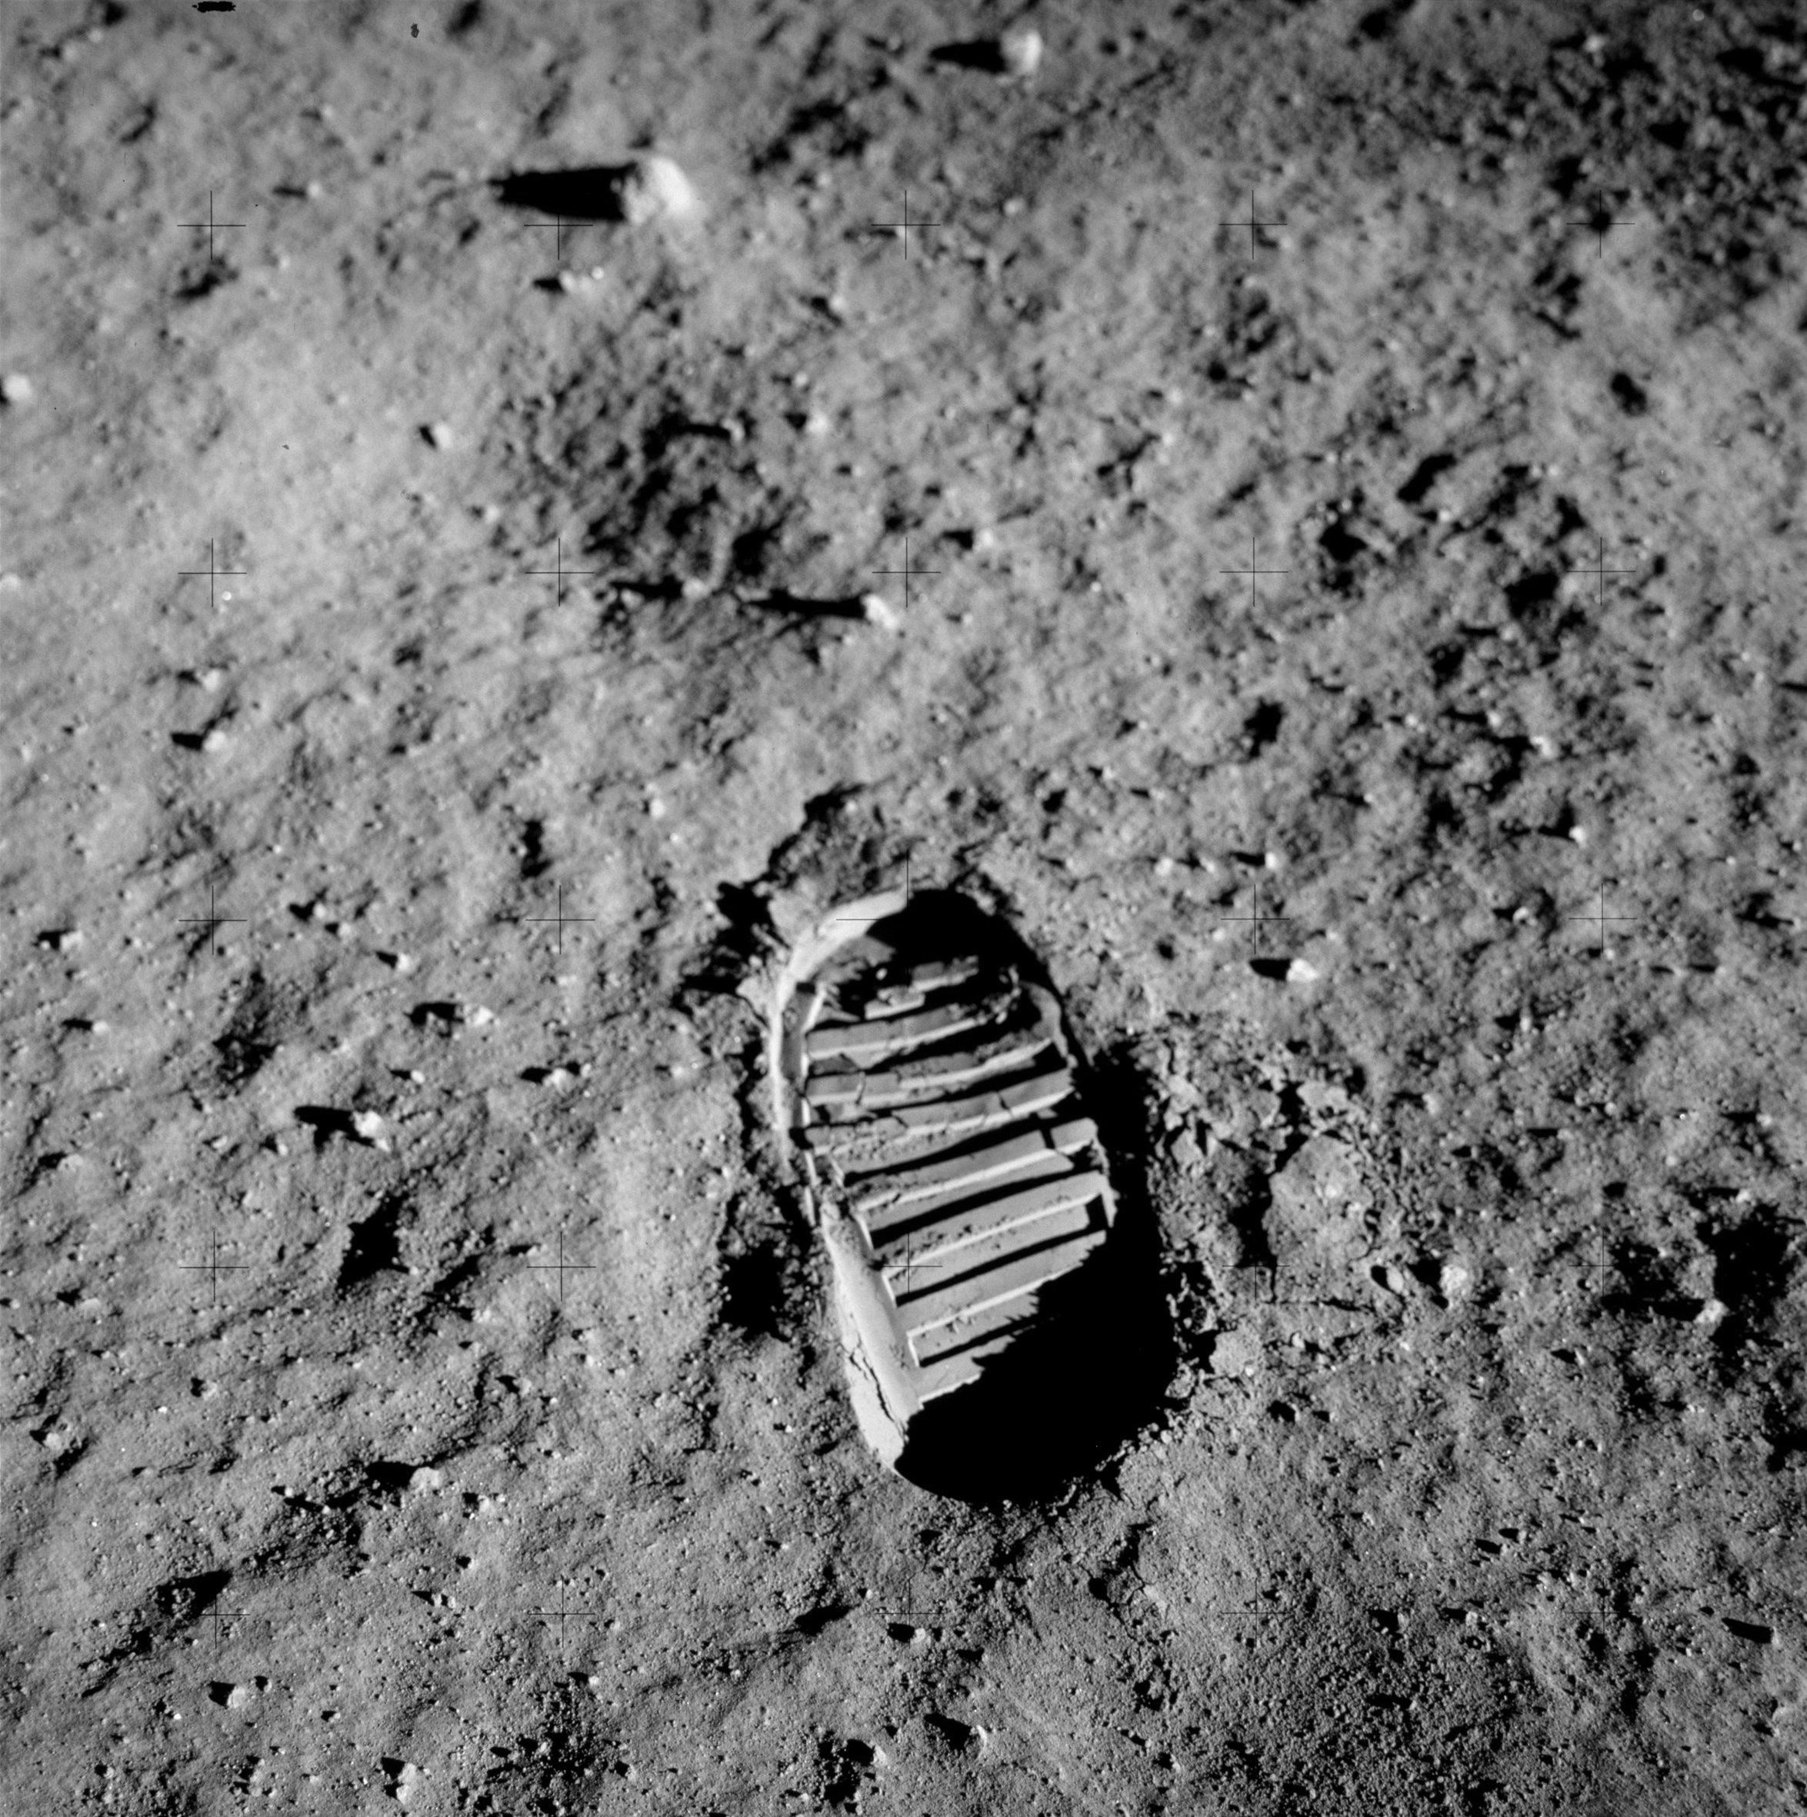
Next steps
What should we investigate next to understand how temperatures on Earth are warming?
Notes:
7. (5 min) It is now time to ground the students in the process (focus question) and decide on the next step moving from a correlational connection to a causal mechanism. Students write down their responses on the Next Steps section of their Student Activity Sheet.
Suggested Prompts:
What have we figured out so far?
Does this bring us closer to connecting human activity to the global temperature trend?
What from our list of human activity might help us connect the two? Or maybe you have a different idea from what is on the list.
Listen for student responses such as:
We figured out that human population has increased and more people means more energy use.
Energy use, mainly from fossil fuels, has also increased a lot so more GHGs are emitted.
Fossil fuels release GHGs, like CO₂, and they trap heat warming the atmosphere and Earth.
Humans use a lot of fossil fuel energy, but we can take action to reduce their use and effects.
8. (5 min) Ask students to brainstorm what our next steps should be in our investigation.⁸
Suggested Prompts:
What should make sure to do in our next class?
What should we investigate next to understand how temperatures on Earth are warming?
Listen for student responses such as:
We should do an investigation that shows CO₂ traps heat and causes the temperature to rise.
Let’s make a model that shows more CO₂ in the air causes warmer temperatures.

