Slide 1
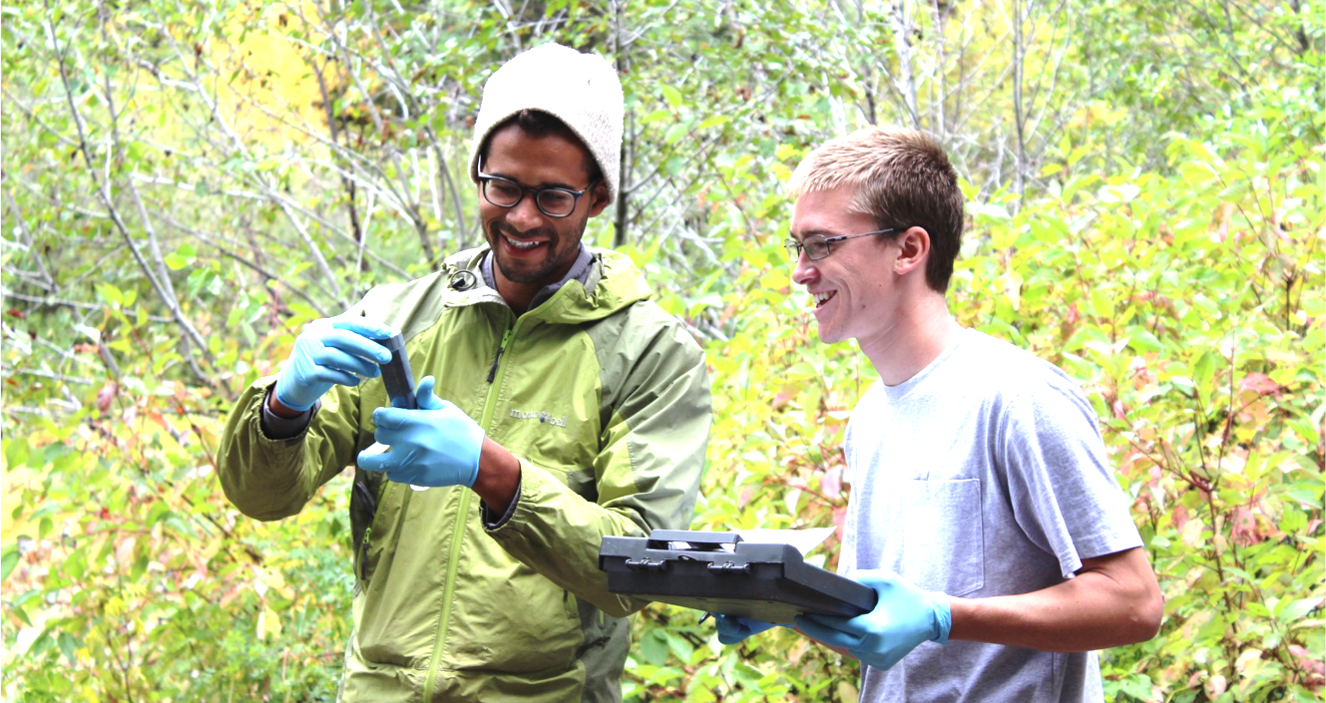
Bringing Science to the Table
October 20, 2016
Rajul Pandya¹, Susan Sullivan², Ben Kirshner³
¹American Geophysical Union, Thriving Earth Exchange (TEX)
²Cooperative Institute for Research in the Environmental Sciences (CIRES)
³CU Engage, University of Colorado Boulder
The Engaged Scientist Series is hosted by the new Albert A. Bartlett Center for Science Communication, CIRES Education and Outreach, INSTAAR, and the Office for Outreach and Engagement (OOE). Funding is provided from OOE.

Slide 2
Goals for this workshop
Develop knowledge of how to approach and scope a community research project
Learn how to pitch a project to an organization
Be able to anticipate some common issues and possible solutions
Define your own idea of what you would like to do
Get connected with like-minded colleagues

Slide 3
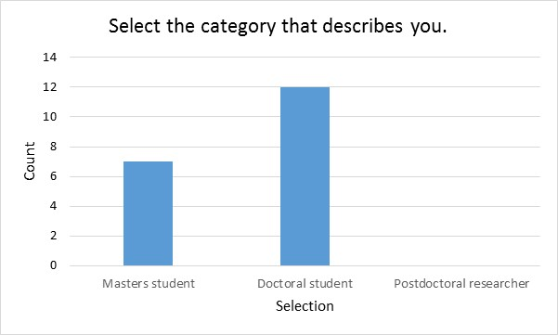
Who is in the room?
Aerospace engineering sciences
ATLAS
Atmospheric and Oceanic Sciences (ATOC)
Civil, Environmental, and Architectural Engineering
Environmental Studies
Geography
Geological Sciences
Molecular, cellular and developmental biology
Others?

Slide 4
What are your interests?
…using academic work to solve problems in our society.
…talking to policy-makers as well as the public…
…communicating climate change and scientific research via videos.
…how to engage the public without becoming confrontational
I'm really looking forward to learning more concrete skills for community engagement.

Slide 5
Get started
Handout-don’t put your name on it!!!
What answers do you have for question 1?
Some examples of question 2?
Some examples of question 3?

Slide 6
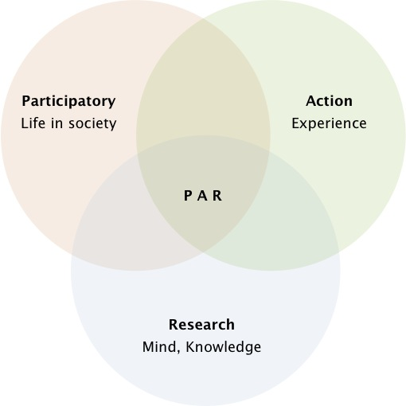
What is Community Engagement?
Citizen science possibly
Service learning possibly
Community science
Participatory action research
What else?
What is it not?

Slide 7
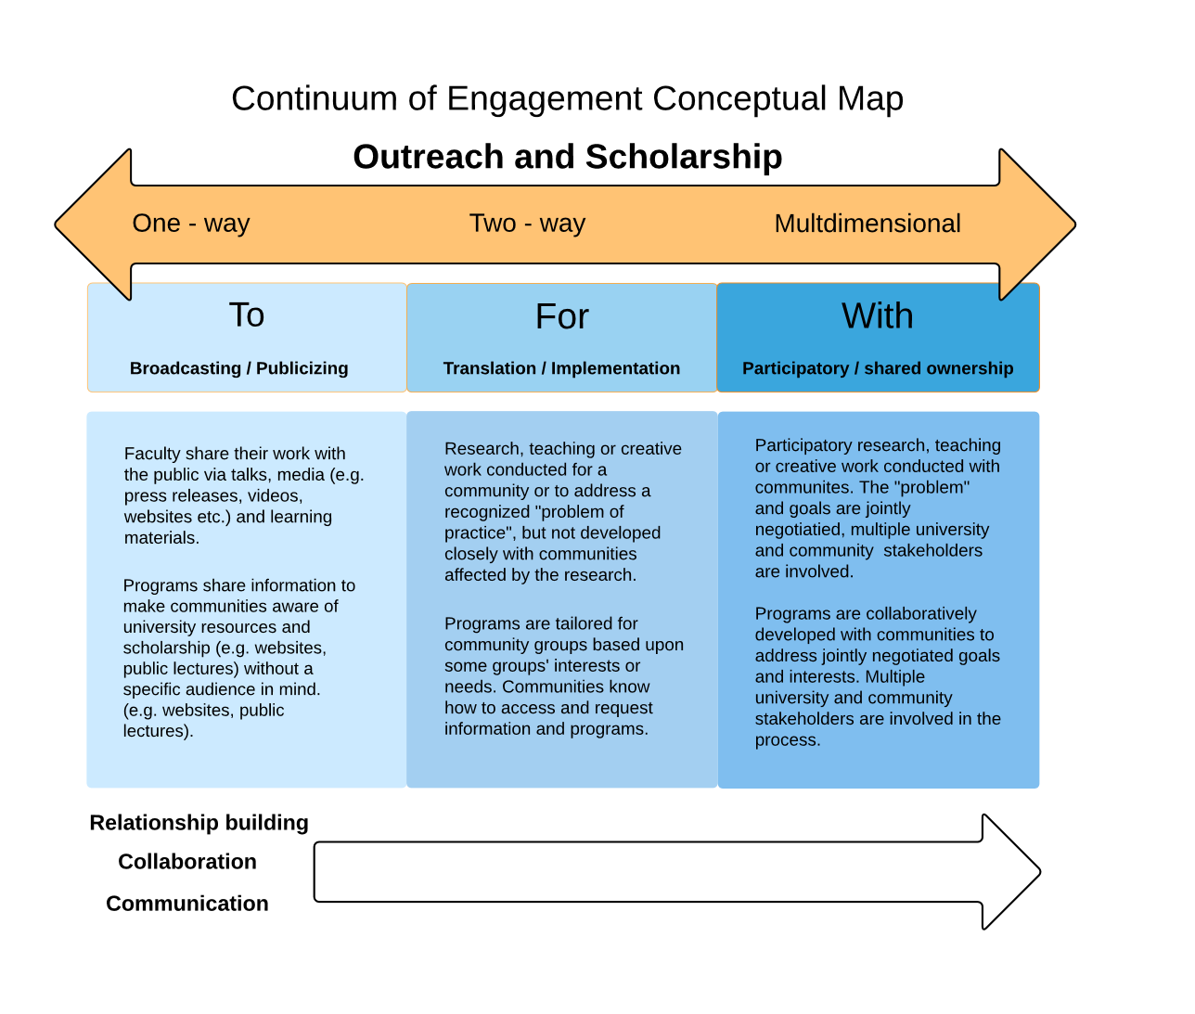

Slide 8
What are some things you need to know and be able to do in your community engagement?
Write on a post-it, add to the wall
  Need to know
  Need to be able to do

Slide 9
The Scoping Conversation-asking questions
Learn to ask questions that get at important aspects of the problem and solution.
Goal: Develop understanding to jointly propose appropriate next steps.
Types of questions:
Q. About who should be included
Q. About community and community capability/expertise
Q. About geoscience-relevant community issues
Q. That get at the scientist’s role
Other aspects?

Slide 10
The Scoping Conversation
Take a few minutes to write questions on your post-its
Put the post-its up on the wall
Walk around and read everyone’s questions
Which do you want to ask in the next round with your “community partner”?

Slide 11
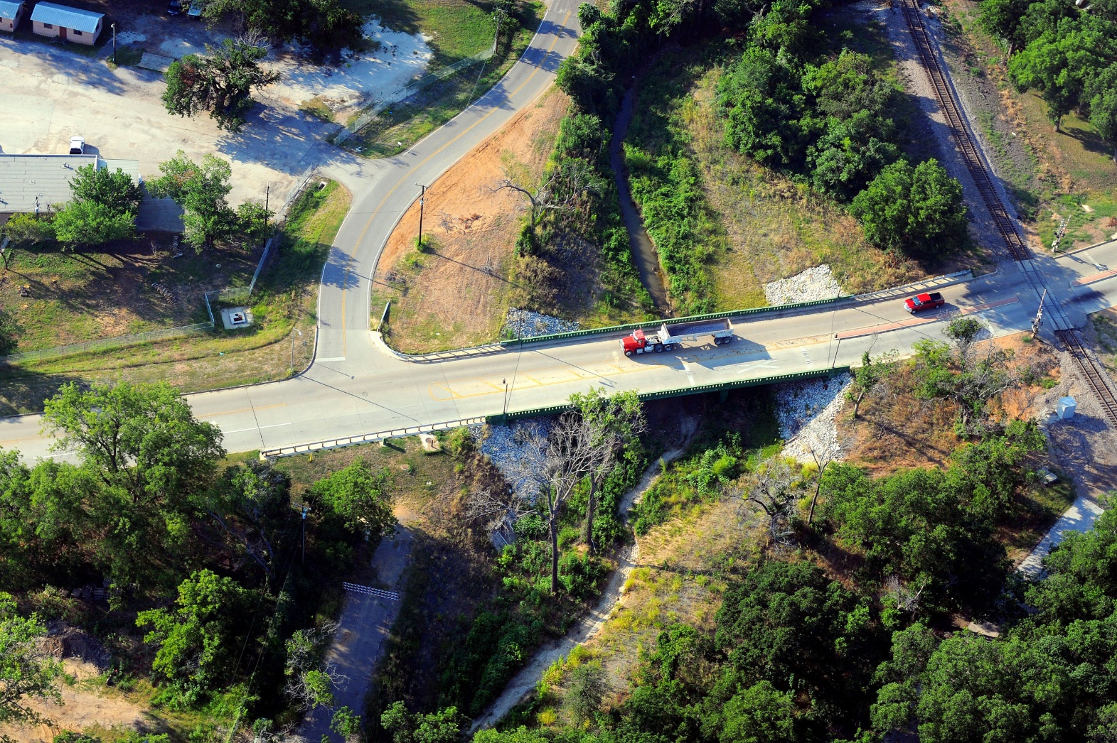
Scoping a project: Kennendale, TX

Slide 12
The Scoping Conversation
Get in groups of 4 (with your “community partner”)
Ask questions in each of the categories as long as time allows. Note answers briefly on your template.
With 5 minutes left, be sure you can report out:
  What is a quick synthesis of what you learned? 2-3 sentences
Report out (briefly!)

Slide 13
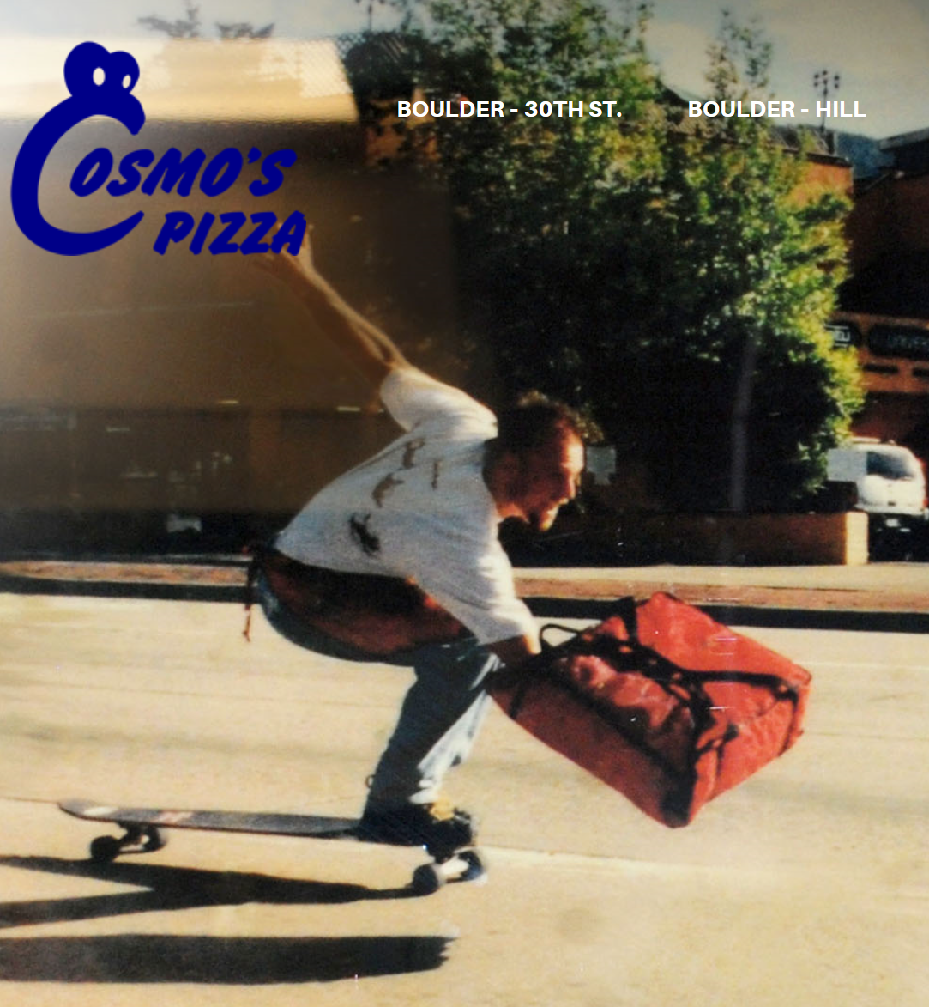
Dinner
What time are we back here?
Pass out pitch handouts

Slide 14
Making Pitches: Kennendale, TX

Slide 15
Making Pitches
Important to offer options
Projects you could do in up to 3-4 uninterrupted weeks if you had everything (translates into about a year at ½ day a week or so)
Things that will make a concrete difference or inform a real decision
Things that are delivered in the format/way that the audience is used to
Not necessarily something publishable

Slide 16
Making a Pitch: Kennendale, TX
Scan the handouts
  Making a pitch
  Backgrounder on Kennendale, TX
In groups, brainstorm ideas for project pitches
Write down your top 2, put them on the wall
Report out

Slide 17
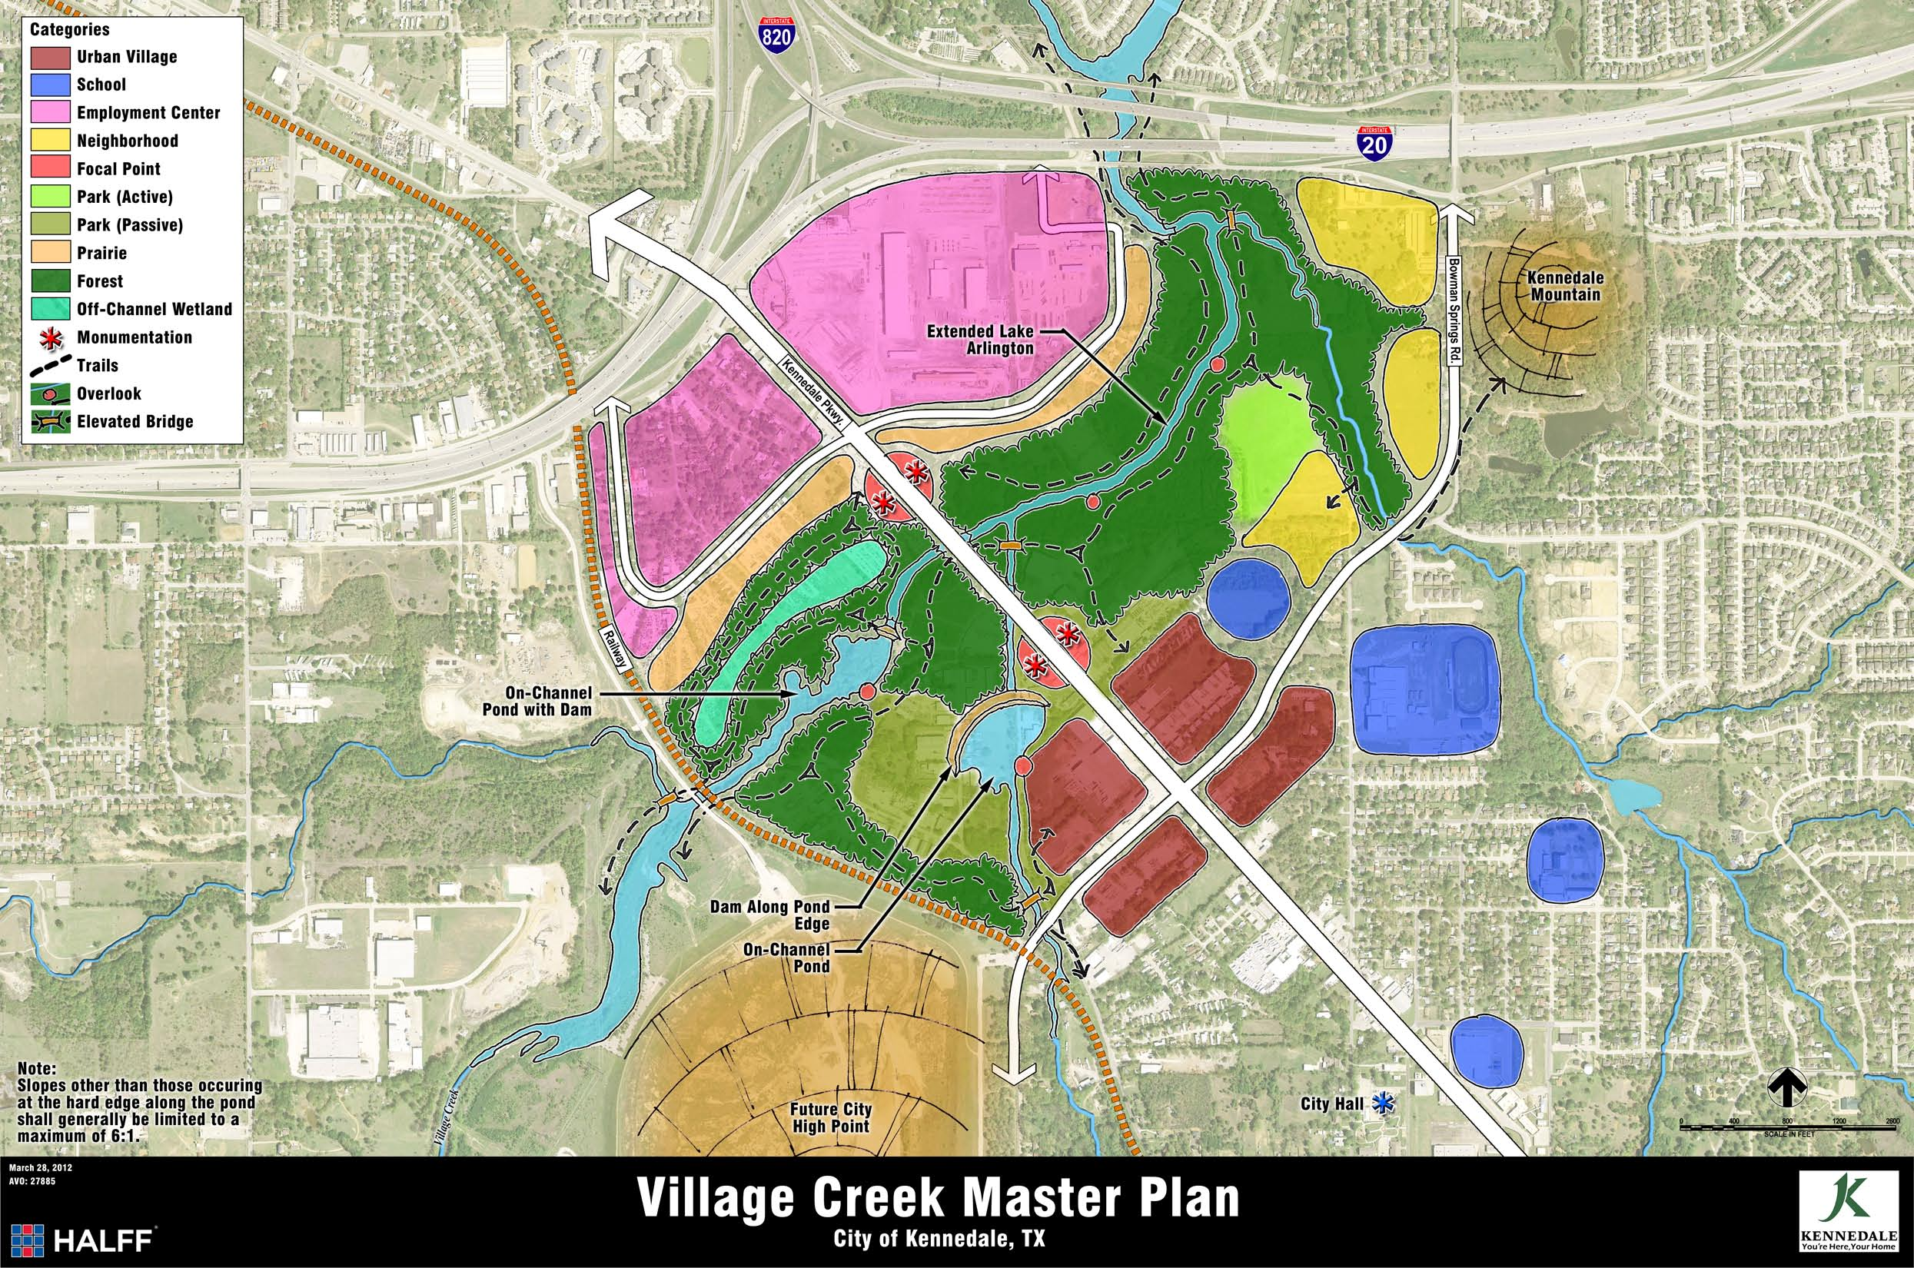

Slide 18
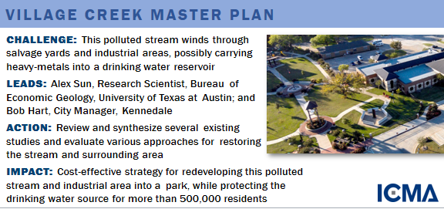
So what happened in Kennendale?

Slide 19
Troubleshooting
Some trouble shooting strategies:
  Presume good intent
  Listen
  Ask questions
  Be solutions oriented
  Try to understand their perspective
  What else?

Slide 20
Troubleshooting
Get in new groups
Pick a few trouble scenarios to work with
Write some solutions on post-its
Put them on the appropriate big post-it
Walk and see what others did
Discuss

Slide 21
Community Partner Wanted
Describe yourself
Describe your ideal partner
Describe ideals of place and time.

Slide 22
What are some things you need to know and be able to do? (Part 2)
Add anything that isn’t there
Add a dot to your top 3 priorities.

Slide 23
Wrap up
What were big takeaways?
What else do you want in future workshops?
Optimal days/times?
Save the Date-January 19, 2017
Evaluation please!
  Link: https://www.surveymonkey.com/r/EngagedScientistPostWorkshop
  Paper

Slide 24

Contact us
Rajul Pandya (rpandya@agu.org)
Ben Kirshner (ben.kirshner@colorado.edu)
Susan Sullivan (Susan.Sullivan@Colorado.edu)
Resources on end slide

Slide 25
Resources from Raj
https://depts.washington.edu/ccph/pdf_files/EducforHealthIsrael.pdf Raj’s favorite; kind of policy heavy but implies great practices for community research.
Some other articles Raj really likes are:
http://www.sciencedirect.com/science/article/pii/S0959378010001093
Ballard, H. L., and L. Huntsinger, L. (2006), Salal harvester local ecological knowledge, harvest practices and understory management on the Olympic Peninsula, Washington, Human Ecol., 34(4), 529–547.
Berkes, F. (2004), Rethinking community-based conservation, Conservation Biol., 18(3), 621–630.
Holton, G., and G. Sonnert (1999), A vision of Jeffersonian science, Iss. Sci. Tech., 16(1), 61–65.
http://www.pnas.org/content/100/14/8086.full
Shirk, J., H. Ballard, C. Wilderman, T. Phillips, A. Wiggins, R. Jordan, et al. (2012), Public participation in scientific research: A framework for deliberate design, Ecol. Soc., 17(2), 29
http://www.pacificdisaster.net/pdnadmin/data/original/Macquarie_2008_participatory_research_DRR.pdf
One more – thought provoking diagnosis with a high-level suggestion for new approaches. Pretty new…
http://www.thenewatlantis.com/publications/saving-science

