Slide 1
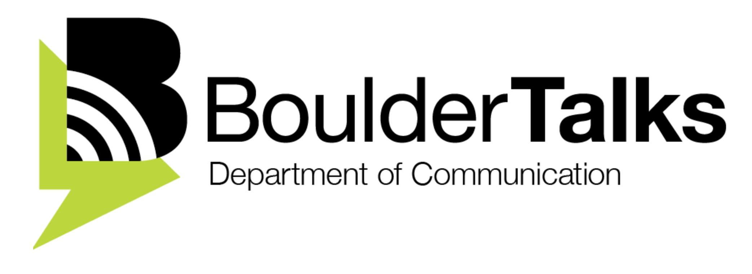
Scientists, Communication,
& Publics
Phaedra C. Pezzullo
Associate Professor &
Director, BoulderTalks
Leah Sprain
Assistant Professor &
Co-Director, BoulderTalks
Uses & Practices of Community Dialogue in Geosciences & Environmental Sciences
Engaged Scientist Series: CIRES Public
Notes:
Stories from the field as part of public lecture. Practical uses for community dialogue. Best practices. May not have been told before re: a sensitivity of engaging communities. (another workshop on equity/diversity) Me; we all bring knowledge to the table.
Shift perceptions, raise awareness, give concrete practical adviCe grounded in professional expertise.
Useful to position community dialogue in the spectrum of roles.
Last workshop: they say we want to know more about communication, but not what they mean. Media, community dialogue water resource manager, title is community dialogue so you can focus on community dialogue. Not about giving a good talk or decision makers. Need training on engaging w communities focus.
Scientists being trained to be part of a broader team engaged in community dialogue?
Good advice: we recommend you look for partnership w this expertise to work on community dialogue…
Next step resources if they want to incorporate this in their future work
Understand this work is possible for scientific careers. Also meet others on campus interested. In scope for an academic career.
Speaking to the choir: maybe one slide on how public engagement is needed…good things can happen…stronger science or more useable/translatable science can get done… (not long to set the stage)
Most important to talk & practice… some expert role, some want to have convo as peers

Slide 2

OVERVIEW
PUBLIC LECTURE (4-5PM)
DINNER (5:30-6PM)
PRAXIS WORKSHOP:
ENGAGEMENT THEORY IN PRACTICE (6-8:30PM)
Notes:
Today, we want to talk about how scientists communicate in the public sphere in a way that engages publics
4-5pm public lecture
5:15-5:45pm Dinner.
5:45pm Intro again. Agenda.
We share learning goals.
5:50-6:20pm Video Warm Up: Critique of what we’re seeing/hearing compared to previous best practices (most will go to both). 10 minute video with written transcripts. Small group to large group Discussion of Shared Sense Making
6:20-7pm Application worksheet. Types of community dialogues could fit in that research. (Public dialogue roles: expert testifying, convene a stakeholder group…
topics you are working on? Why engage public dialogue? What stakeholders would need to be involved? How does that fit into large decision-making?)

Slide 3
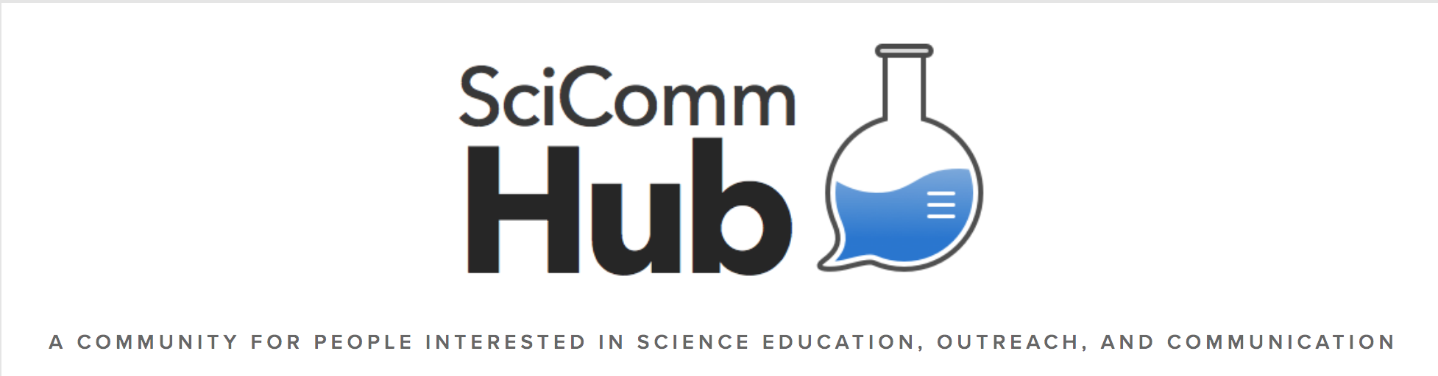
“One need only consider the controversies surrounding climate change, vaccinations, and genetically modified food to understand that learning to communicate better with the public is a worthwhile endeavor.
Whatever the reason may be for scientists sticking to the deficit model,
it should not be a deficit in knowing about communication theory.”
— co-founder of SciComm Hub Amanda Freise (2016 )
Notes:
Communication as a discipline doesn’t get a lot of respect because everyone does it everyday. But, in fact, folks who study communication theory have spent more time than most thinking about why, how, & to what ends we communicate. This quote is from the co-founder of SciComm Hub. As she notes, science increasingly finds communicating with the public a part of your job. Today, we want to talk about some fundamentals of communication theory that we think helps scientists.
“One need only consider the controversies surrounding climate change, vaccinations, and genetically modified food to understand that learning to communicate better with the public is a worthwhile endeavor. Whatever the reason may be for scientists sticking to the deficit model, it should not be a deficit in knowing about communication theory.”
— co-founder of SciComm Hub Amanda Freise (2016 )
Amanda Freise, July 19, 2016, “It’s Time for Scientists to Stop Explaining So Much,” Scientific American (Blog). Available at: https://blogs.scientificamerican.com/guest-blog/it-s-time-for-scientists-to-stop-explaining-so-much/

Slide 4
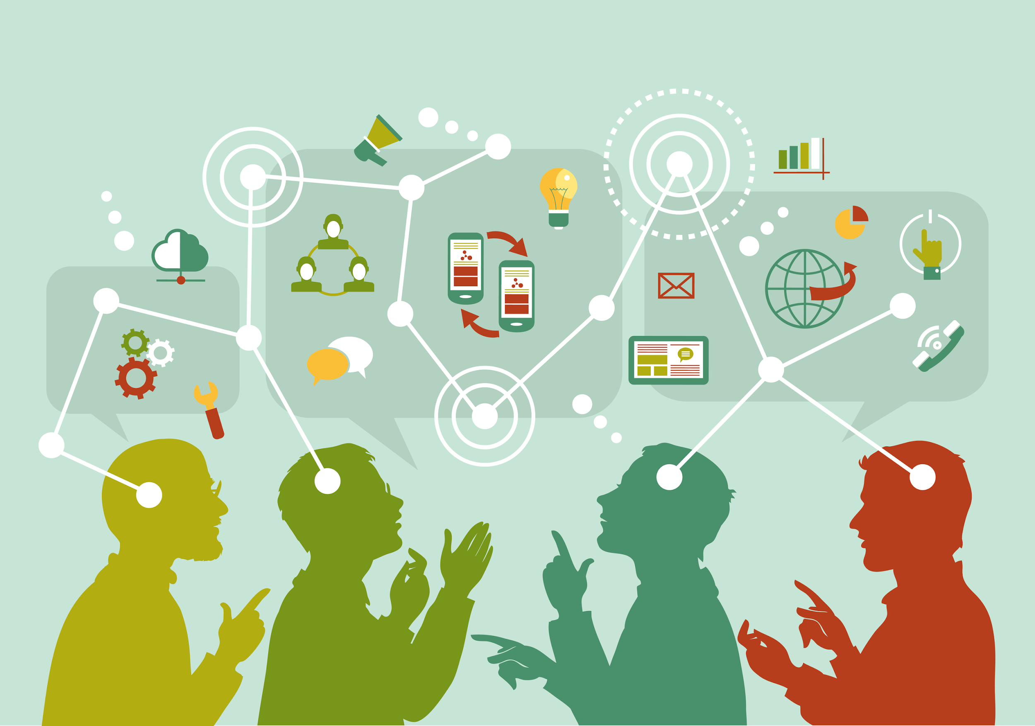
Communication
Systems
Are Complex
Notes:
We live in an age with more communication about more topics, with more people, across greater distances, through a wider variety of mediums than ever before.
And, yet, we aren’t necessarily fostering more knowledge or stronger communities.
(image source: http://www.personalbrandingblog.com/wp-content/uploads/2014/12/shutterstock_218342101.jpg )
1. Communication systems are complex
2. The Public Sphere is not monolithic
3. Public Engagement is not monolithic
4. Stakeholders…

Slide 5
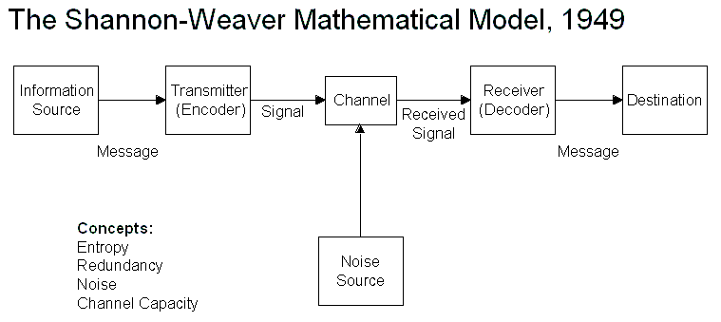
One-Way Communication
Notes:
COMMUNICATION SYSTEMS ARE COMPLEX. Useful to share information & create big data. Ex., I will design a diagram from my data and share it online; it will circulate and the universe will do as it wishes with it.
IMAGE SOURCE: https://cyberneticsmact210.wikispaces.com/Shannon+Weaver+Model+of+Communication

Slide 6
Information deficit model of communication
Assumes “the public” just doesn’t know what the scientist knows and if the scientific data is shared, the public will feel compelled to act.
Notes:
This is a popular form of communication. Think of many hashtags, like #OptOutside or #BantheBead. These are social media campaigns that the public easily can access, appropriate, and imagine as worthy of attention.

Slide 7
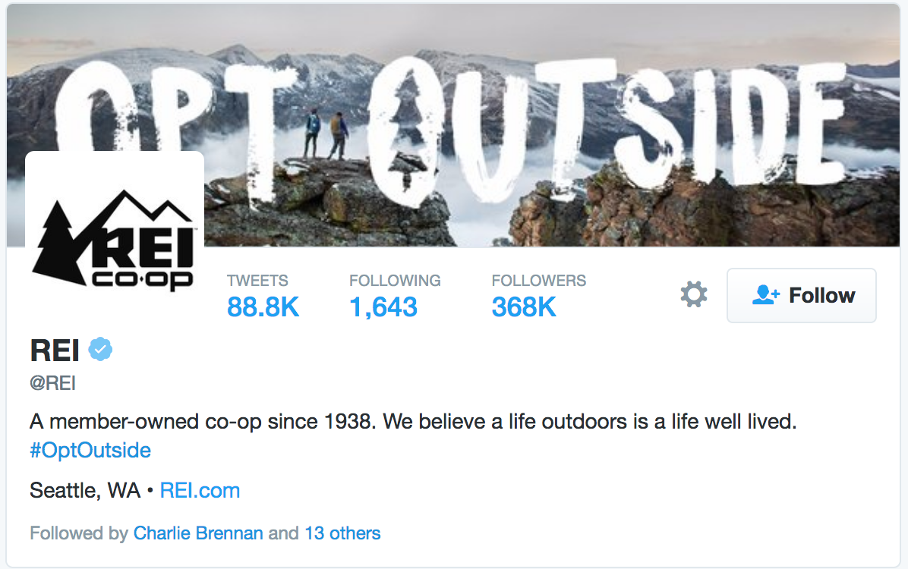
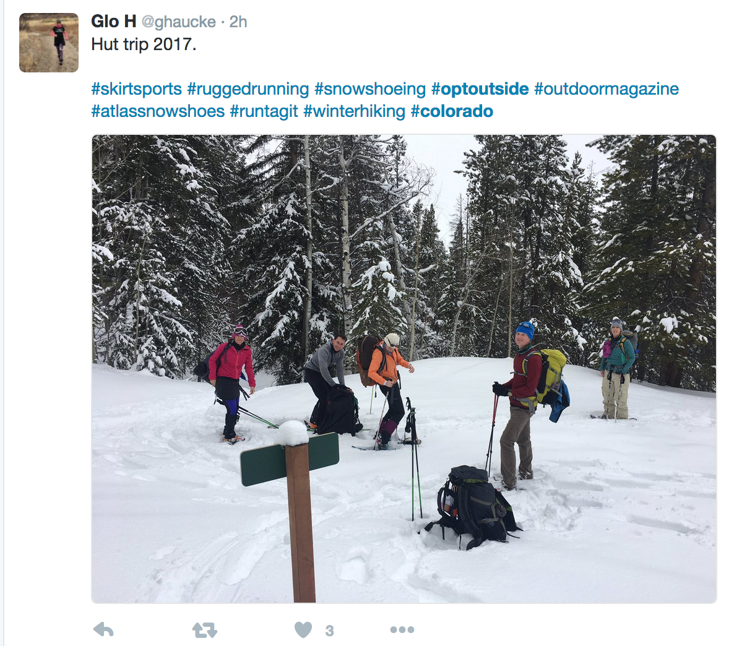
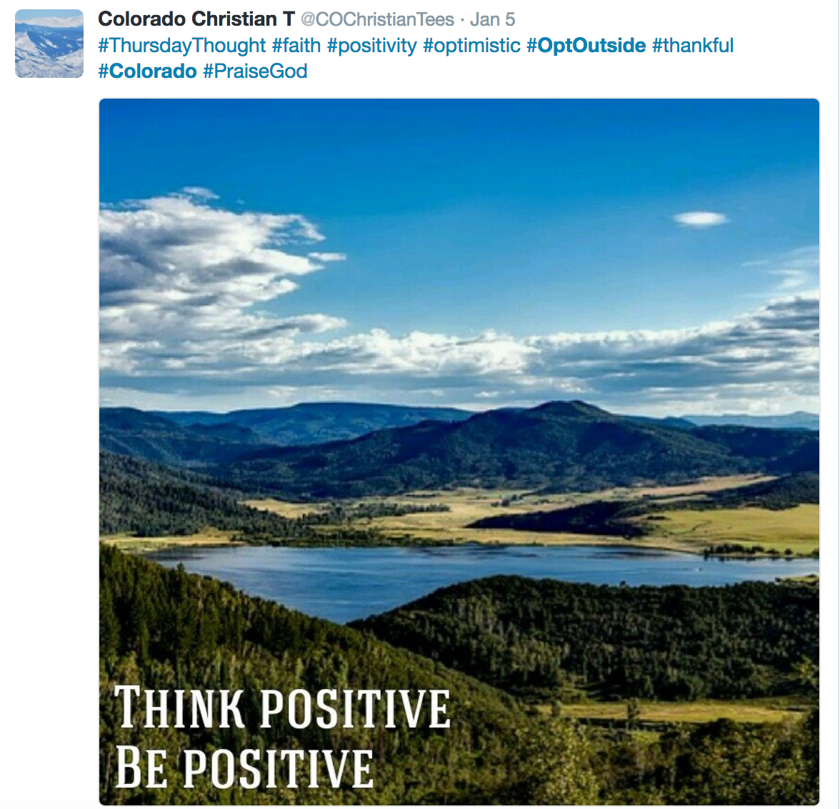
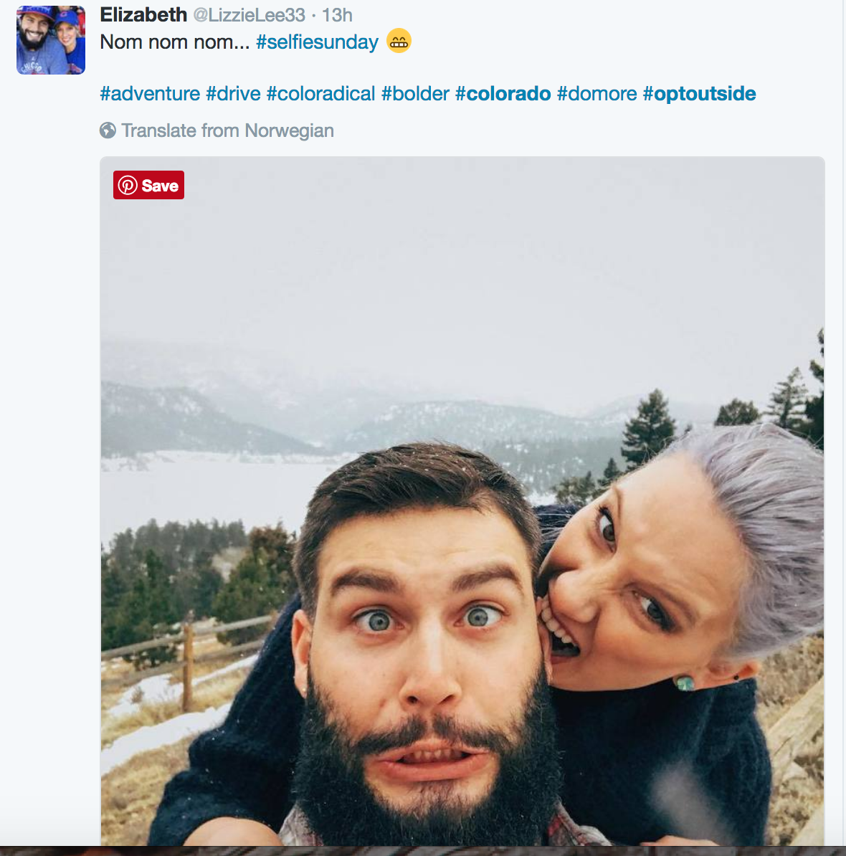

Slide 8
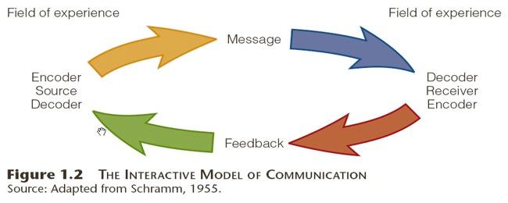
Communication also has feedback loops
Notes:
We know this from Whisper Down the Lane. What I say isn’t necessarily what you hear.

Slide 9
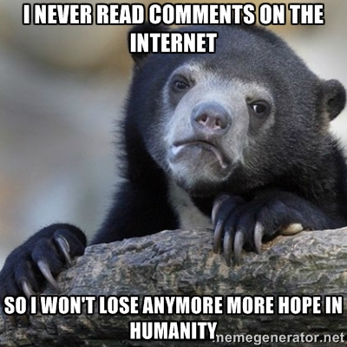
Let’s bracket: nonpersuadables or “trolls”
Notes:
These folks warrant their own lecture and workshop as a topic.

Slide 10
We all have knowledge to share.
Notes:
Let’s focus on the majority of people you will engage. (Phaedra’s mantra with the City on climate. )

Slide 11
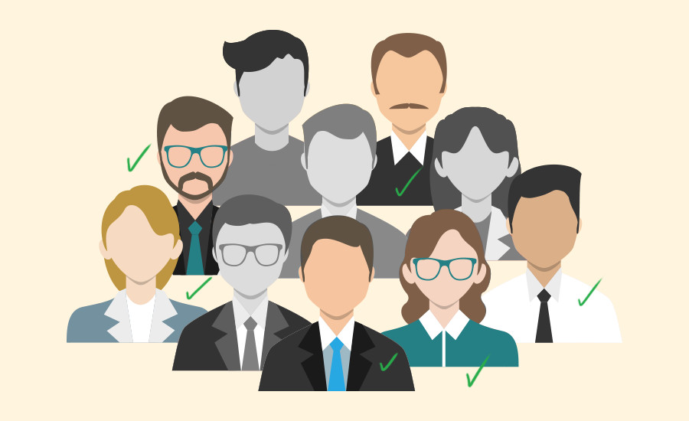
The Public Sphere Is Not Monolithic
Notes:
The public sphere is a misnomer—there are many publics. You have to think about which one or ones you are hoping to engage:
peers? Professionals? Families with anxiety about public health? A social organization already with faith in your expertise? Govt?
Diff/same culture from you? And so on…even radio stations or newspapers tend to have primary followers…
Image source: http://blog.visme.co/wp-content/uploads/2016/07/KnowYourAudience.jpg

Slide 12
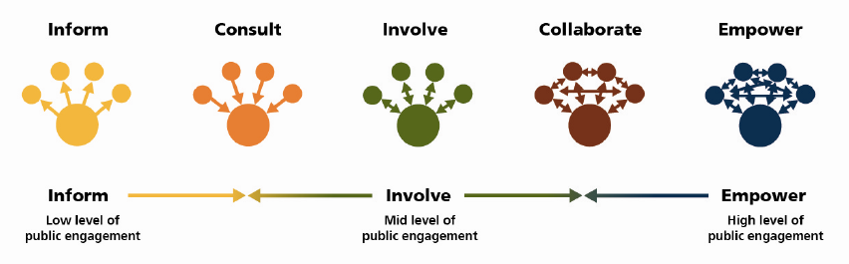
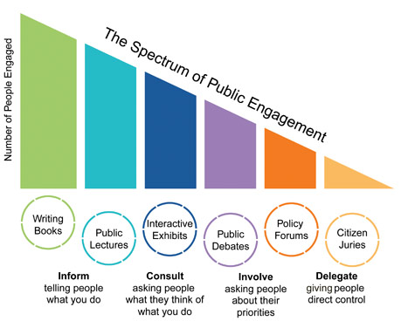
Public Engagement Is Not Monolithic
(Top: International Association of Public Participation, shared by City of Burlington; bottom: Arstein, 1969)
Notes:
(top image) The International Association of Public Participation’s spectrum as shared by the City of Burlington
http://www.burlingtongazette.ca/burlington-community-engagement-charter-version-two/
This is based on: Arnstein, Sherry R. "A Ladder of Citizen Participation," JAIP, Vol. 35, No. 4, July 1969, pp. 216-224,
Which involves 8 rungs (including non-participation).
Spectrum (bottom image) from Beltane Network: http://www.beltanenetwork.org/wp-content/uploads/2012/08/spectrum_of_pe.jpg

Slide 13
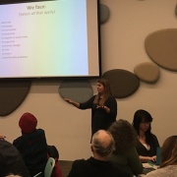
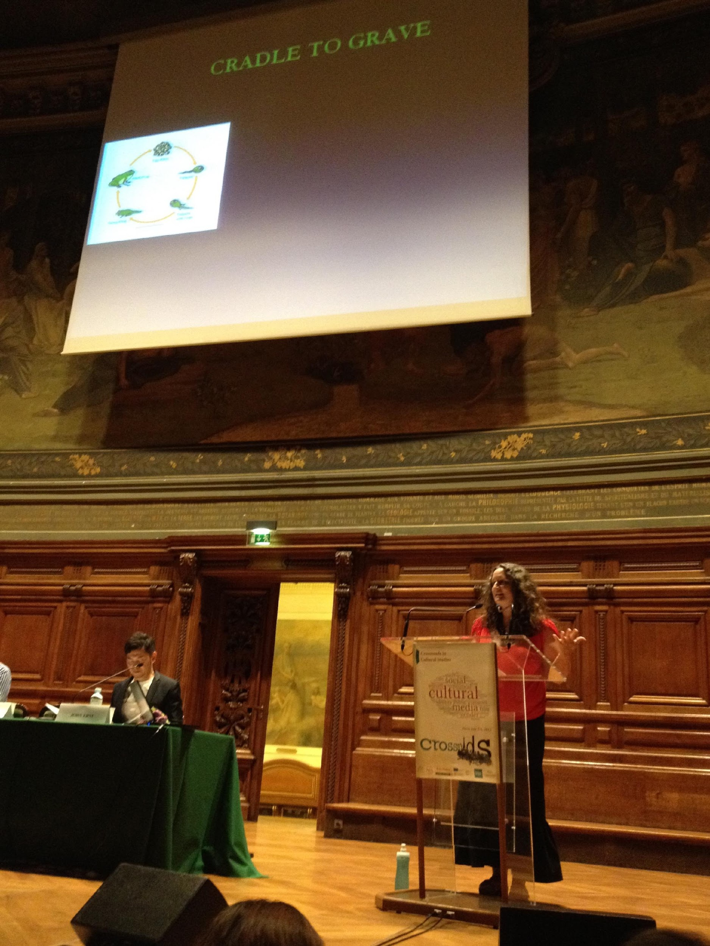
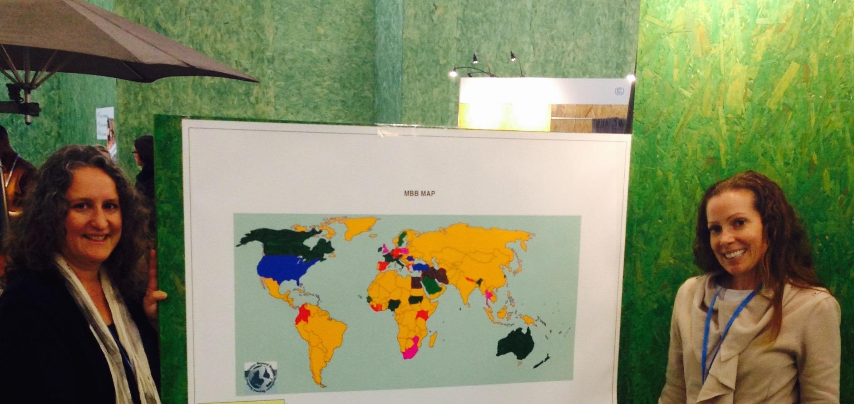
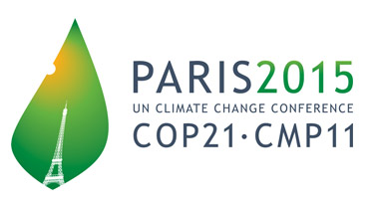
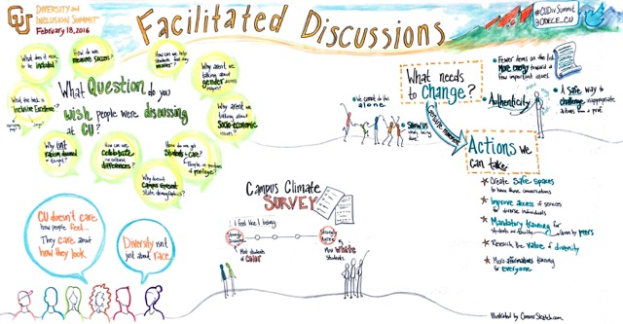
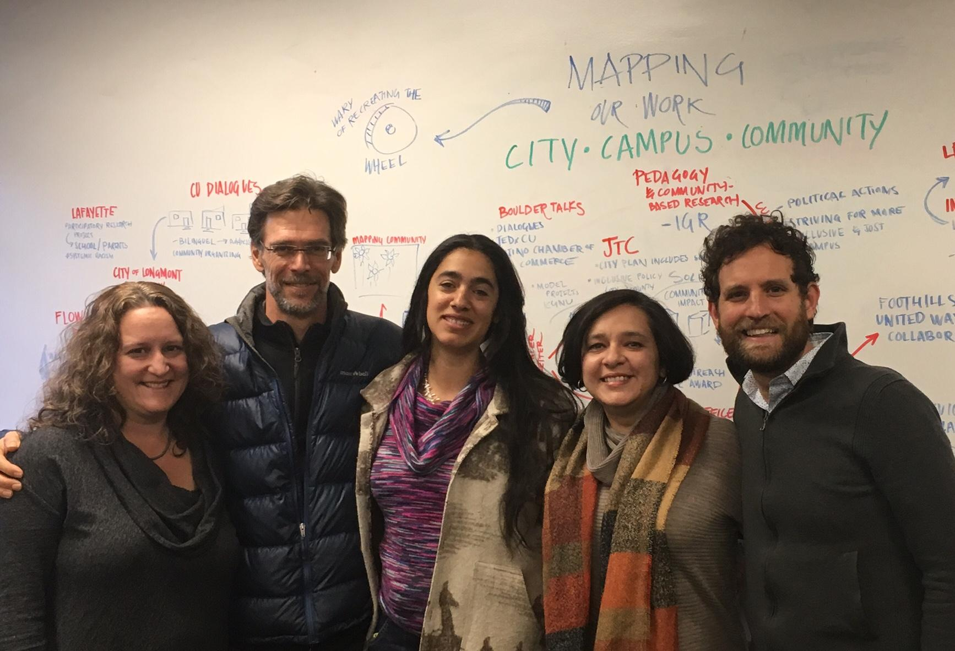
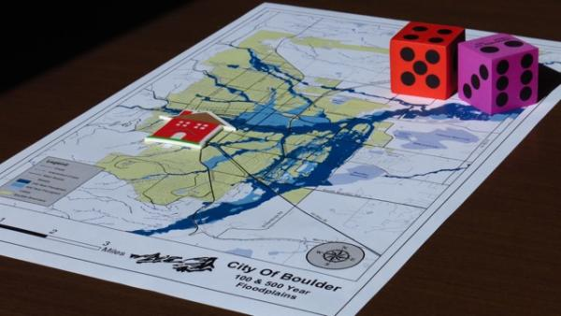
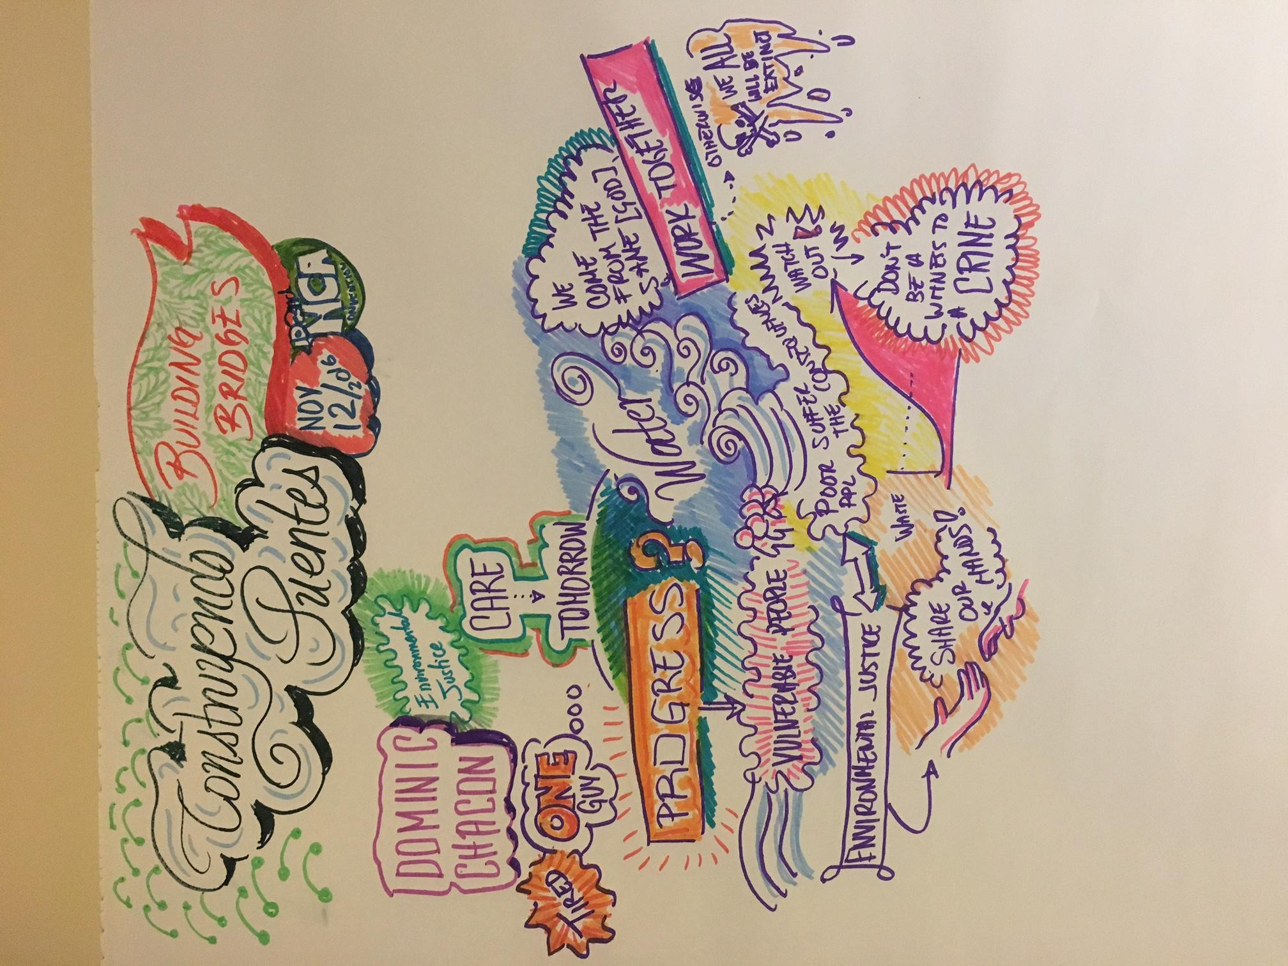
Public Engagement
Is Not Monolithic

Slide 14
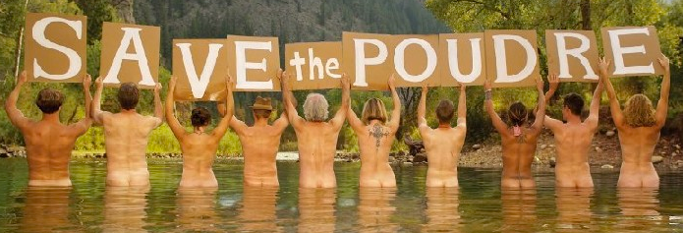

Notes:
I showed up in Fort Collins to see these around town. Glade is a proposed reservior in the Poudre River Basin. Water issue: quantity. To meet increasing water needs, municipal sources. Don’t let water go downstream.
The default is polarization. Ongoing campaigns. Entrenched sides.
Undergoing environmental impact statement: no political actor would decide glade. But the community would be asked for mitigation measures.

Slide 15
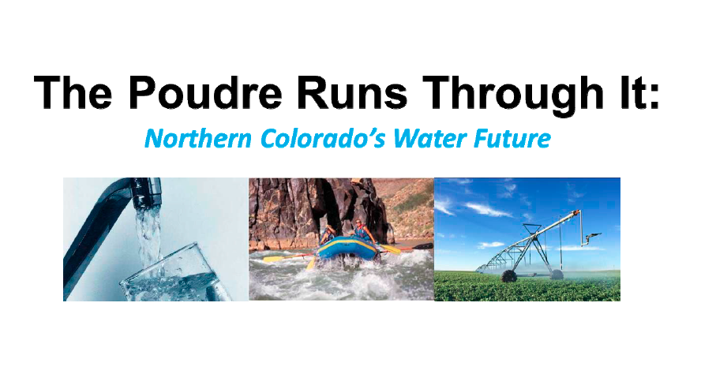
Public dialogue
Public education sessions
Public deliberation
Notes:
A public-private partnership called UniverCity Connections with the city, CSU, and business community.
Colorado Water Institute
Center for Public Deliberation
How do we position the community to be able to provide meaningful input about possible mitigation actions?
How do we discuss water without demonizing the other side?
Shift from a focus on positions (build Glade/Save the Poudre) to values (ecological health, local agriculture, recreation, etc.)
A public dialogue: an event with 300 people focused on values, education sessions on water law, history, conversation, ag-urban transfer
Public deliberation: facilitated discussions about how to meet future water needs

Slide 16
Deliberative Cycle:
A Process for Doing Deliberative Inquiry
(Carcasson & Sprain, 2016)
Deliberative
Issue
Analysis
Reporting
Action
Convening
Facilitating
Interactive
Communication
Notes:
Deliberation isn’t simply about conversations that result in a decision. A type of inquiry, often goes through cycles.
COMM might have assumed that interactive communication is the key thing. But needs support before and after to make it meaningful.

Slide 17
Deliberative Issue Analysis
Stakeholder analysis: anyone who can affect or be affected by the problem or its resolution; “Holders” based on rights, spatial location, knowledge, share, interest, status (Schmitter)
Data collection: surveys, CU Water Conflict seminar
Notes:
Stakeholders in the Glade Conflict
Recreationalists
Home owners
Downtown businesses
Residents
Property owners
Scientists
Engineers

Slide 18
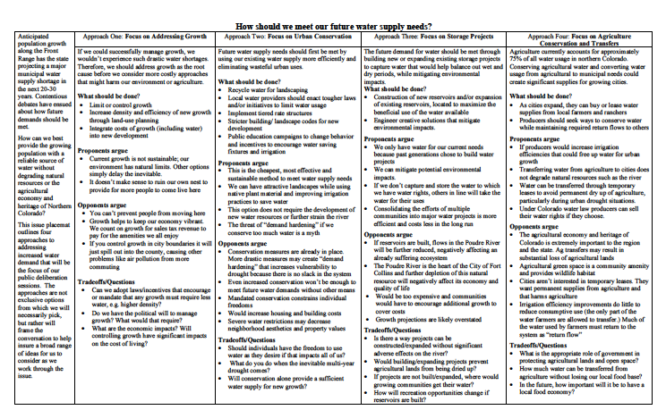
Notes:
Draft for review by Save the Poudre, Northern Integrated Supply Project, Colorado Water Institute
Fair representation
Accuracy

Slide 19
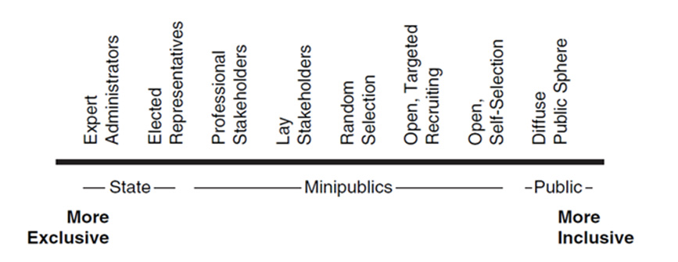
Democracy Cube, Fung (2006)
Convening

Slide 20
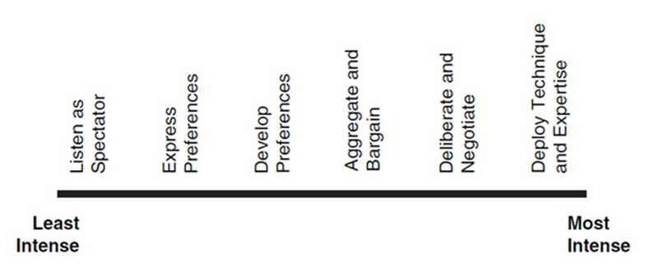
Facilitating Interactive Communication
Democracy Cube, Fung (2006)

Slide 21
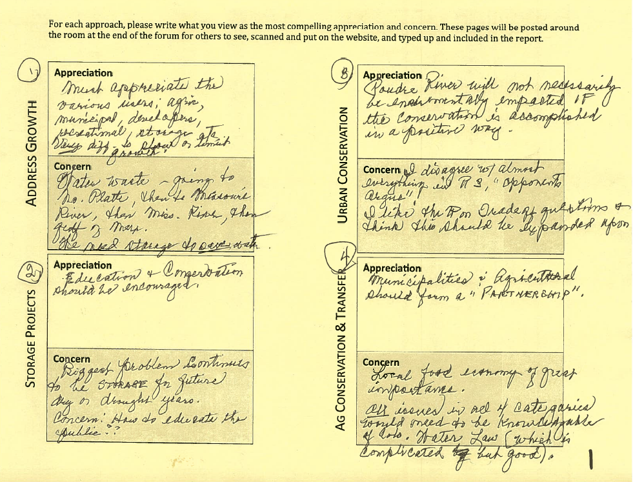

Slide 22
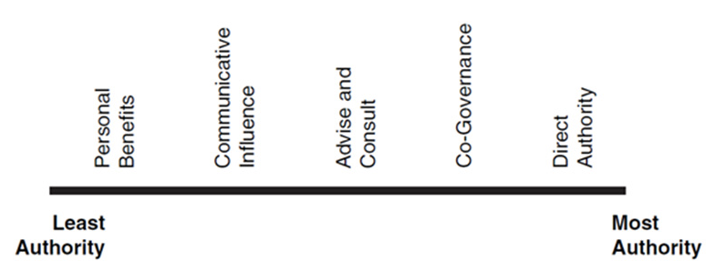
Democracy Cube, Fung (2006)

Slide 23
Reporting
Storage projects: environmental impacts of water projects call for creative solutions currently unknown
Agricultural conservation and transfer: general support for agriculture; is there room for flexible innovation—transfer without drying farms completely?
Notes:
deliberation
helps participants work through the tough choices and tradeoffs
inherent in public decisions as well as helps participants identify
the shared interests or common ground that exists across diverse
perspectives.

Slide 24
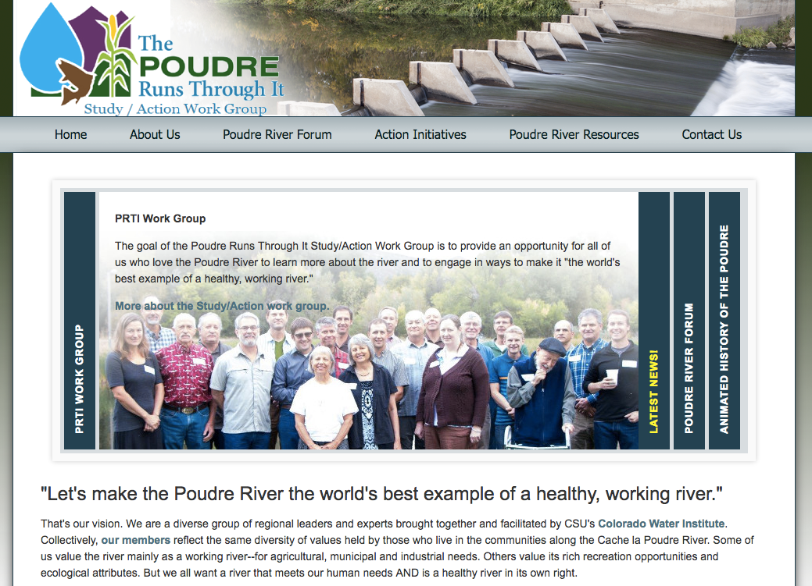
Action
Improving the flows while protecting water rights
Instream flow designation for Poudre
Regional conveyance cooperation
Flow education
Notes:
Improving the flows while protecting water rights
Instream flow designation for Poudre
Regional conveyance cooperation
Flow education
An approach. Most collaborative action doesn’t

Slide 25
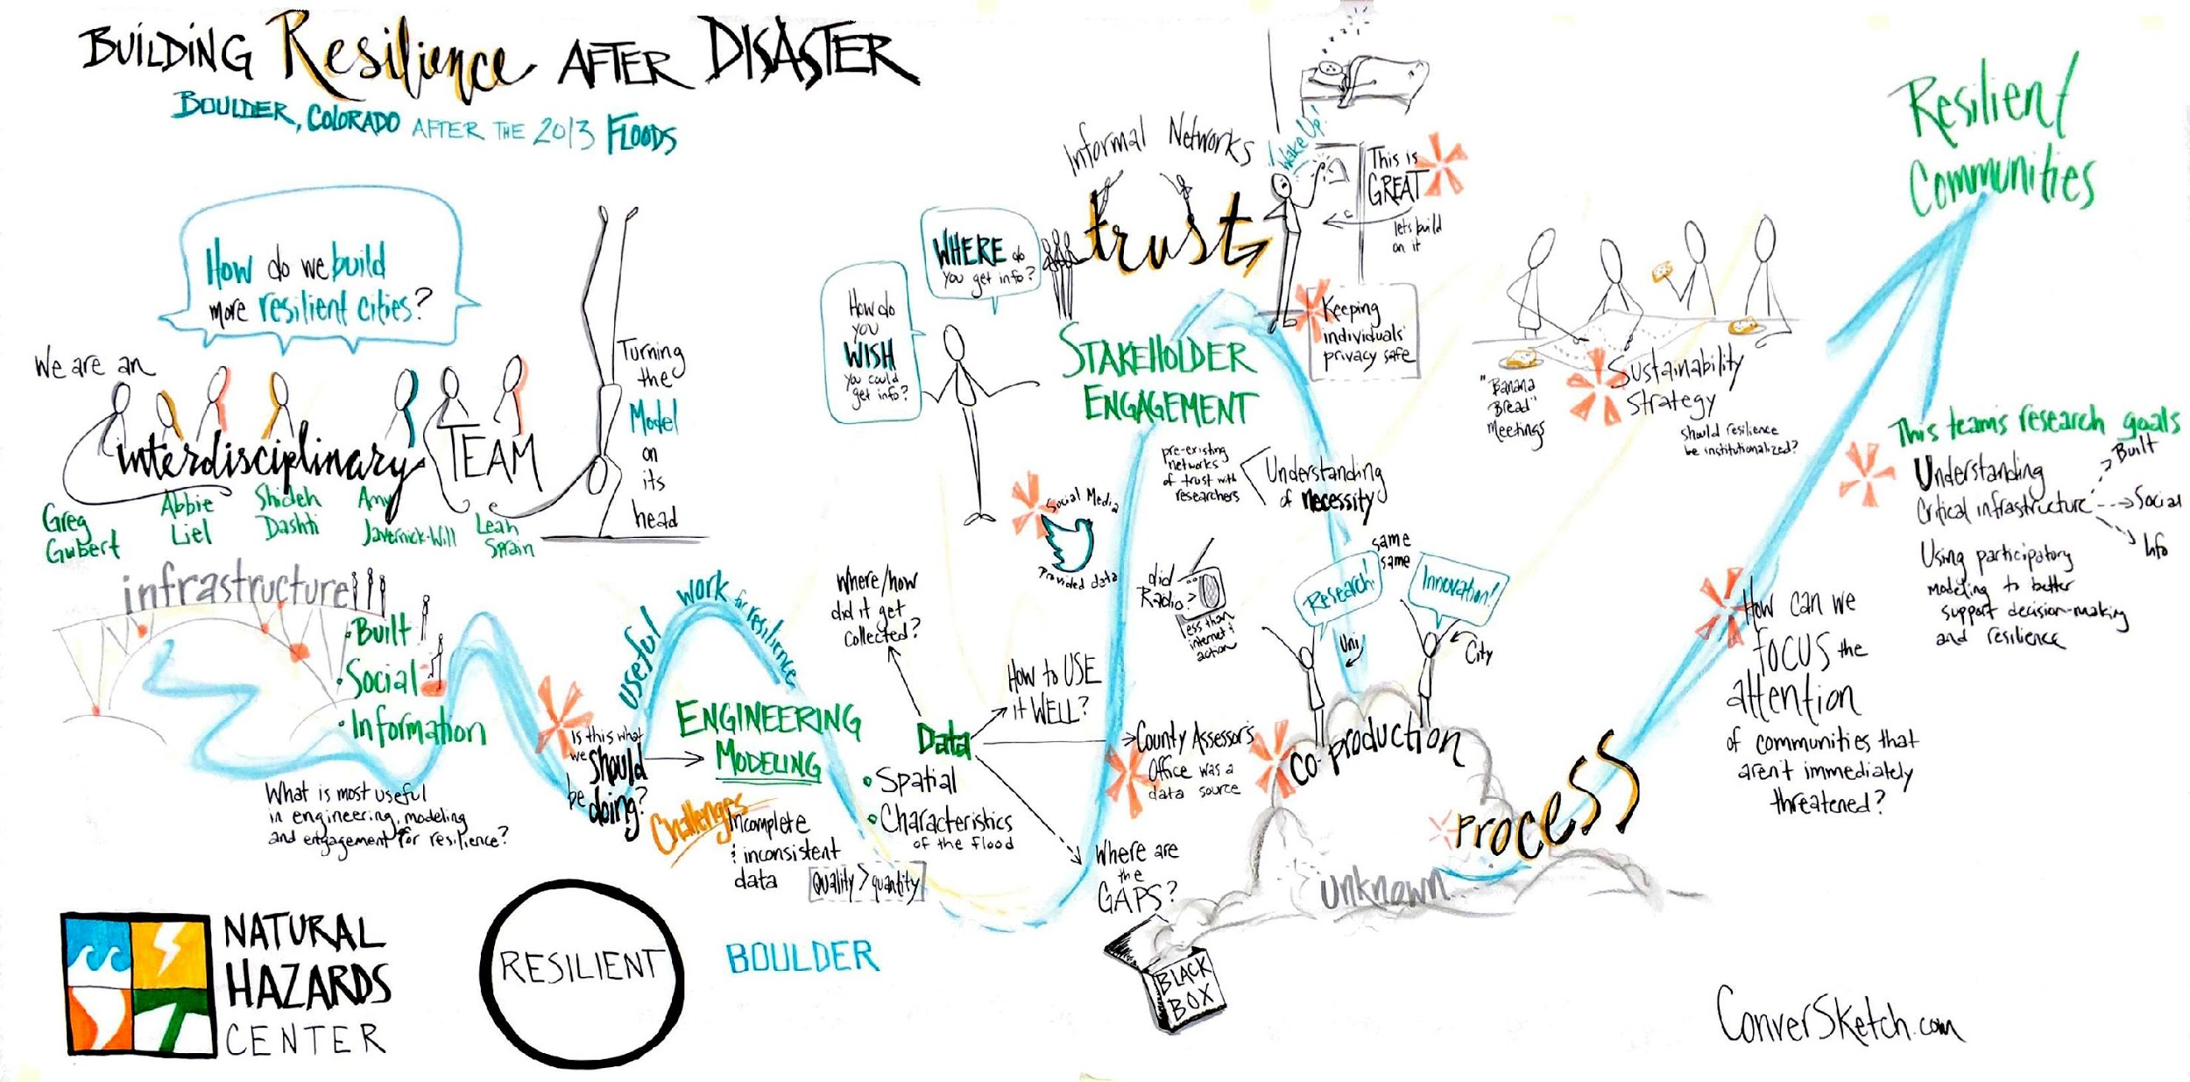
Tales from the field

Slide 26

Contact us
Phaedra Pezzulo (Phaedra.Pezzullo@Colorado.EDU)
Leah Sprain (leah.sprain@colorado.edu)
For more on the Engaged Scientist Series
Susan Sullivan (susan.sullivan@colorado.edu)

Slide 27
DINNER

Slide 28
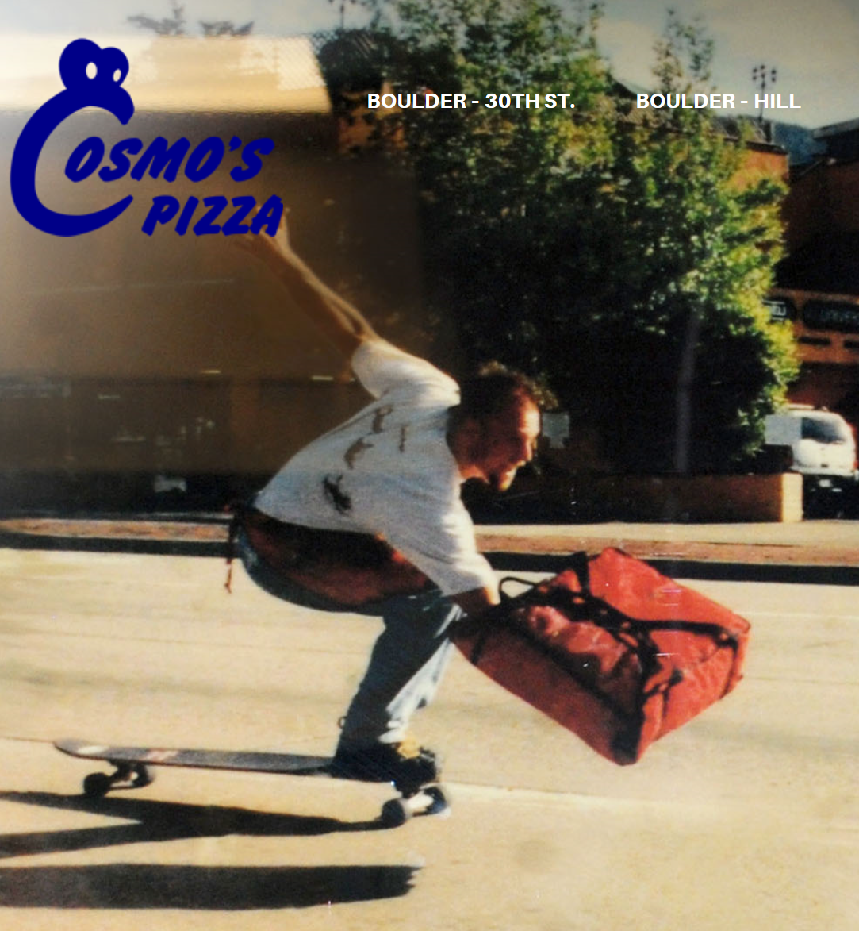
Dinner
Workshop starts 6p
Make sure you are checked in
Make sure you have completed your pre-workshop survey

Slide 29
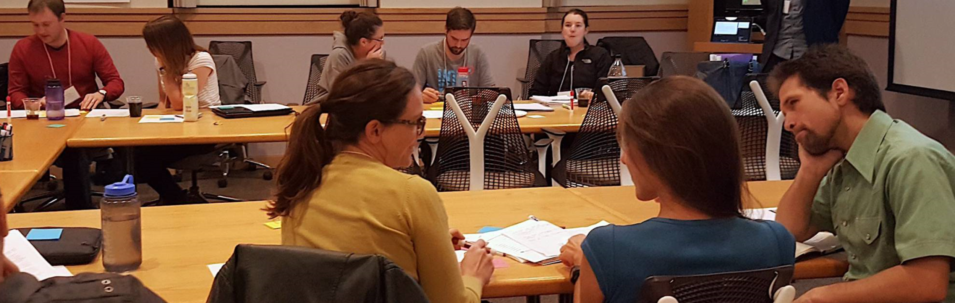
Uses and Practices of Community Dialogue in Geosciences and Environmental Sciences
January 19, 2017
Phaedra Pezzullo and Leah Sprain
Boulder Talks, Department of Communications, University of Colorado Boulder
The Engaged Scientist Series is hosted by the new Albert A. Bartlett Center for Science Communication, CIRES Education and Outreach, INSTAAR, and the Office for Outreach and Engagement (OOE). Funding is provided from OOE.

Slide 30
Goals for this workshop
Discuss the possibilities and limitations around science, communication and democracy
Analyze real world clips of scientists communicating during community dialogues
Resolve engagement dilemmas
Practice framing your research with feedback to help you move towards your goals
Get connected with like-minded colleagues

Slide 31
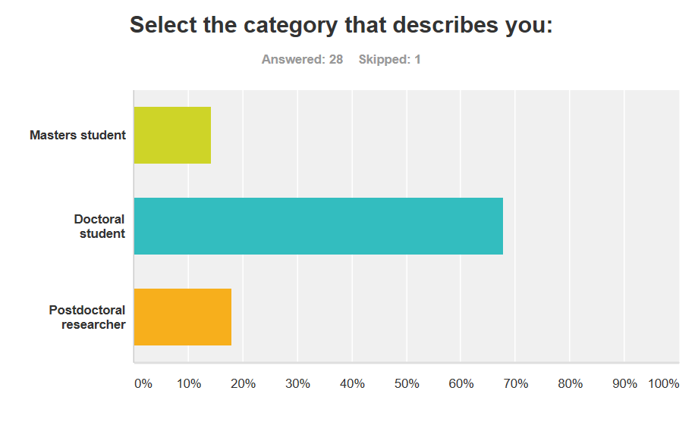
Who is in the room?
Atmospheric and Oceanic Sciences (ATOC)
Bioengineering
Chemistry and Biochemistry
CIRES
Civil, Environmental, and Architectural Engineering
Environmental Studies
Environmental Design
Environmental Engineering
EBIO
Geological Sciences
MCDB
Physics
Others?

Slide 32
What are your interests?
…to carry out practice-relevant research
…communicating scientific concepts to the public
Learn about colleagues’ efforts
Learn about establishing similar [outreach] projects
Learn how to be a better scientist and how to market myself…
I’m interested in energy policy and communicating science to the public.
…to make my research more relevant to the needs of local communities, and who and how to contact the relevant stakeholders to figure out those needs.

Slide 33
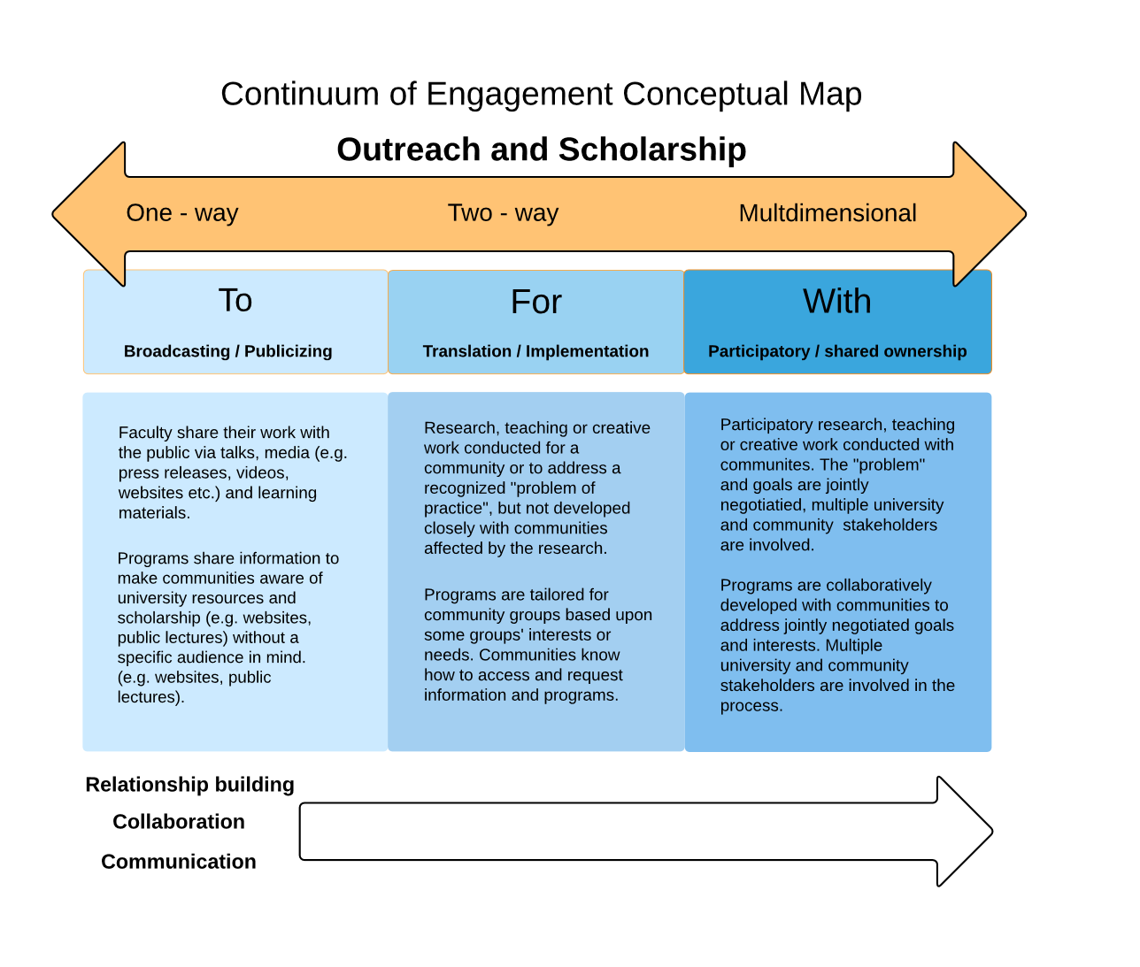

Slide 34
Workshop: Science & Public Deliberation
Phaedra C. Pezzullo
Associate Professor &
Director, BoulderTalks
Leah Sprain
Assistant Professor &
Co-Director, BoulderTalks
Uses & Practices of Community Dialogue in Geosciences & Environmental Sciences

Slide 35
Activity 1:
Reflecting on Best Practices (Introductions)
“so just to begin um we’re going to go around the table and I would like if you guys would um introduce yourself and explain why you’re here kind of tell us what your stake is in this issue and we have about ten minutes for this so try and keep your response to a minute if you can do that if you would like to start …”

Slide 36
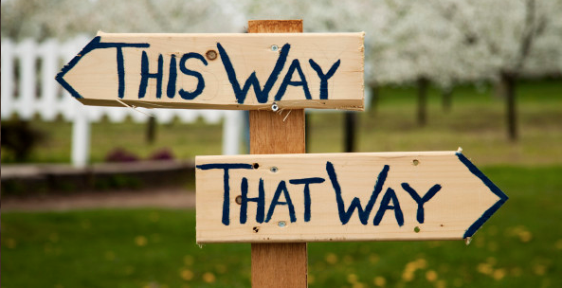
Activity 2:
Addressing Engagement Dilemmas

Slide 37
Activity 3:
Apply to Your Own Research
Convening a dialogue
Participating as a citizen
Participating as a scientist

Slide 38
Wrap up
What were big takeaways?
What else do you want in future workshops?
Needs assessment for proposal in preparation-see the slip in your folder.
Evaluation please! https://www.surveymonkey.com/r/EngagedScientist2017Post

Slide 39
Contact us
Phaedra Pezzulo (Phaedra.Pezzullo@Colorado.EDU)
Leah Sprain (leah.sprain@colorado.edu)
Susan Sullivan (Susan.Sullivan@Colorado.edu)

