Slide 1
Science is Culture
Heidi McCann With ELOKA
Michelle Gabrieloff-Parish with Environmental Center
Notes:
Our introductions
Everybody intros
Overview of evening
What are some things participants want to get out of it/hear about?
Line walk towards each other

Slide 2
Science’s Roles & Goals in Our Society
-
Notes:
At least Optimally?
How does science see its role?
How does society view science’s role?

Slide 3
Is Everything Culture?
What is culture?
What are some aspects of “Western” scientific culture?
  Language (acronyms?)
  Heroes?
  Elders?
    Who/when do you need to ask permission, etc?
  Body contact?
  Personal Space?
  How express emotions?
    Sad, angry, excited, celebrating, life transitions?
  Gender roles?
  Food/Meals?
  Fashion/Clothing?
  How let people know you want/don’t want to engage?
  Certainty? How comfortable with uncertainty/ambiguity?
  Task- or Relationship- oriented?
  Reductionist or see everything connected?
  Linear vs plural?
  Metaphors?
  Creation Story?
  Rites of Passage & Rituals?
This by the way, this is often much clearer to cultures from outside…
Notes:
Michelle- favorite def from college of culture.
Sub-groups as well though science is an interesting place because it’s a sub group and considered in many ways the leaders of our society– top of the knowledge hierarchy.
* So if “Western” science has a culture… Should only “other” sciences be considered ethno-sciences?... Or should “Western” science be considered “Ethno-Science” too? Ethno-Science is often considered going “backwards”... Despite the wealth of knowledge it has brought...

Slide 4

Science as culture!?
“The project that science’s sacredness makes taboo is the examination of science in just the ways any other institution or set of social practices can be examined” –Sandra Harding, via Vandana Shiva, Staying Alive
“The vision of science is not specifically Western. It is no more Western than it is Arab or Indian or Chinese...One of the central facts about science is that it pays no attention to East and West and North and South and black and yellow and white. It belongs to everybody who is willing to make the effort to learn it.” --Freeman Dyson
Notes:
* Which strands of “science” take hold? Bacon’s model clearly and outrightly sought to be a more assertive, masculine version than what had come before– Shiva, Straying Alive, Chapter 2 : Science, Nature and Gender… and discusses Native American responses to the call to agriculture– how dare i rip a knife into my mother or cut her hair? Chief Smohalla
* Quote/Christianity

Slide 5
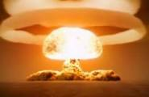
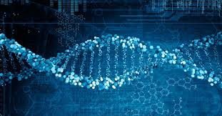
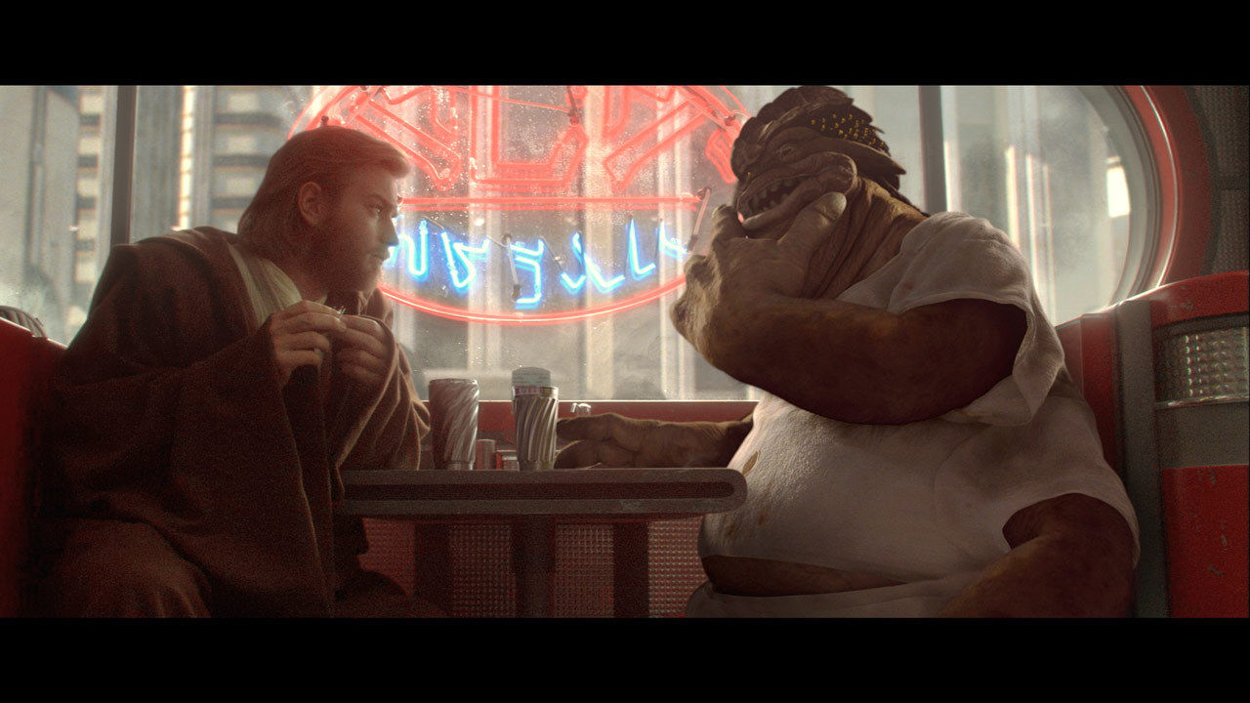
Quotes to Chew On:
“Science is one thing, wisdom is another. Science is an edged tool, with which men play like children, and cut their own fingers.” ~ Sir Arthur Eddington
“It's these funny little cuts on the side that give it away. Those analysis droids only focus on symbols. Huh! I should think that you Jedi would have more respect for the difference between knowledge and... heh heh heh... wisdom.” ~ Dexter Jettster (Star Wars: The Clone Wars)
Notes:
Difference between knowledge & wisdom?

Slide 6
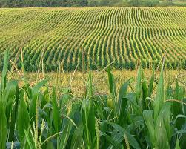
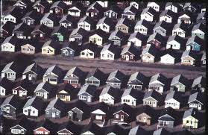
Culture, Imagination and the Future
Is it surprising that the same culture that brought us:
The assembly line
Giant mono crop corn fields
Repetitive non-place-based suburbs

Slide 7
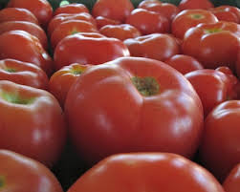
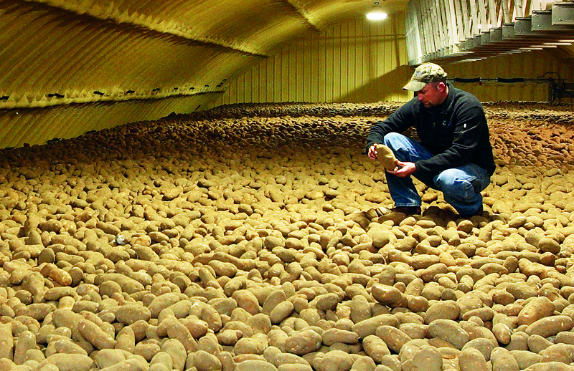
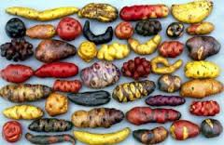
Contd:
Vs.
Prized uniformity in tomatoes– helps with packaging and transport
Mono crop, largely cloned (naturally) potato
Snapshot of Peruvian potatoes
Notes:
Diversity of potatos- Peru
Some to be expected, as place of origin often means more diversity, but this is beyond what would happen naturally many times over
… So with all of this, wouldn’t it make sense that when this same

Slide 8
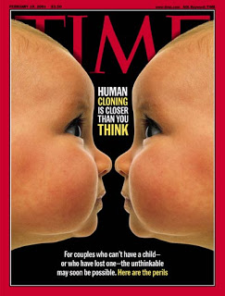
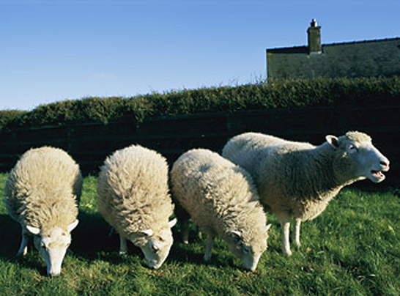
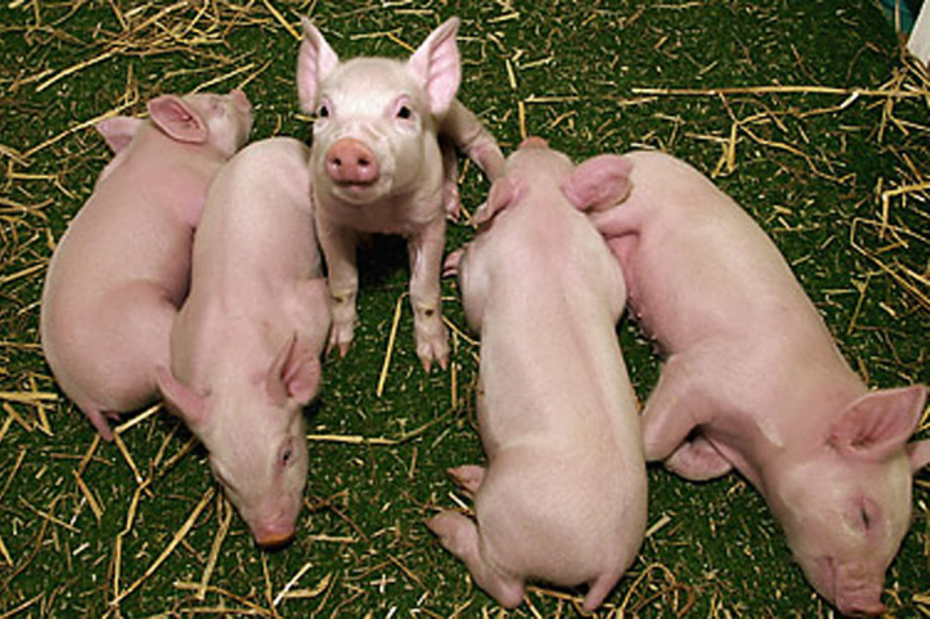
With further technological prowess?
Cloning

Slide 9
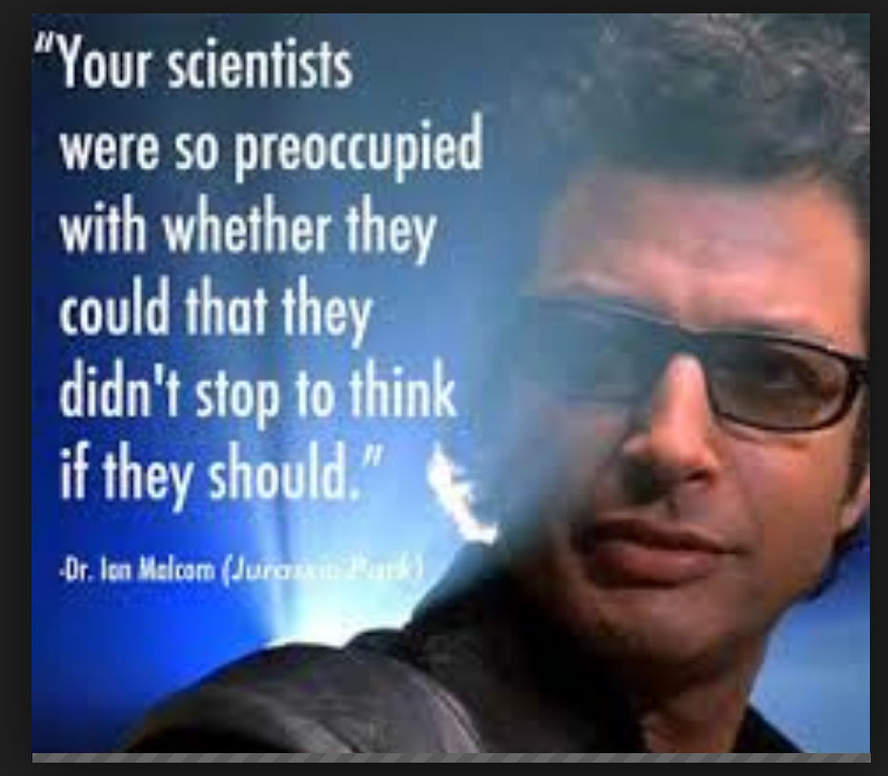
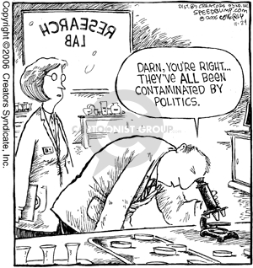
Notes:
Resources Coming from ?
Whose lands?
Whose labor?
What resources?
Waste goes/
Purpose?
Who gets Profits?
Benefits?
Burdens?
Convenience?
Warfare?

Slide 10
Like All Things: Science is Intertwined
Business/Industry
Govt/Regulation
Science/Research
Community
Notes:
?Where is the Funding coming from? In the 80s, 80% of scientific research was devoted to warfare… Many have pointed out the pattern that technological advances (like the internet, pharmeceuticals, chemicals like fertilizers & pesticides) came from warfare, then slowly gets translated through business/industry into peacetime consumer goods, services, etc..
What is the Purpose?
Politics?
Larger Ideological frames?
Culture ;) !

Slide 11
4 Is break out
Ideological
Institutional
TRANSFORMATION
Internal
Interpersonal

Slide 12
Behavior Patterns in Power Relations
Notes:
Adapted from Subjective Side of Politics by Margo Adair & Shea Howell with Bill Aal, with Tools for Change– tools for change.org

Slide 13
Power & Privilege- Brief Intro

Slide 14

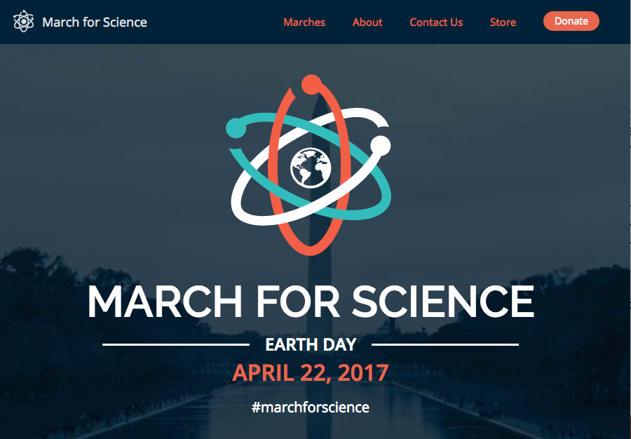
Ethical Issues in the Field?
“Researchers have the best of intentions, but the system rewards bad behaviors.” – John Arnold, Arnold Foundation
“Of 1,576 researchers who responded to a recent online survey from Nature, more than half agreed there is a “significant crises” of reproducibility”- From Waging War on Bad Science, by Sam apple, Wired Magazine
At the same time, Science is feeling under attack:
“March for Science” April 22
Notes:
Getting into some Case studies about science and community– they’re both native examples, but that’s just the beginning. It would actually be quite traumatizing

Slide 15
Mini Case Studies

Slide 16
Indigenous Knowledge: The bowhead whale census
1977 International Whaling commission imposed a ban on the harvest of bowhead whales.
Indigenous Alaskans formed the Alaska Eskimo Whaling Commission, composed of one representative of each bowhead-hunting community to fight the ban.
The fight against the ban was a political and scientific battle on the whale census along the north coast of Alaska.

Slide 17
Indigenous Knowledge: The bowhead whale census
The scientific census started with visual counts of migrating bowheads made from sites on high cliffs or pressure ridges in the shore fast ice along the open lead through which the migratory path lead. Whale counts produced an estimate population of 2000-3000 bowheads.
The Alaska Eskimo Whaling commission felt the count was not accurate as it was based on assumptions that the migrating bowheads passed within sight of the census location and when the lead was closed the bowhead stopped migrating.
The subsistence hunters travel on the ice when the lead is closed and go by boat to the pack ice across the lead and reported seeing whales.

Slide 18
Indigenous Knowledge: The bowhead whale census
As a result of interactions between whalers and scientists similar to collaborative field work and analytical workshops, the census was expanded to include other components such as acoustic and aerial.
Acoustics help detect migrating bowheads when the lead was closed as whales were found to breathe through cracks in the pack ice or force their blowholes through thinner ice.
By flying transect perpendicular to the shore and well beyond the visual range of the surface location, the aerial component showed that bowheads do in fact migrate on a front broader than the confines of the nearshore lead.

Slide 19
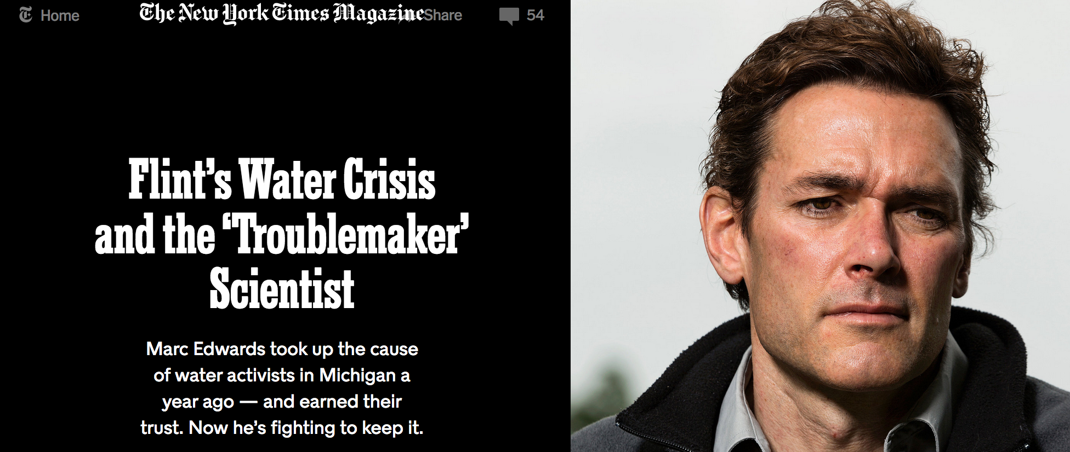
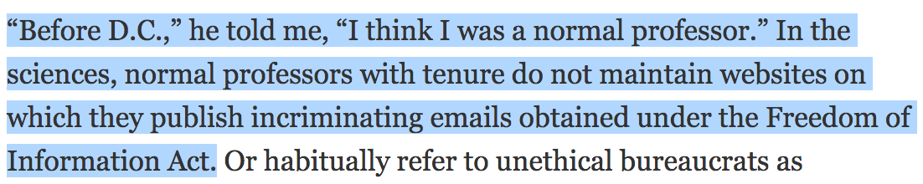
Mini Case Studies
…
…

Slide 20
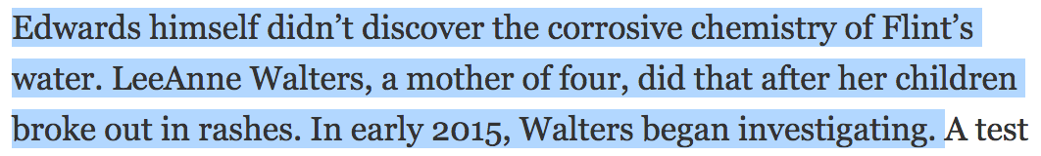
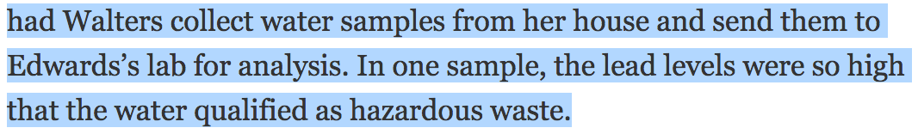
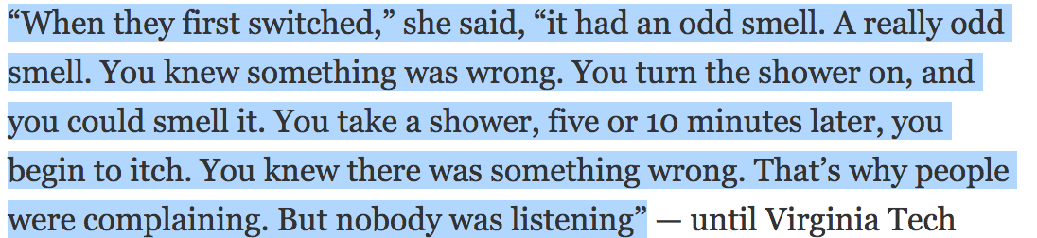

Slide 21
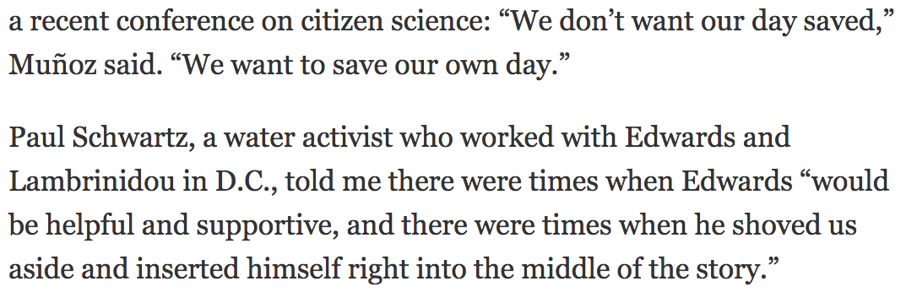

Slide 22
Best Practices
Look locally 1st! Especially with the University!
Communities should be agents of their own change
Communication for social change should be empowering, horizontal (versus topdown), give a voice to the previously unheard members of the community, and be biased towards local content and ownership.
Asset-Based
If you're working with Indigenous communities, plan to visit at least 4 times to discuss research plan before starting.
Allow Indigenous communities to help define the problems or research objectives. Native people intimately understand concerns
Include request for travel to Indigenous communities & open access publications.

Slide 23
Going forward
General Environmental Justice-Inspired questions:
Who will benefit?
  In what ways?
Who will bear the burdens?
  In what ways
For Engaged Research:
What research are you engaged with?
What are some possible ethical dillemas?
What are some possible interfaces with community-- from design, to finish?
Who will have access to the results?

Slide 24
Resources
On-campus:
IDI- Intercultural Development Inventory available to all on-campus. Michelle a Qualified Administrator
ELOKA
Environmenter Center
CU Engage
Just Transition Collaborative
Books and Articles:
Meaning of Ice- Shari Fox Gearheard
Tending the Wild- Kat Anderson
Indigenous Notions of Ownership and Libraries, Archives and Museums; Sharing and Preserving Indigenous Knowledge of the Arctic Using Information and Communication Technologies- feat. Heidi McCann
Indigenous Science- G. Cajete
Decolonizing Museums-A. Lonetree
Medical Apartheid- Harriet Washington
Red Alert: Saving the Planet with Indigenous Knowledge-D. Wildcat
Indigenous peoples and the collaborative Stewardship of Nature: Knowledge Binds and Institutional Conflicts-Anne Ross, K. Pickerling Sherman, J.G. Snodgrass, H. D Delcore, R. Sherman
Climate, Culture, Change: Inuit and Western Dialogues with a Warming North-T. B. Leduc
Sacred Ecology-F. Berkes
Watching Ice and Weather Our Way-Conrad Oozeva, C. Noongwook, G. Noonqwook, C. Alowa, I. Krupnik
Cosmic Serpent- Jeremy Narby
Staying Alive, Vandana Shiva
An Indigenous People’s History of the United States - RoxanneDunbar-Oritz
Professor explores intersection of climate change and social justice- Cornell Daily Sun
Documentaries/Film:
Inuit Knowledge and Climate Change
People of a Feather
The Leech & the Earthworm- documentary
Websites:
“Matching Researchers to Local Stakeholders” with MarineScienceMatch.com:
Center for Open Science https://cos.io/
Audio:
Build 2020- https://molina.bandcamp.com/album/build-2020-manifesto

