Slide 1
🌎 Data Lens: Exploring Earth’s Visual Stories
We are going to slow down and take ten minutes or so to just observe and discuss what we discover and notice. There are no right or wrong answers.
First: Ground Rules
Raise your hand to share your ideas with the class.
All ideas are welcome.
Be respectful of others’ ideas. It’s okay to disagree.
Build on each other’s ideas.
Next: One minute to quietly observe…

Slide 2
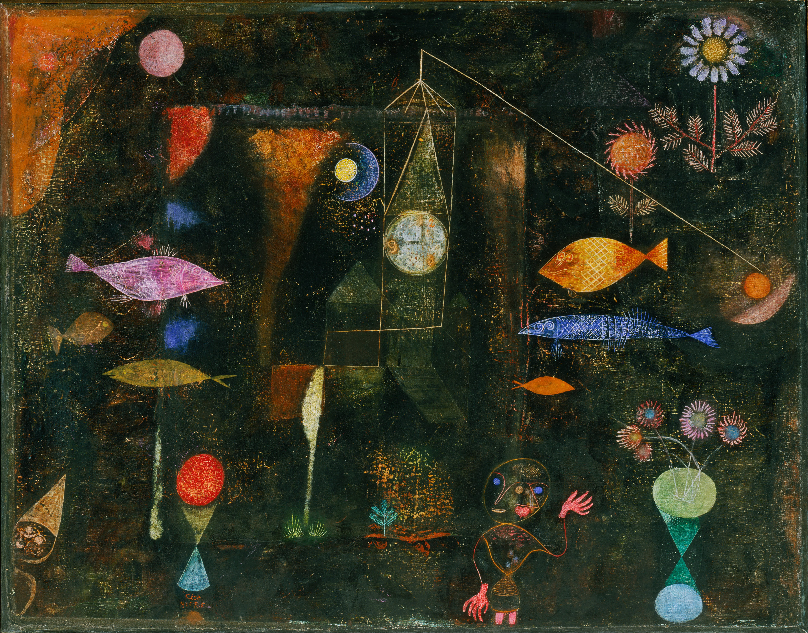
What’s going on here?
Notes:
Q1 – “What is going on in this image?”; after an observation is made, paraphrase and maybe follow up with Q2.
Q2 – “What do you see that makes you say that?; paraphrase again and to obtain the next observation use Q3.
Q3 – “What more can we find?”; this is an opening for another student to share an observation.
Paul Klee, Swiss – Fish Magic – Google Art Project.jpg (1925)
Allowing students to inspect an artistic image gets their observation juices flowing. They perk up. They know there isn’t a right answer. They are intrigued. Then move on to the maps. Do the same facilitation for both.

Slide 3
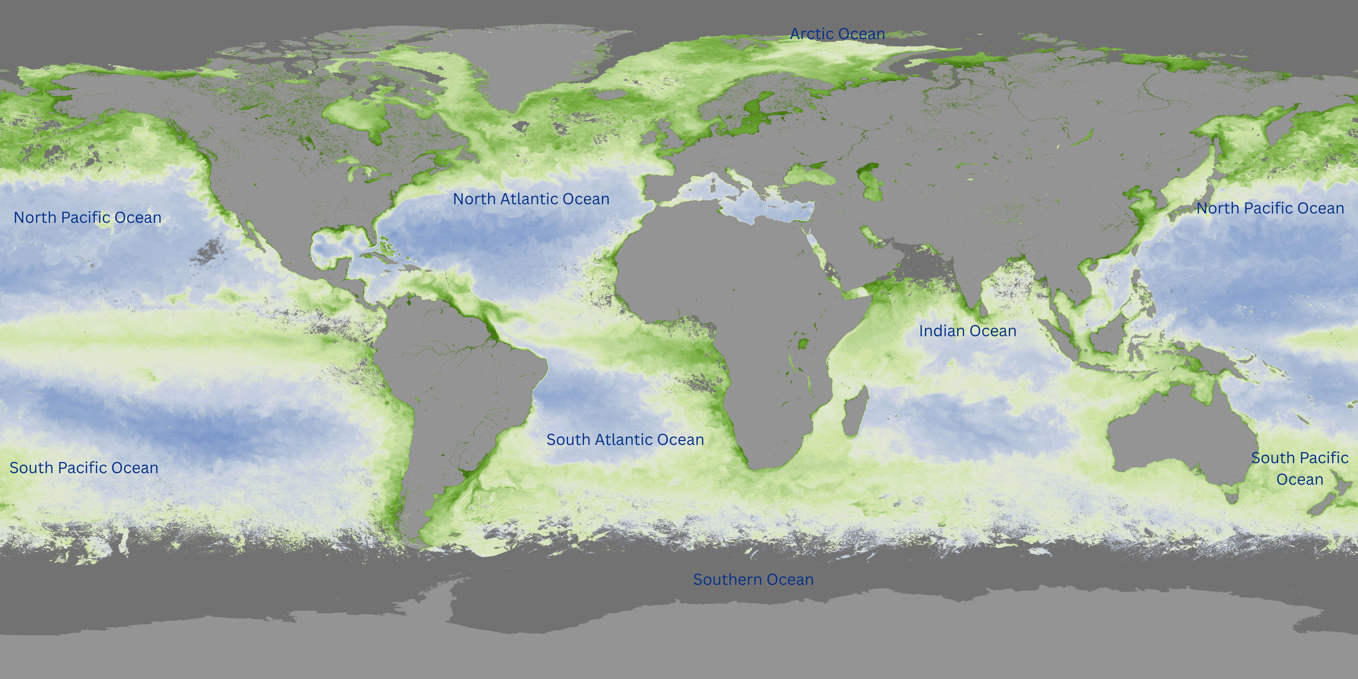
What’s going on here?
Notes:
Q1 – “What is going on in this image?”; after an observation is made, paraphrase and maybe follow up with Q2.
Q2 – “What do you see that makes you say that?; paraphrase again and to obtain the next observation use Q3.
Q3 – “What more can we find?”; this is an opening for another student to share an observation.

Slide 4
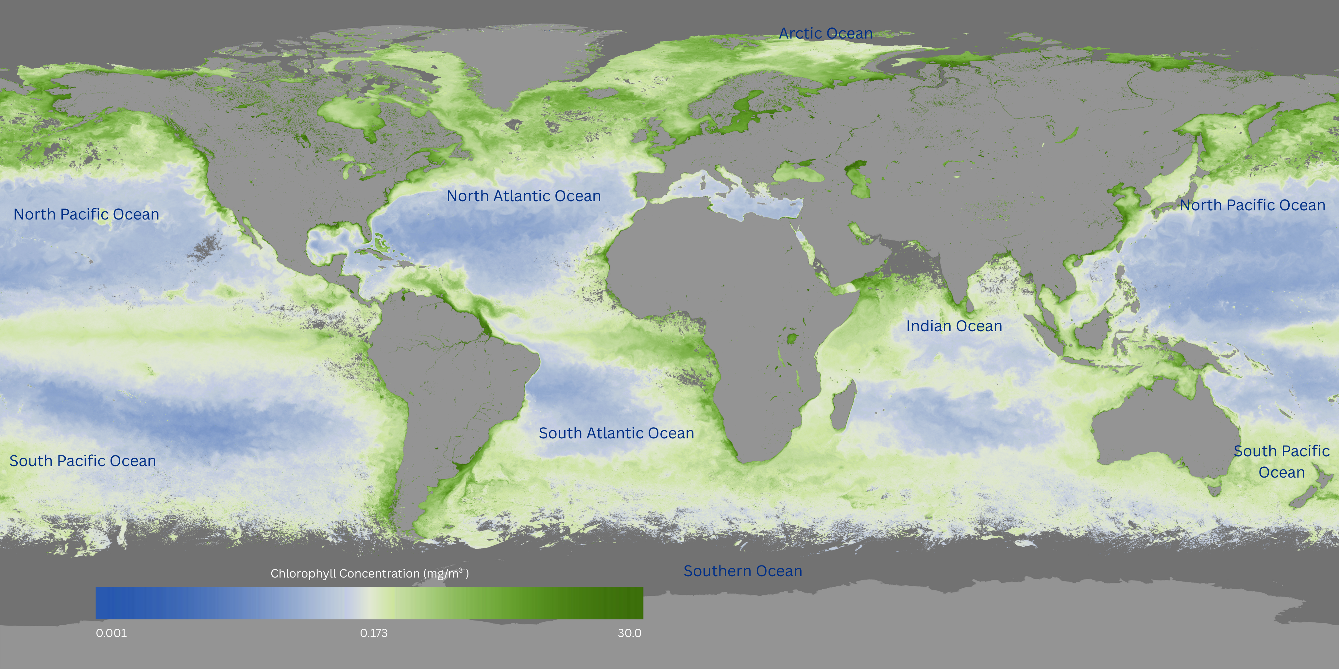
Now, what do you notice?
Monthly average Chlorophyll Concentration – August 2025
Notes:
Q1 – “What is going on in this image?”; after an observation is made, paraphrase and maybe follow up with Q2.
Q2 – “What do you see that makes you say that?; paraphrase again and to obtain the next observation use Q3.
Q3 – “What more can we find?”; this is an opening for another student to share an observation.

Slide 5
Questions
Answer on your worksheet:
In this map, identify which Earth systems are shown.
How do these systems interact?
How might the systems change over time?
Monthly average Chlorophyll Concentration – August 2025
Sources: NOAA Science On a Sphere, NOAA View

Slide 6
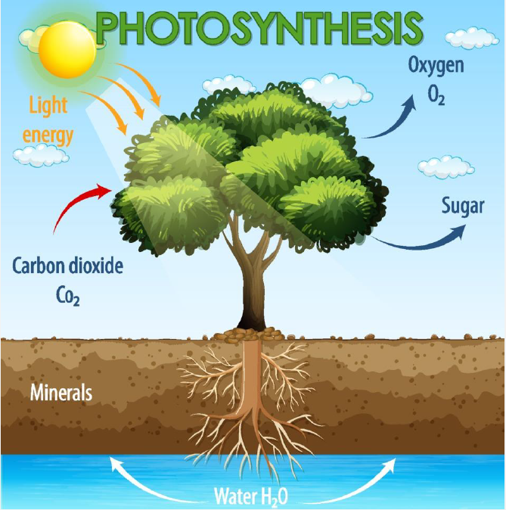
Higher order thinking
4. How might the maps of chlorophyll in the ocean relate to this photosynthesis diagram?

Slide 7
End of Data Lens
Learn more about the dataset and artwork. Read the descriptions on the next slides. (5 min)
Go to the last slide for directions to the multimedia extension. (10 min)

Slide 8
Ocean Color
About half of the oxygen we breathe actually comes from the ocean! Tiny ocean plants called algae release oxygen during photosynthesis, just like land plants do. These algae are also the base of most ocean food webs, feeding everything from small fish to whales.
Satellites can “see” the ocean by measuring how sunlight bounces off the surface. Algae contain a green pigment called chlorophyll. Chlorophyll absorbs red and blue light but reflects green light, so scientists can use satellite data to figure out how much algae is in the water.
Since 1997, satellites like NASA’s SeaWiFS, Aqua, and the joint NASA/NOAA Suomi NPP have been collecting this kind of information. NOAA uses the data to study things like how productive the ocean is, how carbon moves through Earth’s systems, and where fish are likely to live.
In the imagery, ocean areas with little algae show up blue, while areas with more algae appear green to yellow. Gray patches mean the satellite couldn’t “see” the ocean surface because of clouds—or in the polar regions during winter, because there’s no sunlight.
This dataset is updated every month. In the year-long loop, you can watch the seasonal changes in algae growth across the globe.

Slide 9
Fish Magic
Artist: Paul Klee, Swiss
Year: 1925
Description: Oil and watercolor on canvas on panel

Slide 10
Multimedia extension
Intended for: 6-12 Grade (15-20 minutes)
Either as a class or individually – explore a 360º Virtual Dive into one or more National Marine Sanctuary.
Answer a few questions on your worksheet.
What careers do you think are highlighted in these videos and images.

