Slide 1
🌎 Data Lens: Exploring Earth’s Visual Stories
We are going to slow down and take ten minutes or so to just observe and discuss what we discover and notice. There are no right or wrong answers.
First: Ground Rules
Raise your hand to share your ideas with the class.
All ideas are welcome.
Be respectful of others’ ideas. It’s okay to disagree.
Build on each other’s ideas.
Next: One minute to quietly observe…

Slide 2
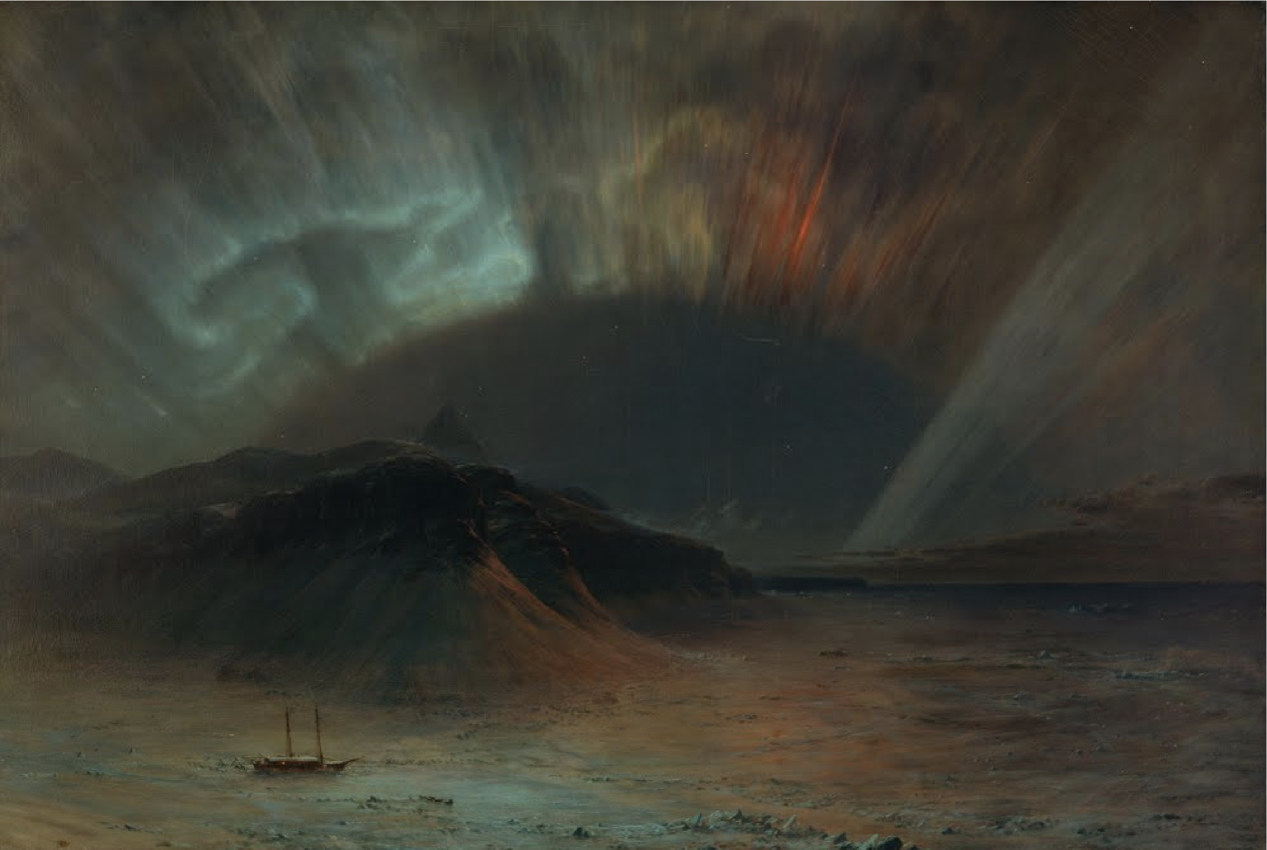
What’s going on here?
Notes:
Q1 – “What is going on in this image?”; after an observation is made, paraphrase and maybe follow up with Q2.
Q2 – “What do you see that makes you say that?; paraphrase again and to obtain the next observation use Q3.
Q3 – “What more can we find?”; this is an opening for another student to share an observation.
Artist: Frederic Edwin Church
Year: 1865
Topic Keyword(s): E.g., Earth & the Solar System, Earth Systems
Description: Frederic Edwin Church, Aurora Borealis, 1865, oil on canvas, 56 x 83 1/2 in. (142.3 x 212.2 cm), Smithsonian American Art Museum, Gift of Eleanor Blodgett, 1911.4.1
Related Lessons/Units: Link(s) to lessons/units where artwork is featured
Related Data: Link(s) to data tagged with the same topics
Usage Rights: Creative Commons 0 (Free to Use)

Slide 3
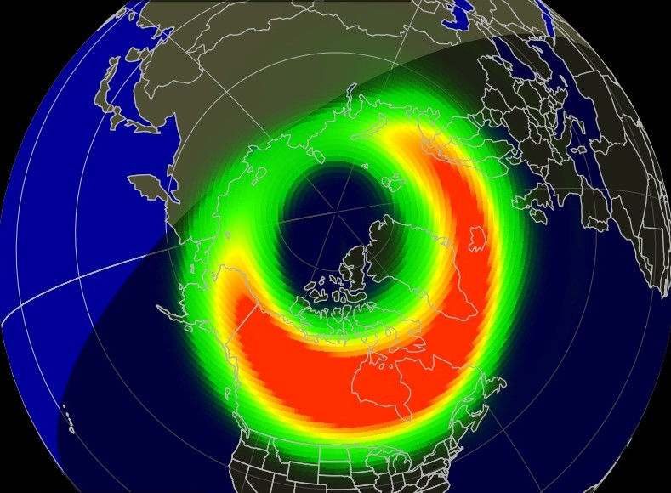
What is going
on here?
Notes:
Q1 – “What is going on in this image?”; after an observation is made, paraphrase and maybe follow up with Q2.
Q2 – “What do you see that makes you say that?; paraphrase again and to obtain the next observation use Q3.
Q3 – “What more can we find?”; this is an opening for another student to share an observation.

Slide 4
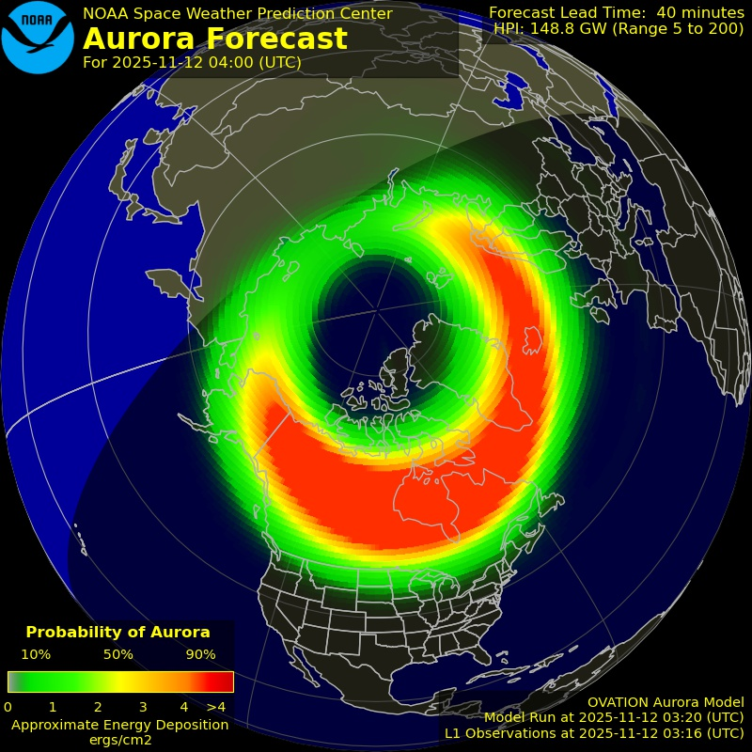
Now, what do
you notice?
Notes:
Q1 – “What is going on in this image?”; after an observation is made, paraphrase and maybe follow up with Q2.
Q2 – “What do you see that makes you say that?; paraphrase again and to obtain the next observation use Q3.
Q3 – “What more can we find?”; this is an opening for another student to share an observation.

Slide 5
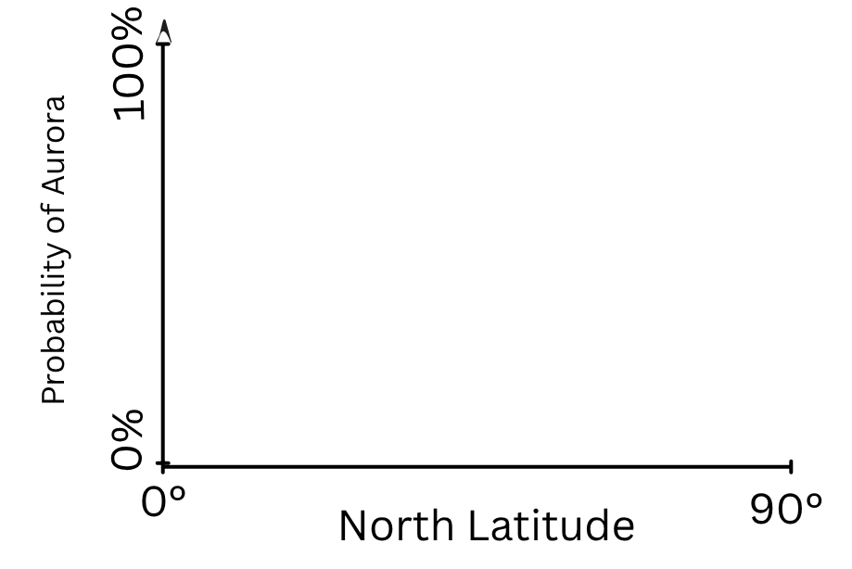
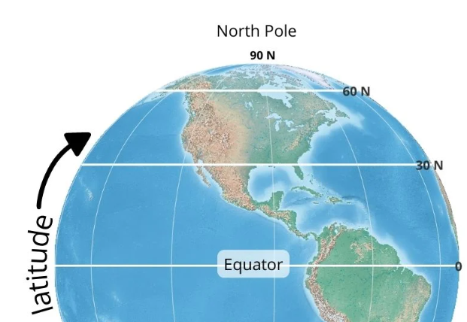
Questions Answer on your worksheet:
1. What latitude do you live at? Where did you find the answer?
2. Did you or anyone you know see the aurora on November 11th 2025?
3. According to the probability of the aurora image here, roughly estimate at what latitude do you think you would be able to see it?
4. On your worksheet or on a sheet of paper, try to plot a graph estimate of probability of the aurora in the northern hemisphere on the axis here.
Source: NOAA Space Weather
Prediction Center

Slide 6
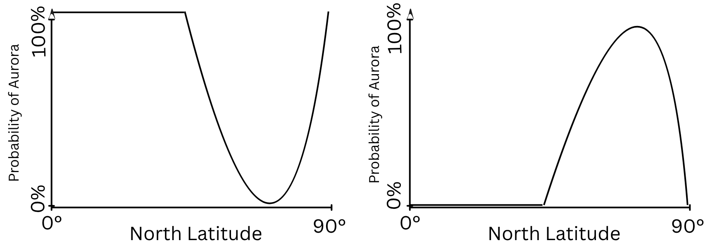
Let’s discuss
Was your answer closer to A or B?
A
B

Slide 7
End of Data Lens
Learn more about the dataset and artwork. Read the descriptions on the next slides. (5 min)
Go to the last slide for directions to the reading extension. (10 min)

Slide 8
Auroral ovation
✨ The OVATION Aurora Forecast (30-90 Minute Prediction)
What it is: A model-based forecast that predicts the location and brightness of the Northern Lights (aurora borealis).
Reading the Map:
  The aurora shows up as an oval centered on the magnetic pole.
  Green means normal brightness; Red means the aurora is more intense.
  The lights are only visible on the nighttime (darker) side of the map.
Why it Matters (Beyond Beauty): The aurora is an indicator of space weather and directly impacts critical technologies:
  Communication: Affects HF radio.
  Navigation: Affects GPS/GNSS.
  Power: Closely related to currents that can impact the electric power grid.
Source: NOAA Space Weather Prediction Center

Slide 9
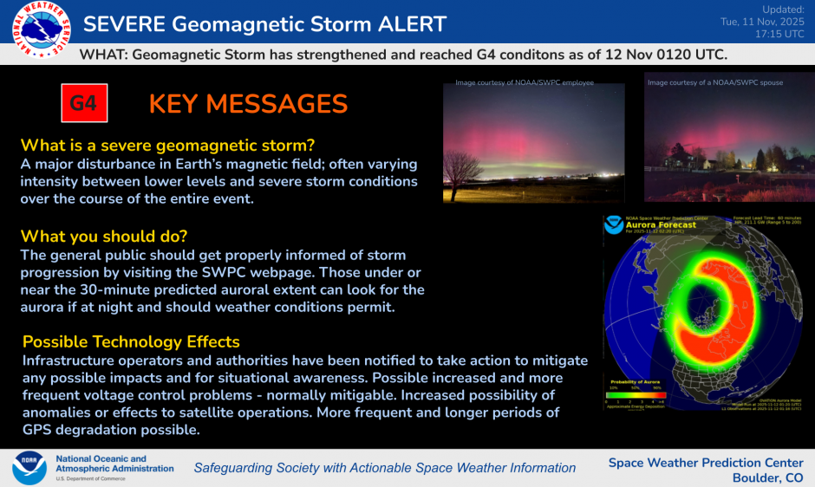

Slide 10
Art - Aurora Borealis
Artist: Frederic Edwin Church
Year: 1865
Topic Keyword(s): E.g., Earth & the Solar System, Earth Systems
Description: Frederic Edwin Church, Aurora Borealis, 1865, oil on canvas, 56 x 83 1/2 in. (142.3 x 212.2 cm), Smithsonian American Art Museum, Gift of Eleanor Blodgett, 1911.4.1

Slide 11
Reading extension (suggested for 8th-12th grade)
To learn more about the severe solar storms that happened in early November 2025 and their potential impacts read this article from PBS.
https://www.pbs.org/newshour/science/severe-solar-storms-could-hit-earth-space-forecasters-say-heres-how-to-see-auroras
Pair up – What did you already know about this topic? What surprised you?

