Slide 1
🌎 Data Lens: Exploring Earth’s Visual Stories
We are going to slow down and take ten minutes or so to just observe and discuss what we discover and notice. There are no right or wrong answers.
First: Ground Rules
Raise your hand to share your ideas with the class.
All ideas are welcome.
Be respectful of others ideas. It’s okay to disagree.
Build on each other’s ideas.
Next: One minute to quietly observe…

Slide 2
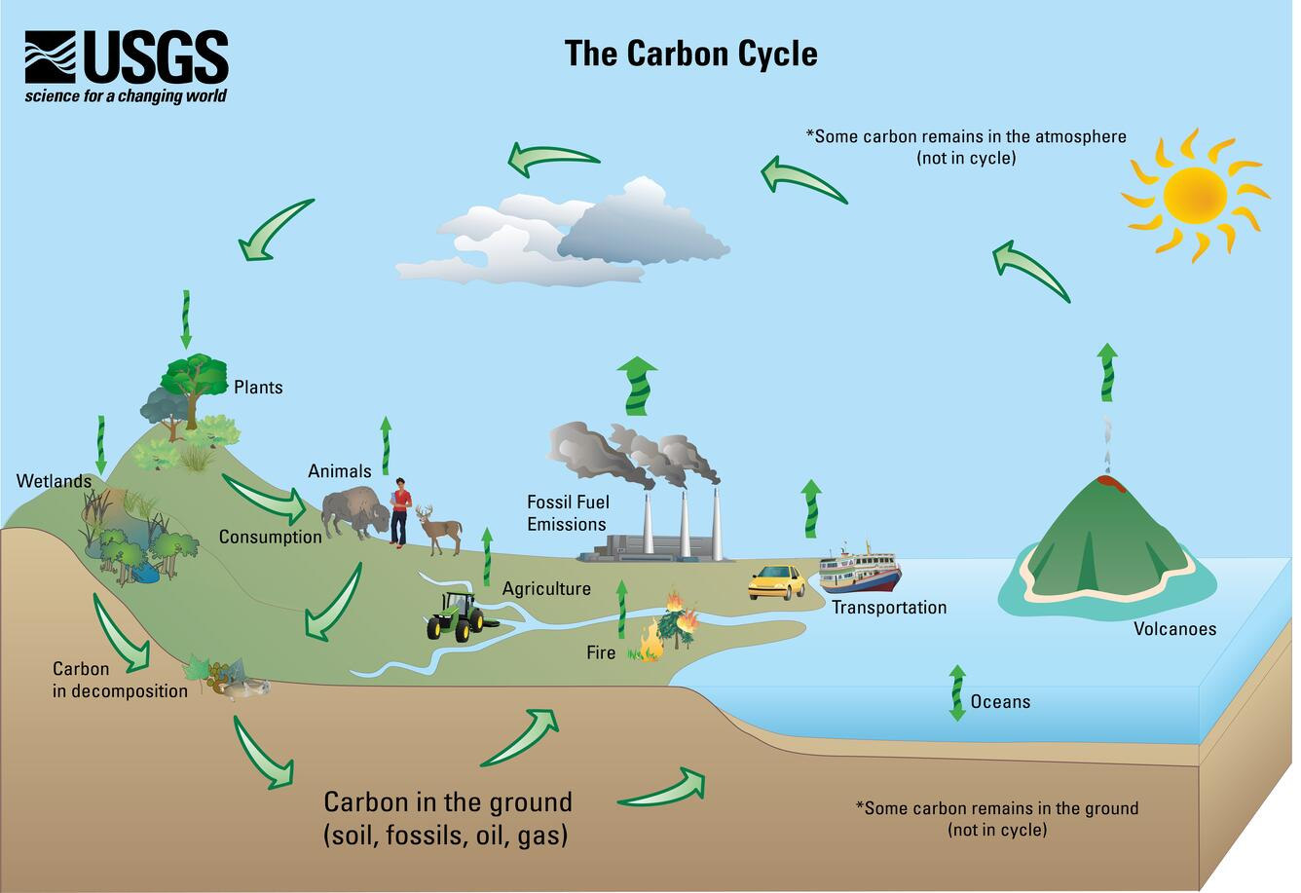
Take one minute to silently observe, then two minutes to write down what you understand and don’t understand about this diagram.

Slide 3
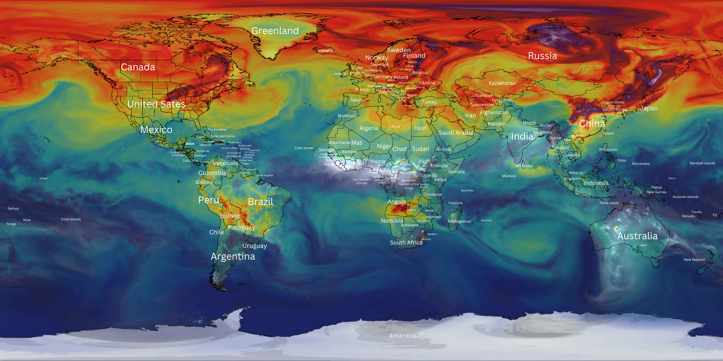
What’s going on here?
Notes:
Q1 – “What is going on in this image?”; after an observation is made, paraphrase and maybe follow up with Q2.
Q2 – “What do you see that makes you say that?; paraphrase again and to obtain the next observation use Q3.
Q3 – “What more can we find?”; this is an opening for another student to share an observation.

Slide 4
Jigsaw Exercise - Exploring Carbon dioxide through visuals (30 minutes)
Make groups of 3 – Select person A, B & C.
10 min - Individual reflection: Answer questions on worksheet corresponding to the Figure (A, B, or C).
10 min – Group up with other people with same Figure (all A’s, for example). Discuss your ideas about the figure using the questions on your worksheet.
10 min – Group back up with your original threesome ABC. Each person for explains Figure to the others (3 minutes each).
Questions:
In three sentences, how would you describe what is going on in the map or figure?
What are the patterns that you notice?
What surprises you?
What do you not understand?

Slide 5
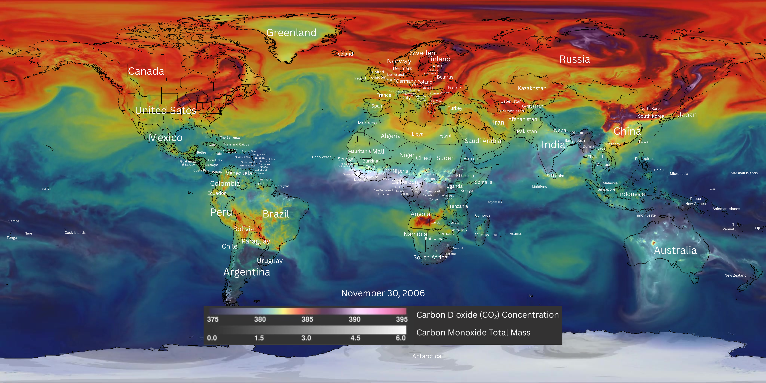
Figure A – Carbon Dioxide and Carbon Monoxide – November 30, 2006

Slide 6
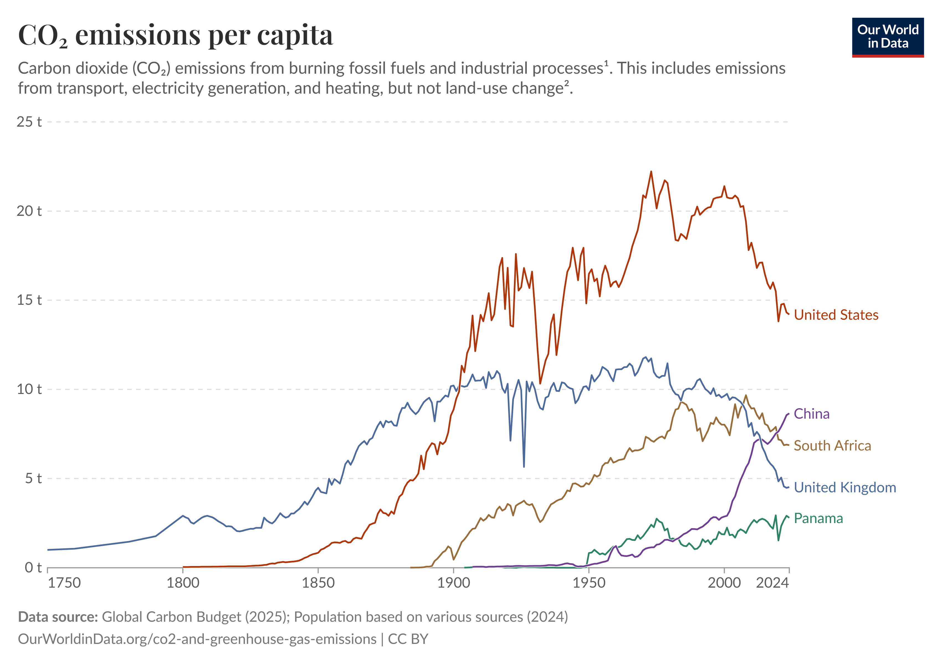
Figure B: Carbon dioxide emissions per capita

Slide 7
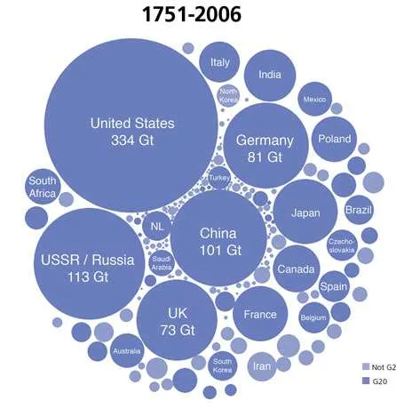
Figure C:
Comparing cumulative carbon dioxide emissions by country
Source: Oak Ridge National Laboratory in Tennessee, AnthropoceneMagazine.org

Slide 8
Final discussion – Teacher facilitated
All. Some. None.
What can we say about ALL of the figures?
What can we say about SOME of the figures?
What can we say about NONE of the figures?

Slide 9
Optional Question
What are the social implications of the data that you discovered?

Slide 10
End of Data Lens
Learn more about the data visualizations in the next few slides.

Slide 11
USGS Carbon Cycle diagram
Carbon cycles through natural systems. Carbon dioxide is present in the atmosphere as a gas. Plants and animals take in and release carbon dioxide through respiration. Human activities involving fossil fuels, including manufacturing, transportation, and agriculture, release carbon dioxide into the atmosphere in large amounts. There are also natural sources of carbon dioxide, including volcanos and forest fires. Microorganisms break down dead organic matter. Carbon also dissolves into porous rocks and in warm ocean water. Carbon can be "stored" in natural systems over long time scales, called carbon sinks. Underground oil and gas reserves, carbon-rich ecosystems (such as forests and wetlands), and deep oceans are some of the largest carbon sinks.
https://www.usgs.gov/media/images/usgs-carbon-cycle

Slide 12
Carbon Dioxide Concentration: GEOS-5 Model
Tracking Earth's Breath:
Scientists use computer models to create a "digital portrait" of Earth. By plugging in everything we know about physics and weather, they can run experiments to see how our planet reacts to different changes.
This specific visualization gives us an ultra-high-definition look at how carbon dioxide (CO2)—the main gas in our atmosphere responsible for trapping heat—swirls around the globe and changes throughout the seasons. Watching these plumes move shows exactly how wind carries pollution across borders and oceans. Carbon dioxide is a very natural gas in our atmosphere but when there is a lot of it, we consider that pollution because it is emitted by industrial activities. Sometimes where there is red or purple is where carbon dioxide is being emitted directly, other times, the gas is carried from the source through the atmosphere by weather patterns.
How it Works: The "Nature Run"
Think of this like a high-end video game simulation, but based entirely on real science. This model, called GEOS-5, was built by NASA scientists. Most global climate models look a bit "blurry" because they use large data chunks, but this version has 64 times more detail than usual.
It’s called a "Nature Run" because scientists feed it real-world data (like actual smoke and weather patterns) and then let the model run on its own. It’s essentially a 2-year "time-lapse" of the Earth's atmosphere from 2005 to 2007, showing how mountains, oceans, and weather systems act like obstacles and highways for greenhouse gases. The image used in this exercise was just one snapshot on 11/30/2006.
Reading the Map
The colors tell you how much (CO2) is packed into the air:
Dark Blue: Lower concentration (375 ppm).
Red: Medium concentrations (385 ppm).
Light Purple: Higher concentration (395 ppm).
White Plumes: These show carbon monoxide (CO), which usually comes from fires and industrial pollution.

Slide 13
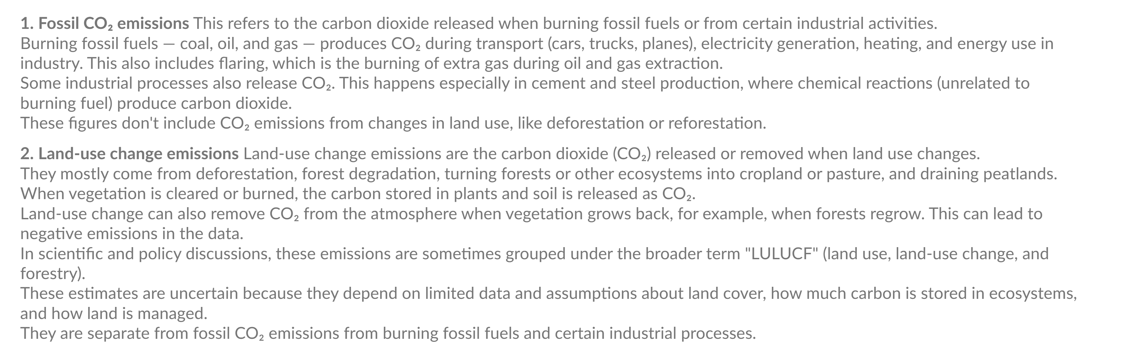
Our World in Data – CO2 emissions per capita
https://ourworldindata.org/

Slide 14
Carbon dioxide cumulative by country 1751-2006
Researchers at the Oak Ridge National Laboratory in Tennessee estimated national carbon emissions from fossil fuels dating back to 1751 by using historical energy statistics. Carbon Visuals took the data out of the confines of the spreadsheet and created this “bubble chart” to compare cumulative emissions by country. Over the 256-year span, half of the CO₂ produced has been released since the mid-1970s.
https://www.anthropocenemagazine.org/conservation/2013/06/visualizing-carbon/

