Slide 1
🌎 Data Lens: Exploring Earth’s Visual Stories
We are going to slow down and take ten minutes or so to just observe and discuss what we discover and notice. There are no right or wrong answers.
First: Ground Rules
Raise your hand to share your ideas with the class.
All ideas are welcome.
Be respectful of others ideas. It’s okay to disagree.
Build on each other’s ideas.
Next: One minute to quietly observe…
Notes:
https://sos.noaa.gov/education/data-lens/

Slide 2
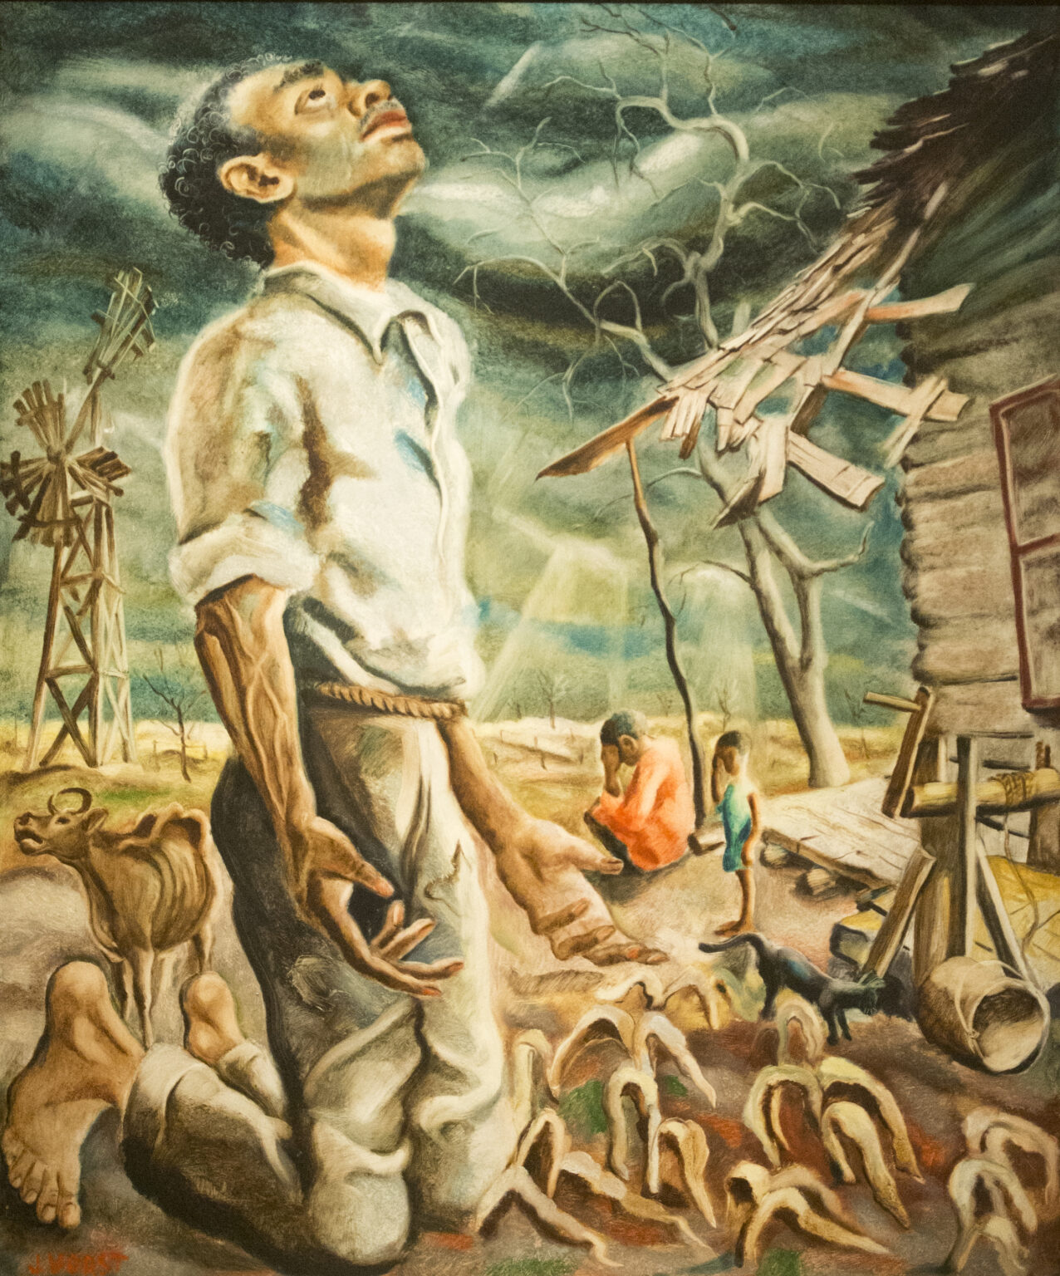
What is going on here?
Notes:
Optionally, take time to jot down a few things on your worksheet.
Artist: Jacob Kainen (artist) American, 1909 - 2001, Federal Art Project (New York City)
Year: 1935
Topic Keyword(s): Human Activity & Impacts, Weather & Climate
Description: Lithographic drawing
Related Lessons/Units: Drought: Examining the Causes and Effects of Precipitation Shortage
Related Data:
Drought Intensity
Freshwater Withdrawals
Statewide Maximum Temperature Ranks
Statewide Precipitation Ranks
Usage Rights: Public Domain
Source/Link to Source: National Gallery of Art
More art resources https://www.nurturenaturecenter.org/art-images/

Slide 3
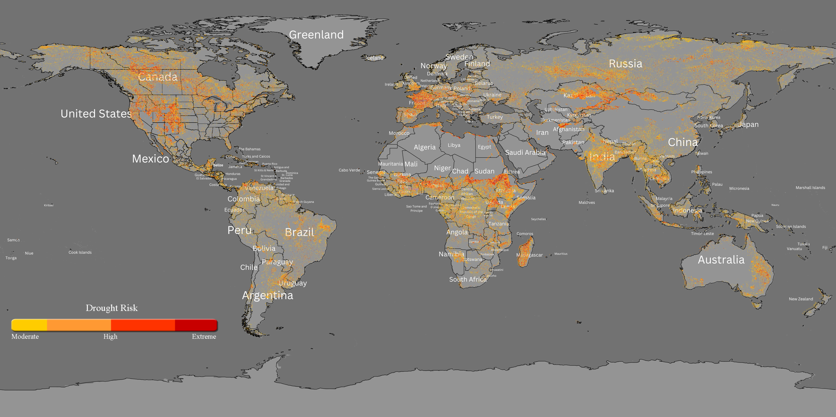
What’s going on here?
July 13 - 19, 2026
Notes:
Q1 – “What is going on in this image?”; after an observation is made, paraphrase and maybe follow up with Q2.
Q2 – “What do you see that makes you say that?; paraphrase again and to obtain the next observation use Q3.
Q3 – “What more can we find?”; this is an opening for another student to share an observation.

Slide 4
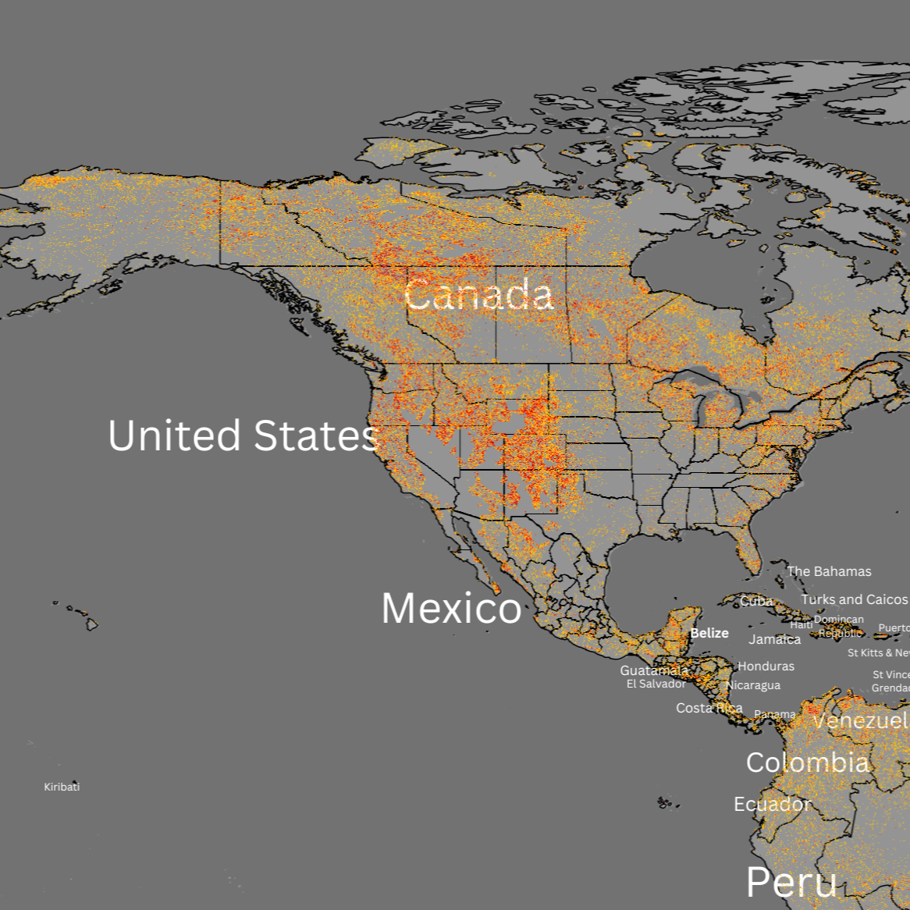
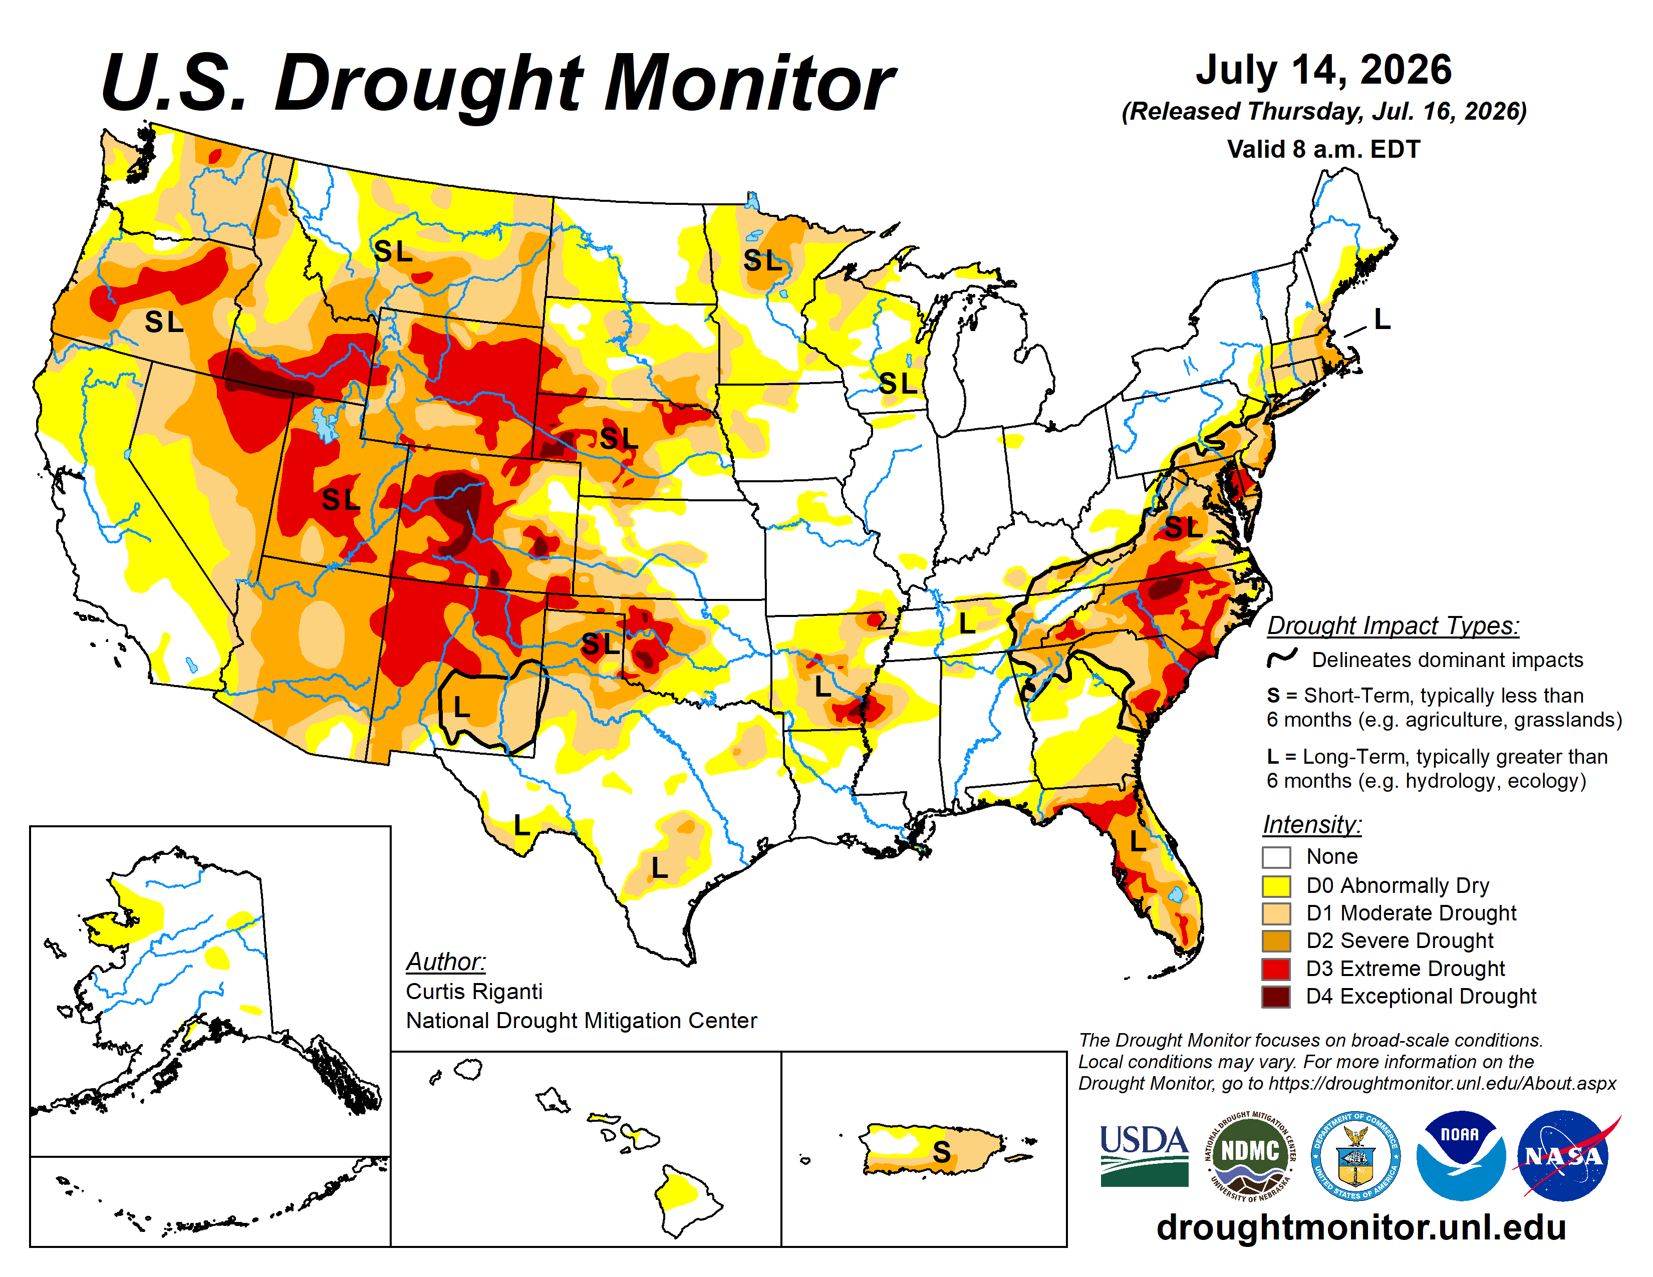
Comparing two different drought interpretations
On your worksheet:
2. Identify three similarities between the maps.
3. Identify three differences between the maps.
July 13 - 19, 2026

Slide 5
Read the drought mapped data descriptions and answer the questions on your worksheet.
Link for readings - https://sos.noaa.gov/media/downloads/data-lens/drought-data-descriptions.pdf
4. What might account for the differences between the two maps?
5. Think about your experience of drought or lack of drought this year. Do the maps match your experience? Explain.
6. What do you still have questions about?
Notes:
https://sos.noaa.gov/education/data-lens/drought/#teacher-resources

Slide 6
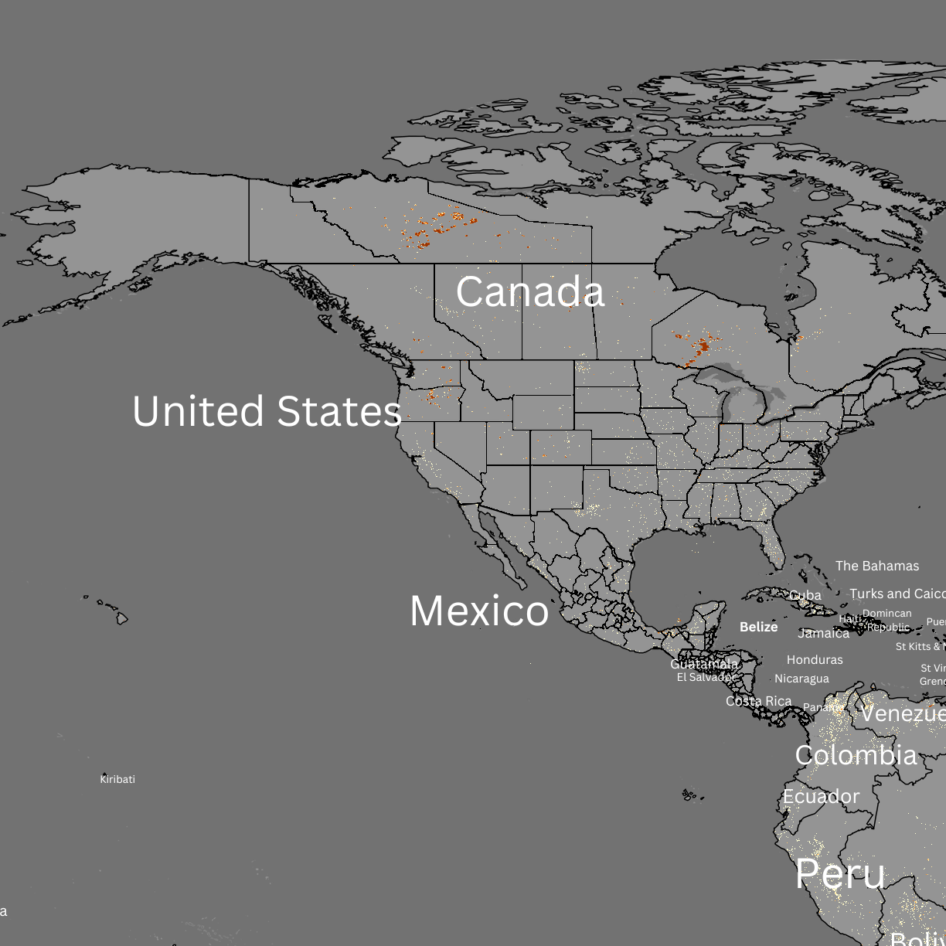
Final discussion – Teacher facilitated- All Some None
Drought Risk
Fires
What can we say about ALL of the maps?
What can we say about SOME of the maps?
What can we say about NONE of the maps?
All maps:
July 13 – 19, 2026

