Slide 1
🌎 Data Lens: Exploring Earth’s Visual Stories
We are going to slow down and take ten minutes or so to just observe and discuss what we discover and notice. There are no right or wrong answers.
First: Ground Rules
Raise your hand to share your ideas with the class.
All ideas are welcome.
Be respectful of others’ ideas. It’s okay to disagree.
Build on each other’s ideas.
Next: One minute to quietly observe…
Notes:
https://sos.noaa.gov/education/data-lens/

Slide 2
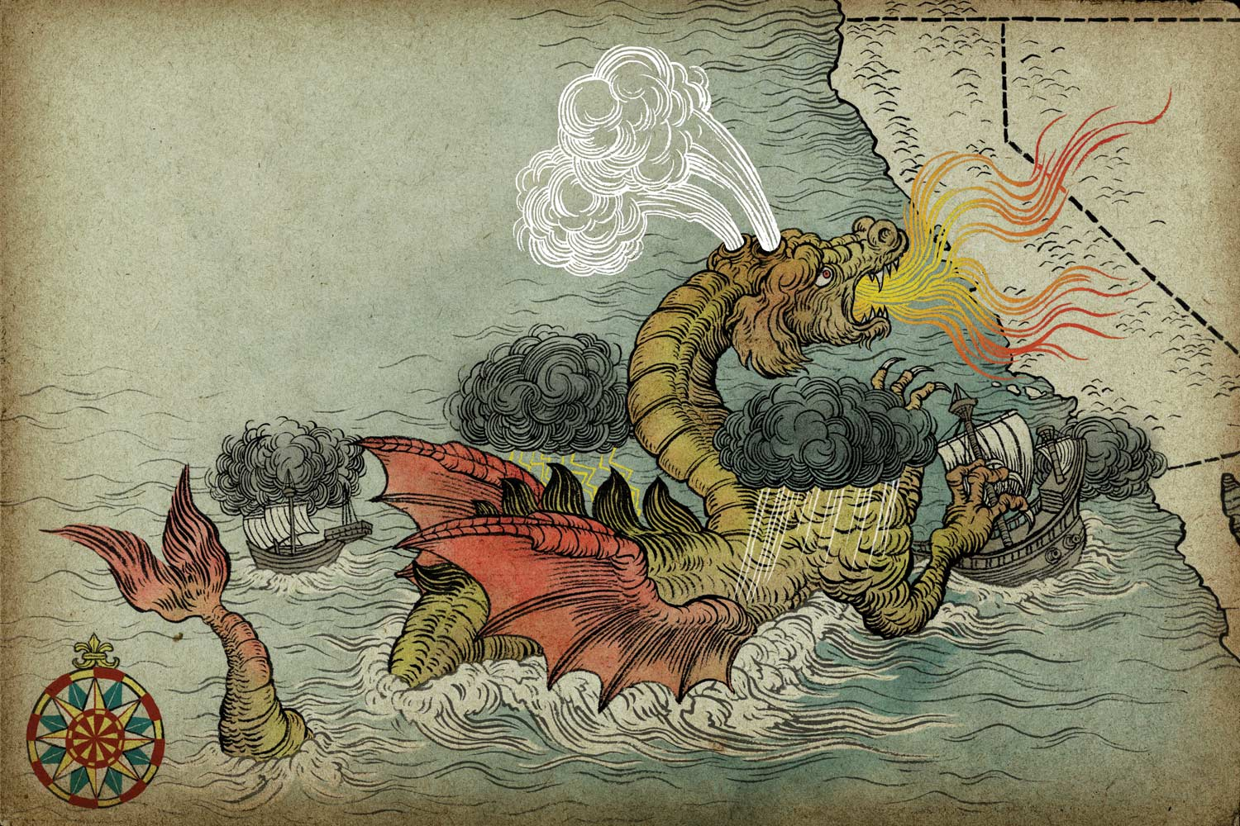
Yuko Shimizu
Notes:
Q1 – “What is going on in this image?”; after an observation is made, paraphrase and maybe follow up with Q2.
Q2 – “What do you see that makes you say that?; paraphrase again and to obtain the next observation use Q3.
Q3 – “What more can we find?”; this is an opening for another student to share an observation.
Art credit: Yuko Shimizu https://yukoart.com/category/work/
Thank you to Yuko for allowing use of this image.

Slide 3
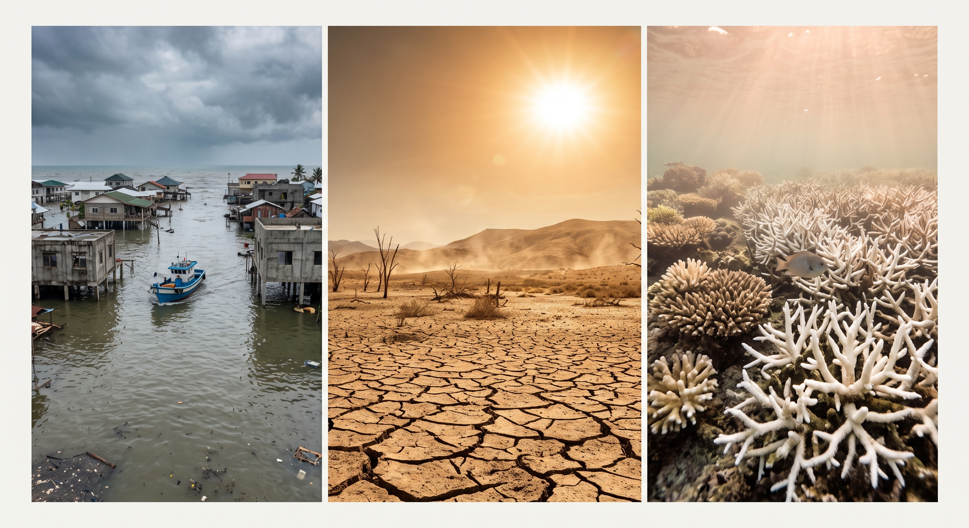
Notes:
Alternative AI generated image to use for art VTS.
Q1 – “What is going on in this image?”; after an observation is made, paraphrase and maybe follow up with Q2.
Q2 – “What do you see that makes you say that?; paraphrase again and to obtain the next observation use Q3.
Q3 – “What more can we find?”; this is an opening for another student to share an observation.\
Image was created using Gemini AI

Slide 4
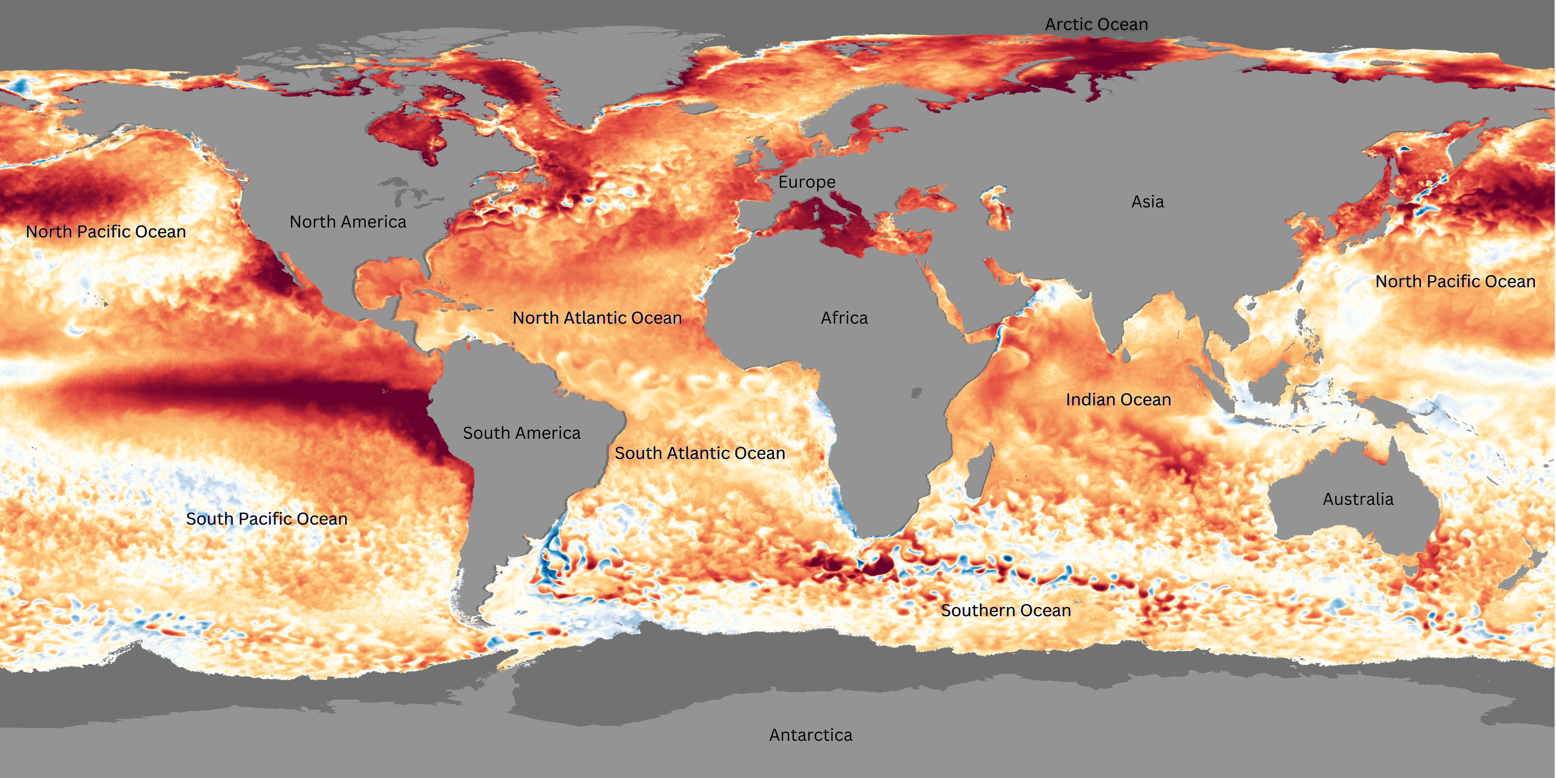
What’s going on in this image?
Source: NOAA View Global Data Explorer
Notes:
Q1 – “What is going on in this image?”; after an observation is made, paraphrase and maybe follow up with Q2.
Q2 – “What do you see that makes you say that?; paraphrase again and to obtain the next observation use Q3.
Q3 – “What more can we find?”; this is an opening for another student to share an observation.

Slide 5
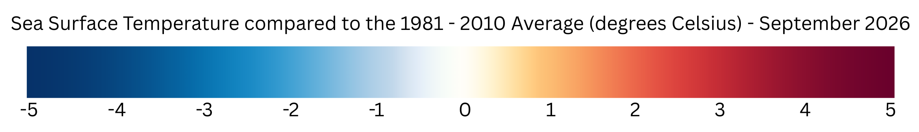
What’s going on in this image?
Source: NOAA View Global Data Explorer
Notes:
Q1 – “What is going on in this image?”; after an observation is made, paraphrase and maybe follow up with Q2.
Q2 – “What do you see that makes you say that?; paraphrase again and to obtain the next observation use Q3.
Q3 – “What more can we find?”; this is an opening for another student to share an observation.

Slide 6
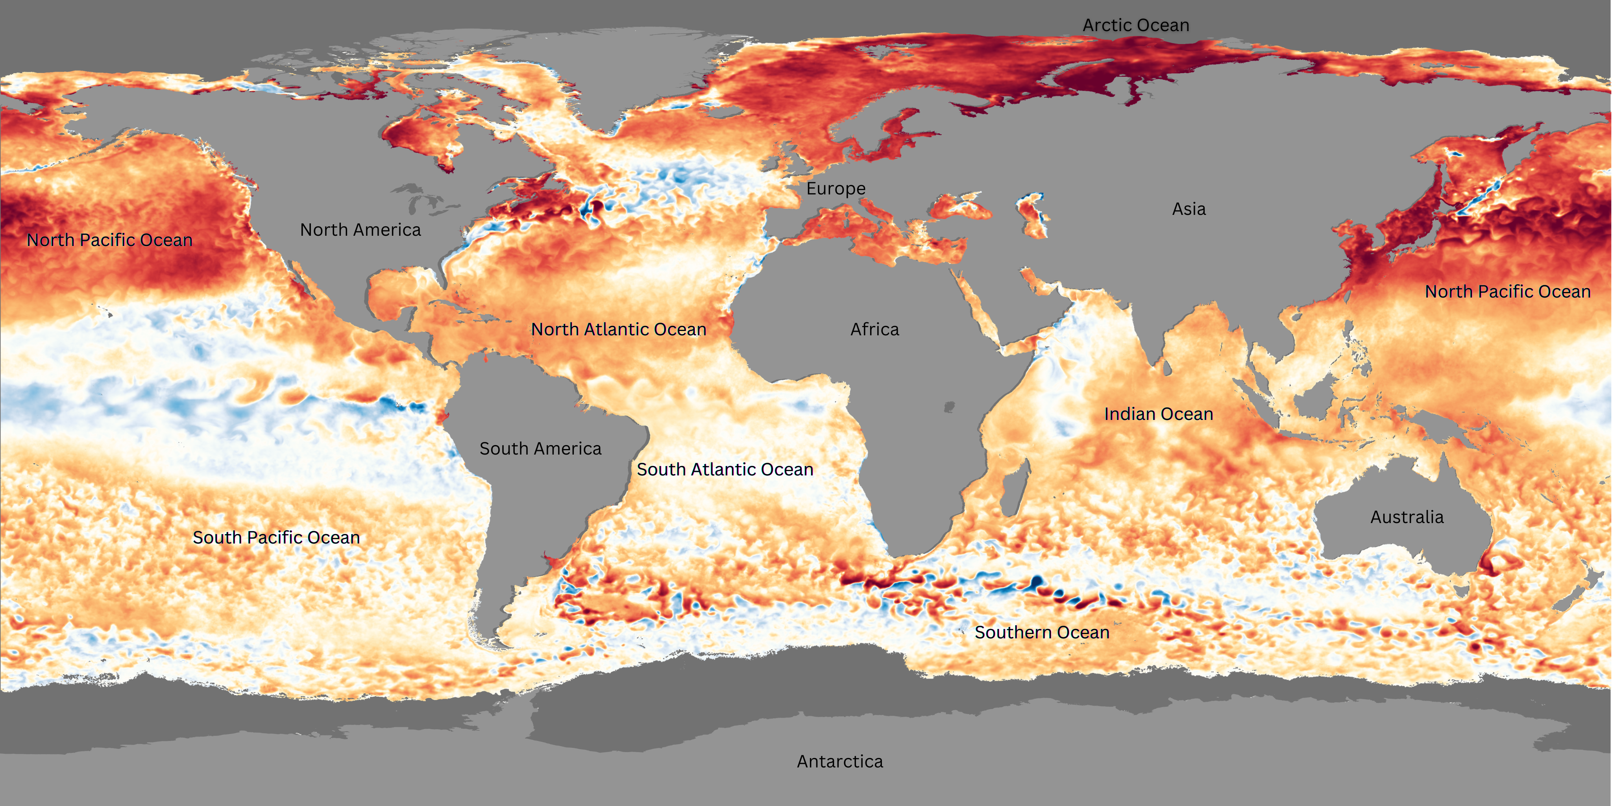
What is different and what is similar about these two different time periods of the same mapped data?
Fill out the Venn diagram with your answers.
Map A:
September 2026
Map B:
September 2025
Source: NOAA View Global Data Explorer

Slide 7
About the data: Sea Surface Temperature Anomaly
This real-time sea surface temperature data comes from NOAA's Coral Reef Watch. It helps scientists monitor coral reefs by tracking changes in ocean temperature, which can lead to coral bleaching. The data is collected by satellites from the U.S. and other countries like Japan and Europe.
To understand the ocean's temperature, scientists compare today’s sea surface temperature with the long-term average temperature for that day. The difference between these two temperatures is called a “sea surface temperature anomaly.”
This data is very detailed, with each pixel showing about 5 kilometers of the ocean. You can see big patterns like El Niño and La Niña - which happen in the Pacific Ocean near Peru in South America - but also smaller events like hurricanes.
Just like the air around us, the ocean’s temperature is always changing. However, water takes longer to heat up and cool down than air, so the ocean doesn’t change as much day-to-day. But you can see seasonal changes, like how warm water spreads toward the U.S. in summer and pulls back in winter.
Scientists study these temperature changes because they are important for understanding things like coral reef health, hurricanes, and global weather patterns like El Niño and La Niña.
Source: NOAA Science On a Sphere
Notes:
Here is the description for the dataset. Use it whenever you see fit.

Slide 8
Jigsaw reading
Reading jigsaw activity: Make groups of 3, select person A, B, C. Individually answer questions below about your reading. Then, each person for explains the main points of their reading to the group. (instructions and links on student worksheets)
Reading A - Monitoring Global Temperature and Precipitation in August 2026. NOAA National Centers for Environmental Information (NCEI)
Reading B - El Nino forms, expected to strengthen, say NOAA forecasters. National Oceanic and Atmospheric Administration (NOAA)
Reading C - El Niño and high tide flooding, a possible double whammy for some coastal communities in 2026. NOAA National Ocean Service (NOS)

Slide 9
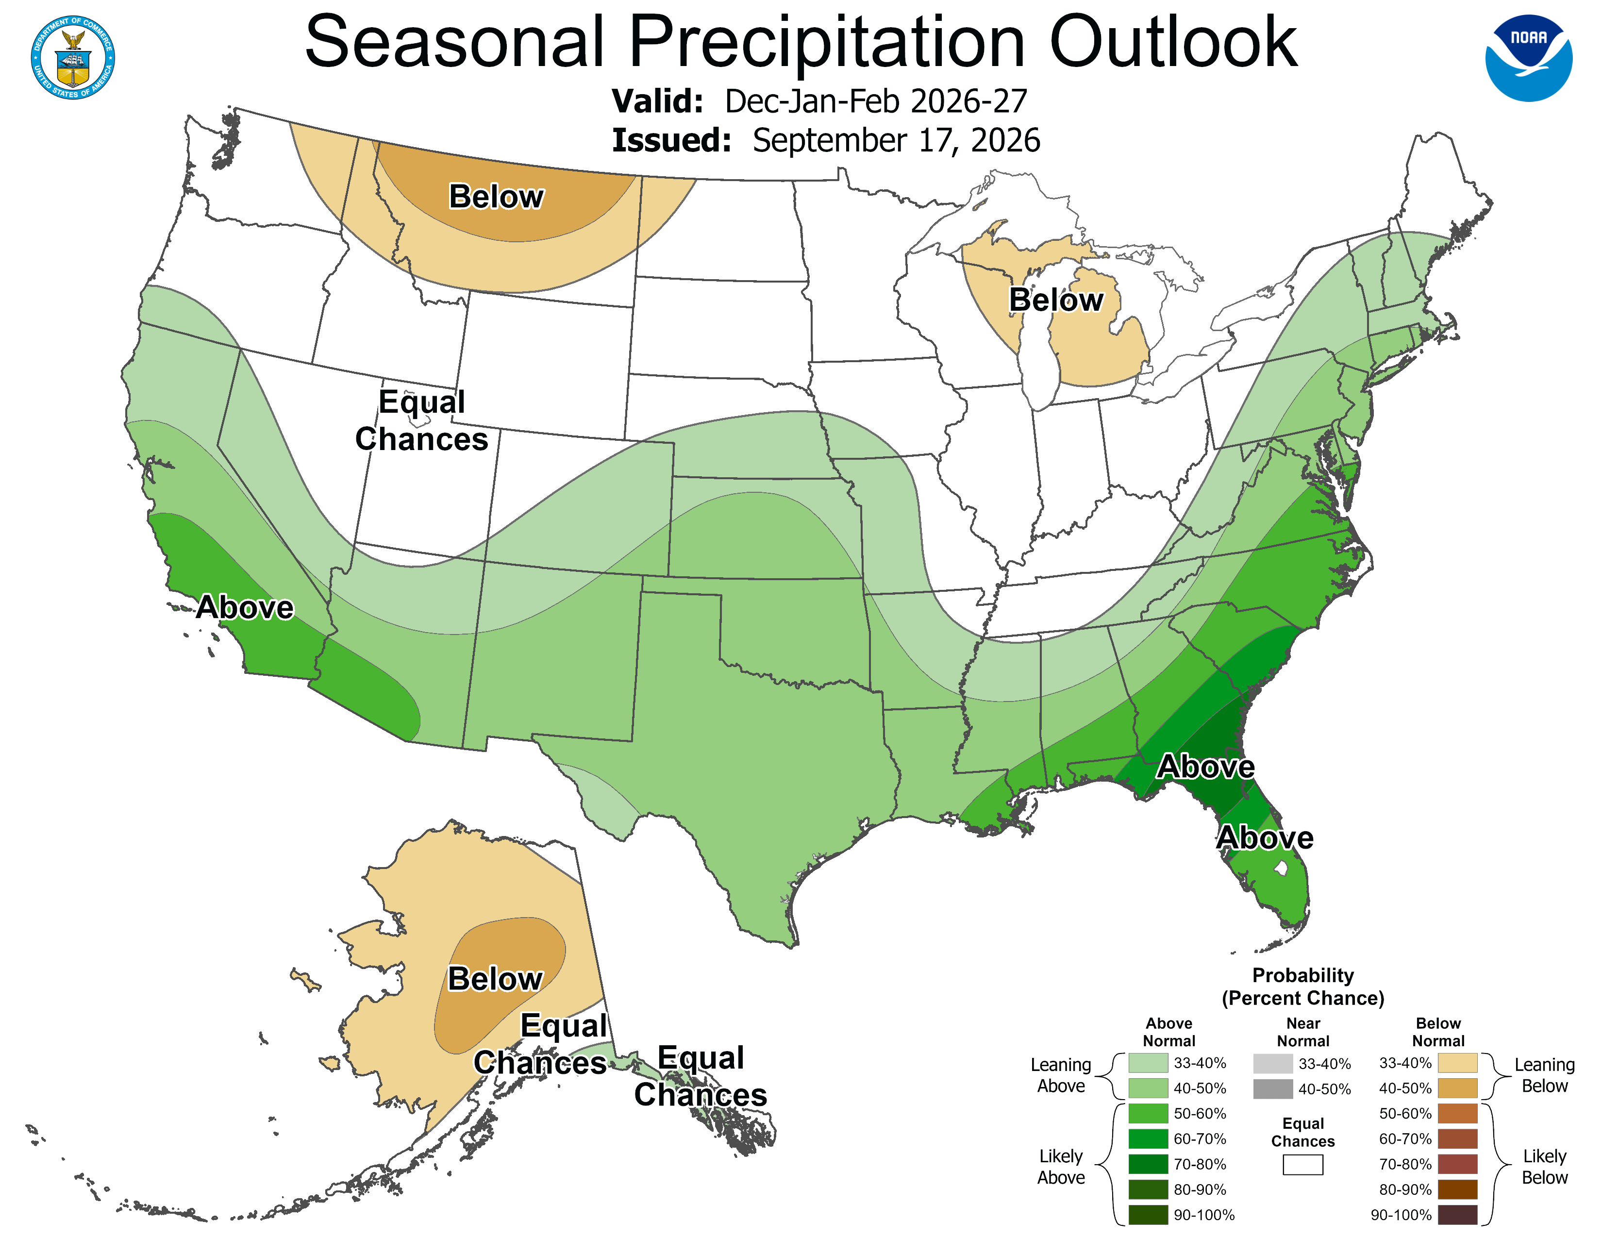
Discuss together
Source: NOAA National Weather Service Climate Prediction Center
Notes:
https://www.cpc.ncep.noaa.gov/products/predictions//multi_season/13_seasonal_outlooks/color/churchill.php

Slide 10
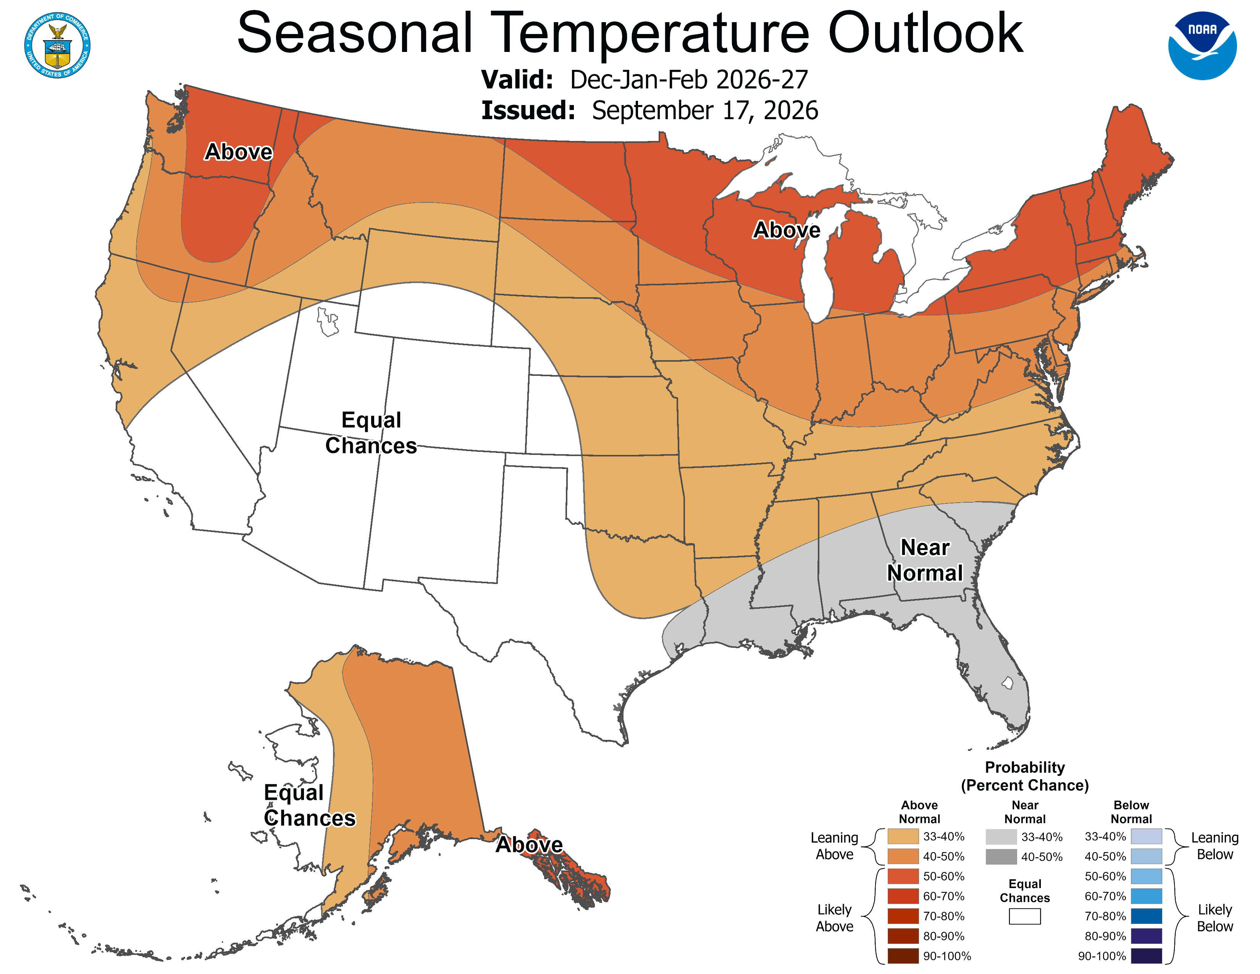
Discuss together
Source: NOAA National Weather Service Climate Prediction Center
Notes:
https://www.cpc.ncep.noaa.gov/products/predictions//multi_season/13_seasonal_outlooks/color/churchill.php

